Slide 1
Digital Health Intervention in TZ - Plans and Time Schedule
Felix Sukums
NIMR / MUHAS

Slide 2
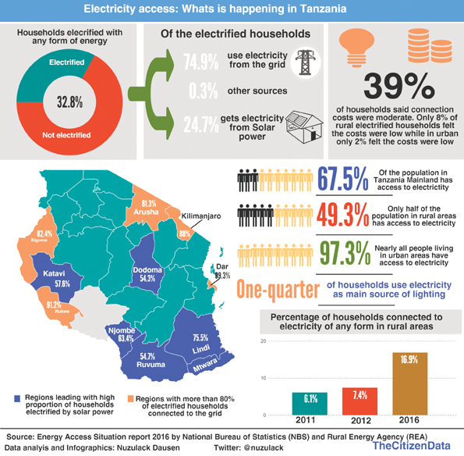

Slide 3
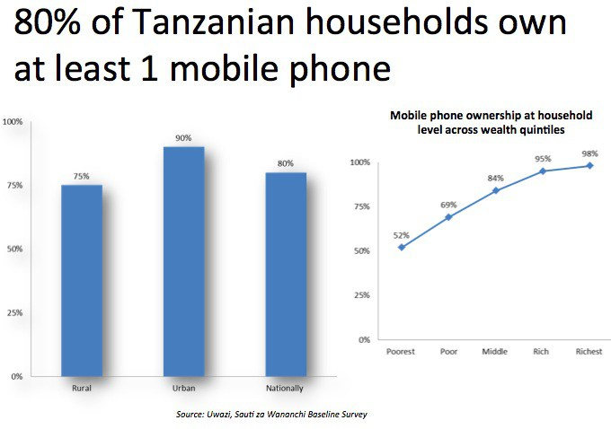
2014

Slide 4
Introduction
In Tanzania, About 40m voice telecom subscriptions (99% via mobile operators)
About 20m Internet service users (90% via mobile wireless) in 2017 Q1 from 3.7m in 2011. Source: TCRA
There is increase in availability of affordable data enabled devices (smartphones and tablets) thus increase in demand for data services.
Great potential for digital health content and services provision
CREDIT: GETTY

Slide 5
Introduction …
Tanzania’s Health Sector Strategic Priorities
“Reach all households with essential health and social welfare services.”
Achieve objectively measurable quality improvement of primary health care services, delivering a package of essential services in communities and health facilities.
Gaps
“Health workers have burdensome tools for data collection and use at the point of care”.
“Ineffective mechanisms for clients to provide feedback on services received” - Data Use Partnership, PATH/Tanzania

Slide 6
Introduction … Example
European Space Agency (“ESA”) Contributes €10.7 Million to Deploy the Avanti ECO Wi-Fi Concept Across Africa
Every Child Online (ECO) or Every Community Online
ECO is a new sustainable digital inclusion initiative focused on providing affordable, superfast satellite broadband to schools and their local communities across Sub-Saharan Africa.
Solar-powered ECO Wi-Fi hotspots will be hosted at schools that will benefit from subsidised Internet access.
CSR and government customers cover the costs of the ECOPOP (Wi-Fi hotspot) and the end user consumer pays bandwidth costs.
The ECO App enables users to buy and trade broadband credits
300 schools connected in Tanzania

Slide 8
Introduction … Example
Mhealth opportunities in Tanzania by Genuchten et al, 2012
41 respondents

Slide 12
Digital Health Intervention in Tanzania
Main objective
To design, implement and assess the digital health intervention to improve the KAP, health-seeking behaviour, reporting and magnitude of Taeniosis/Cysticercosis, HIV/AIDS, TB and Anthrax in the selected villages in Tanzania.
Specific objectives
To understand status of Internet connectivity and telecommunications infrastructure in the selected villages/sites
To assess KAP, health care seeking behavior and magnitude of HIV, Tuberculosis, Cysticercosis and Anthrax
To conduct needs assessment for digital health intervention
To develop, and implement a digital health intervention(s)
To assess improvements after introducing the intervention(s)

Slide 13
Content
What problem are we addressing?
No or very low access to health information in rural areas
What information, which format?, how to access?
Local digital health information – local server / wifi hotspots/tablets
SMS based
Smartphones apps
Website with multimedia – text, pictures, voice, video/streaming

Slide 14
Baseline Surveys
Technical survey
To understand the status of Internet connectivity and telecommunications infrastructure
Health survey
To assess KAP, health care seeking behavior and magnitude of HIV, Tuberculosis, Cysticercosis and Anthrax

Slide 15
Methodology
Pre-post intervention assessment
To conduct review of records in the health facilities
To conduct a community-based, door-to-door cross-sectional study to assess the KAP and health care seeking behavior
using mobile device (tablets) data collection tools
To conduct digital literacy among community members and health workers
To conduct acceptance/uptake/usability of the digital health intervention

Slide 16
Baseline Surveys – Expected Findings
Prevalence proportions of current infection with cysticercosis, HIV, TB and anthrax
KAP on the cysticercosis, HIV, TB and anthrax on transmission, prevention and control
Health care seeking behaviour among community members
HIV counseling and testing awareness
Promote HIV testing and TB screening
Availability and accessibility of the National guidelines, training materials and policy at the health facilities

Slide 17
Digital Health Intervention
To increase KAP and health care seeking behavior among community members in the selected villages
Digital Health information about HIV, TB, Cysticercosis and anthrax to be provided to the community using mobile apps, text messages (sms), website (multimedia), and local server.
BYOD and Tablets in the kiosks
To provide decision support tools and digital content to Health workers
Digital national treatment guidelines, policy and training manuals to the health workers using mobile apps, text messages (sms), and website (multimedia)

Slide 18
Activities
Finalize Digital health intervention design/protocol including detailed/revised work plan and budget
Apply for ethnical clearance from NIMR/COSTECH
Conduct baseline surveys
To understand status of Internet connectivity and telecom coverage in the villages
To establish KAP on the selected diseases
To understand knowledge/digital literacy of population on the use of digital health
Negotiation and agreement with Internet service providers/Telecom operators
Supply, Install and maintain/manage Internet connectivity and systems/
Design and develop digital content/mHealth apps and text messages
Review and approve digital health content(education materials/guidelines)
Implement and monitor mHealth intervention
Conduct endline assessment of the intervention

Slide 19
Digital Health Plan/Schedule
Design Intervention – Study protocol
By October 2017
Baseline assessment
Develop Digital Health content
Implement and monitor Digital Health Content
Evaluate the Intervention
6 months
By March 2017
By March 2018
24 months
April 2018 – April 2020
6 months
By October 2020

Slide 20
Open questions
How will baseline findings inform mHealth apps development?
Needs of the health workers and community
How to package digital content ? An mHealth app/SMS for each disease or one for all 4 disease?
Will the digital health content be accessible to only the selected villages or beyond?
How to overcome illiteracy among community members – ability to read Kiswahili/English?
How to address Technophobia?
How to motivate community members to participate in the intervention?

Slide 21
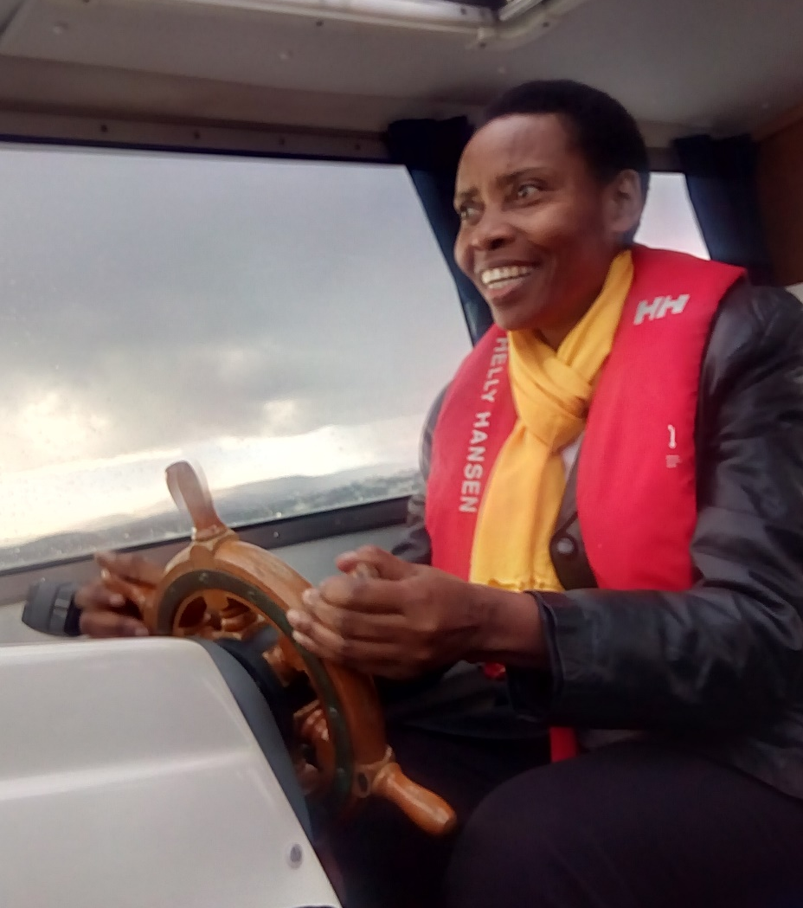
Asanteni sana Vielen dank Tusen takk

