Slide 1
Design Indoor Mobile and Wireless Networks
Building Mobile and Wireless Networks
Supervisor: Prof. Josef Noll
Presented by: Seraj Fayyad
University of Oslo, 16-02-2015

Slide 2
Outlines
Study objectives.
Indoor Wi-Fi network design.
ITU indoor propagation model.
ITU-based modeled values verification
Indoor mobile network design.
Conculsion and evalution.

Slide 3
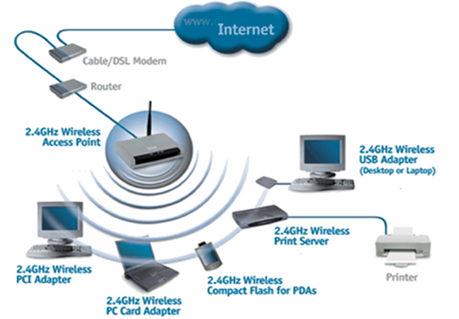
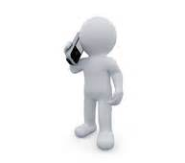
Study Objectives
Design indoor (Wi-Fi, Mobile) networks for a given building (Kjeller AS), in order to meet a minimum required quality of service effectively:
Wi-Fi network
Mobile network

Slide 4
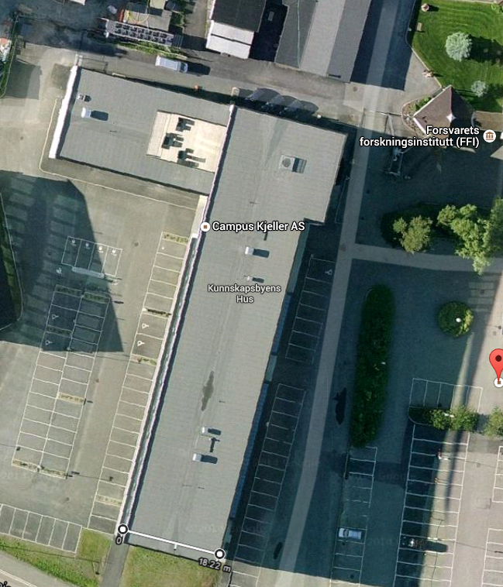
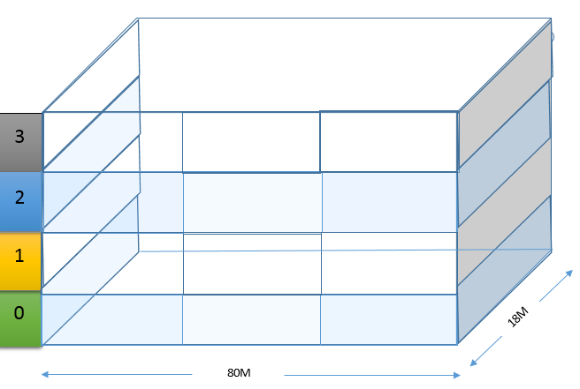
Indoor Wi-Fi Network Design Kjeller AS (4 floor building)

Slide 5
(Wi-Fi, Mobile) Indoor Network Design Factors
Some factors:
Tx (Transmitter) and Rx (Receiver) characteristics (Antenna, Power, Sensitivity …).
Building characteristics (Dimensions,..).
Capacity required Quality of Service (QoS).
Expected number of users and user distribution(Building, floor,.. )
Propagation Model (ITU model).

Slide 6
ITU Model (Path Loss)
International Telecommunication Union (ITU)
Radio propagation model for indoor path loss estimation.
Modeled frequency 2400 MHz (indoor Wi-Fi network)
Modeled frequency 1900 MHz (indoor Mobile network)
Ltotal = 20 log10 f + N log10 d + Lf (n) – 28
Where:
N: distance power loss coefficient (ITU given value)
f : transmission frequency [MHz]
d : separation distance between the base station and portable station. [m]
Lf : floor penetration loss factor (ITU given value).
n : number of floors between base station and portable station.

Slide 7
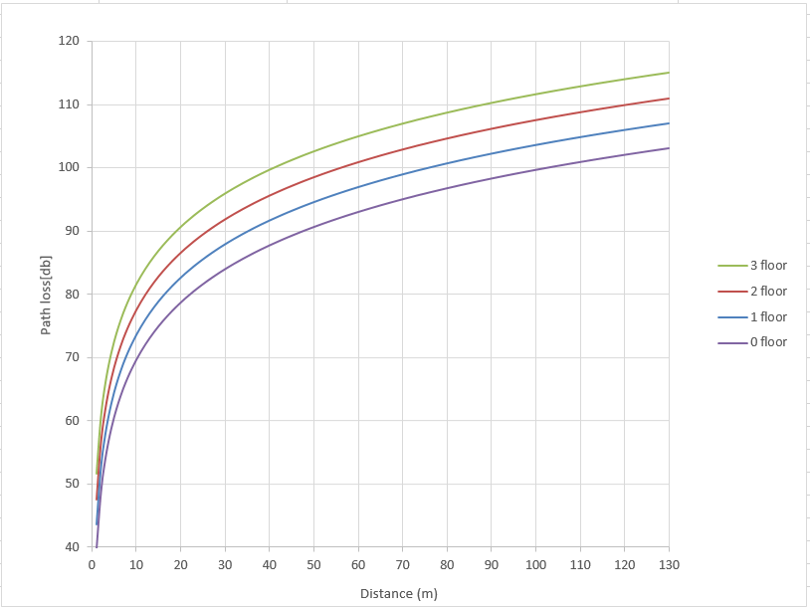
Indoor Wi-Fi ITU-based Path Loss model

Slide 8
Wi-Fi Network Received Power Parameters
Meru AP1010 Transmitted power (TS) -11 [db]
Meru AP1010 Transmitter Antenna Gain(GT) 4 [db]
Receiver Antenna Gain(GR) 0 [db]
(minimum expected device gain)
Received Power= TS + GT + GR – Path loss
Meru AP1010 Senstivity: - 110 [db]

Slide 9
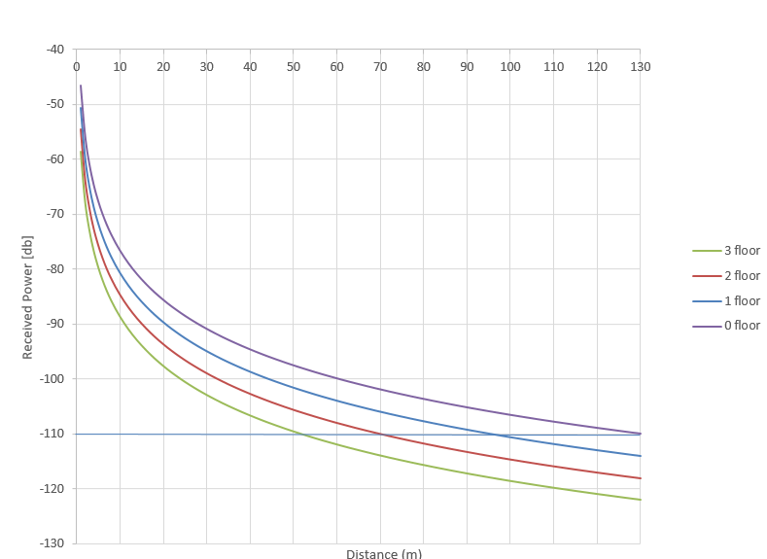
Indoor Wi-Fi ITU-based Received Power Model
Sensitivity

Slide 10
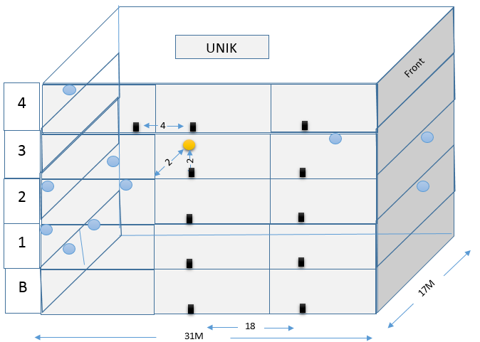
ITU-based modeled values verification
Notes:
Verify that the analytical model value reasonable comparable to practical value

Slide 11
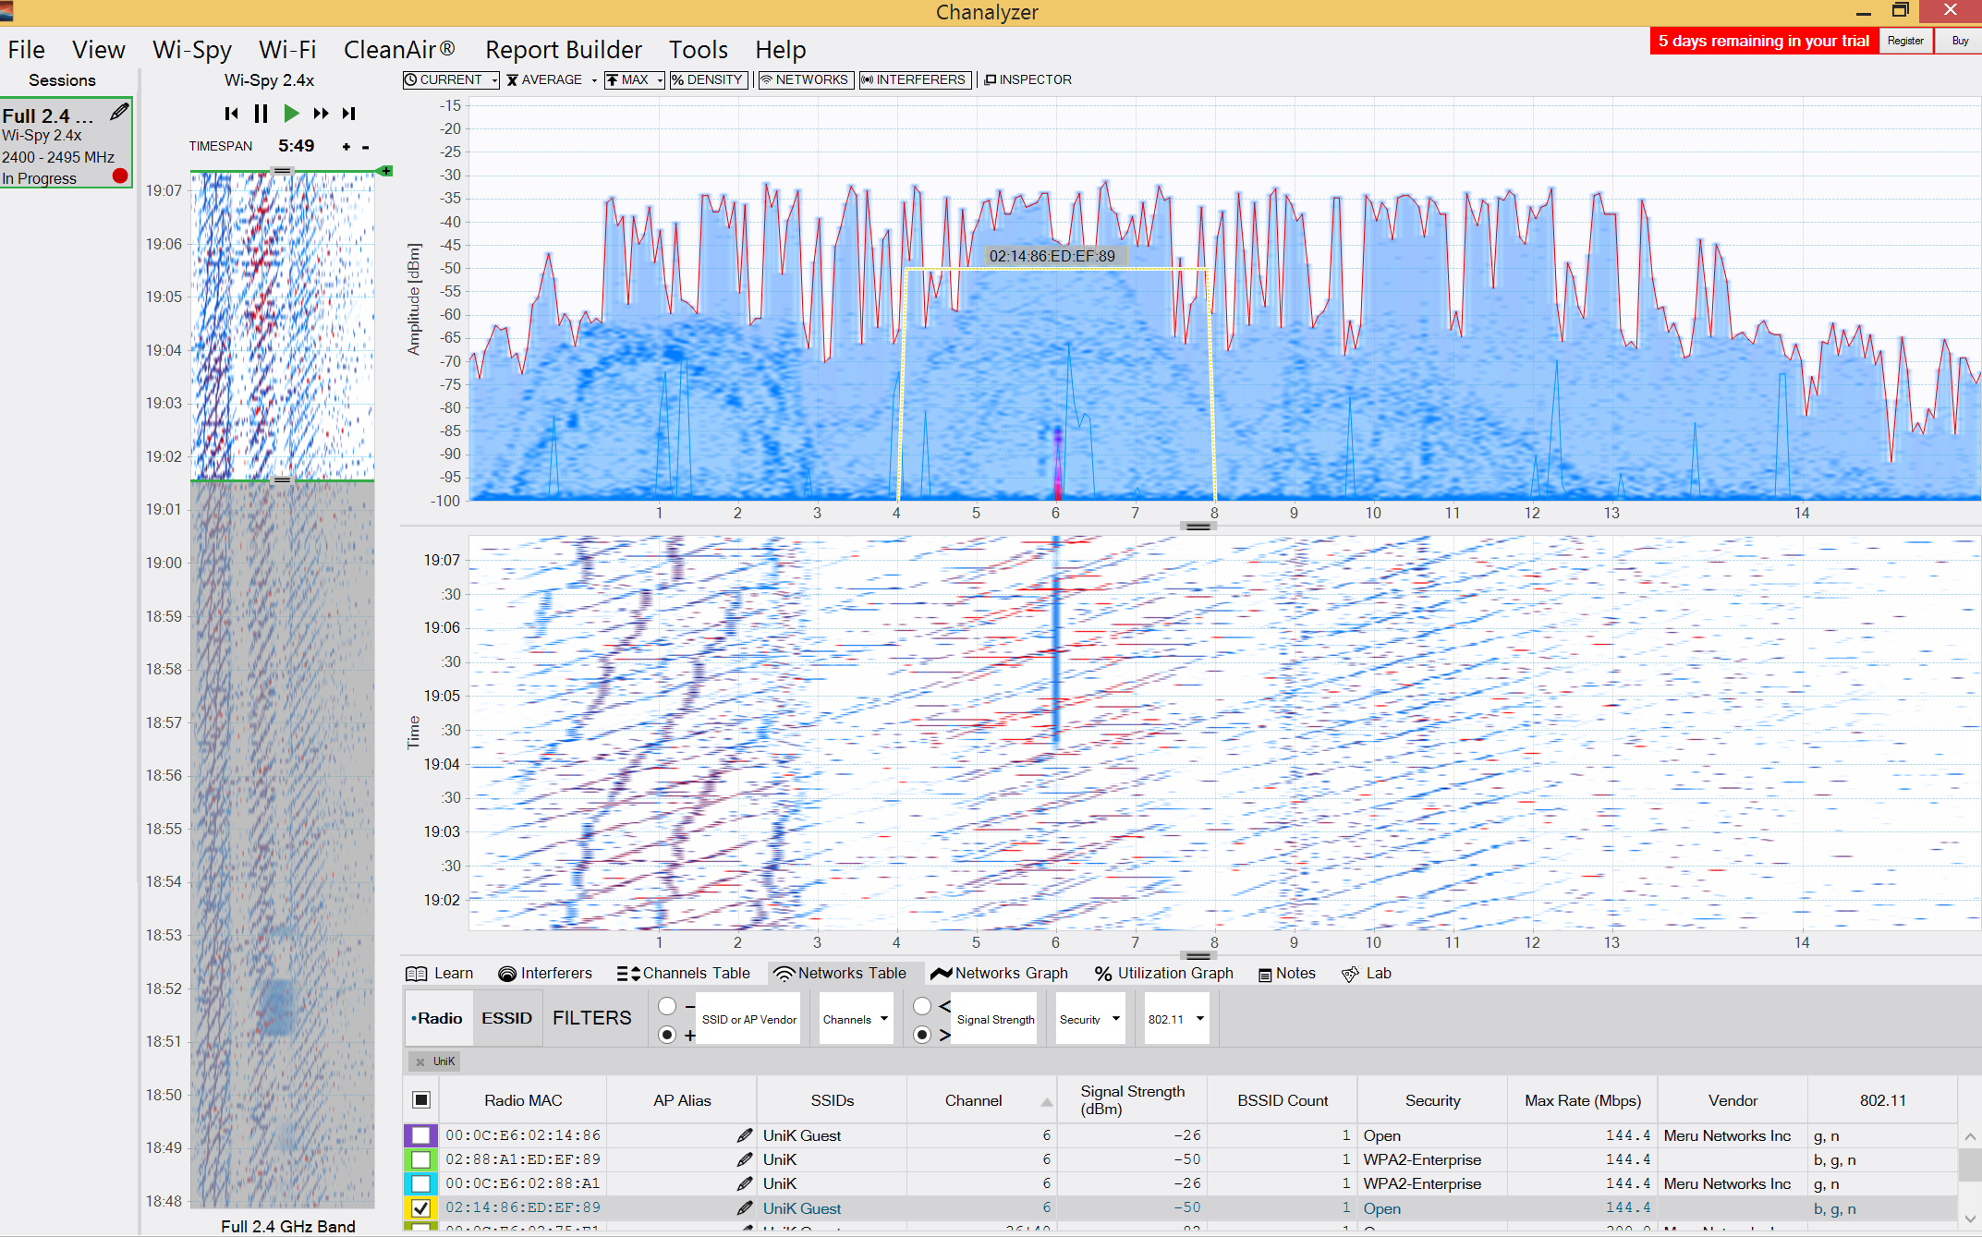
ITU Model Verification
Received power within given indoor Wi-Fi measuring (Wi-spy channel analyzer).
Measured & modeled received power comparison.

Slide 12
Measured & Modeled Received Power Comparsion
Floor ID | Number of floor | Distance [m] | Signal Strength (Modeled)[db] | Signal Strength (Measured)[db]
1 | 2 | 20 | -93 | -87
3 | 0 | 18 | -84 | -80
4 | 1 | 18 | -88 | -83
4 | 1 | 4.6 | -65 | -57

Slide 13
ITU-based Capacity Modeling
C = B log2 $\left(\text{1+}{\frac{S}{N}}\right)$
C : Capacity
B : Channel bandwidth 20 [MHz]
S : signal strength
N : noise (- 110)
Goal: objective capacity quality of service is 20 [Mbps] (usage peak)

Slide 14
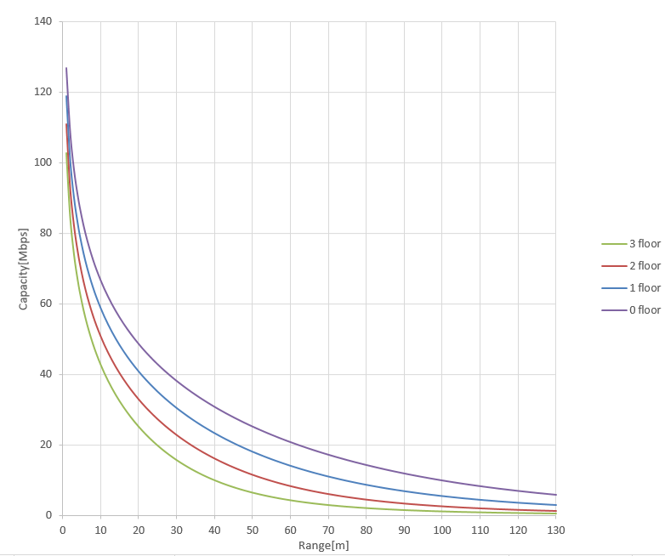
Capacity & Range
Capacity QoS

Slide 15
Indoor Wi-Fi Construction Consideration
Received power sensitivity : -110 [db]
Acceptable distance is any distance where: received power >= -110 [db] capacity QoS >= 20 [Mbps] objective
AP1010 max data rate 300 [Mbps] >>>>> 1 AP cover 15 user
Floor ID | Number of users | Number of APs needed to QoS
1 | 80 | 6
2 | 70 | 5
3 | 30 | 2
4 | 20 | 2
Number of Floor | Capacity futherest distance [m] | Signal futherest distance [m]
0 | 60 | 130
1 | 45 | 95
2 | 35 | 70
3 | 25 | 50

Slide 16
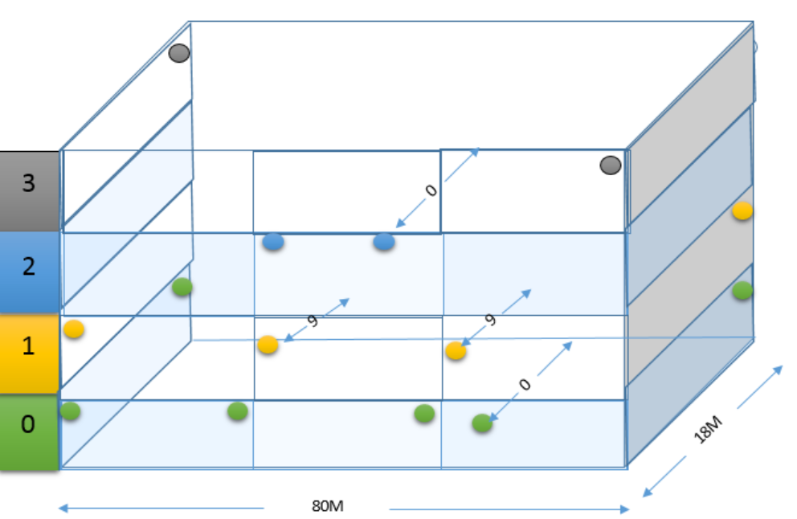
Proposed Indoor Wi-Fi Network

Slide 17
Indoor Mobile Network Design Kjeller AS (4 floor building)

Slide 18
(Wi-Fi, Mobile) Indoor Network Design Factors
Some factors:
Tx (Transmitter) and Rx (Receiver) characteristics (Antenna, Power, Sensitivity …).
Building characteristics (Dimensions,..).
Expected number of users and user distribution(Building, floor,.. )
Fading margin.
Propagation Model (ITU model).

Slide 19
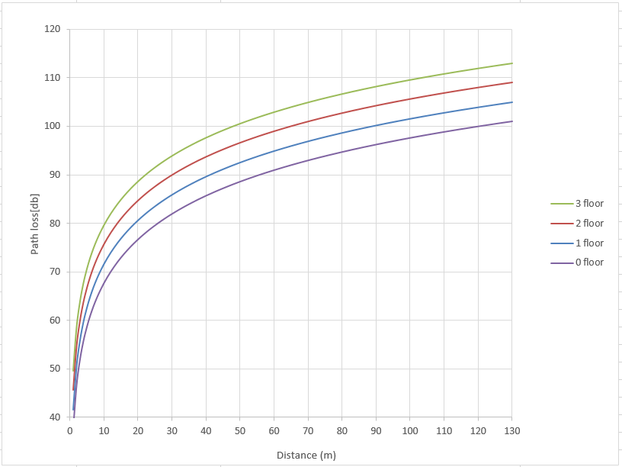
Indoor Mobile ITU-based Path Loss model

Slide 20
Mobile Network Received Power Parameters
Cisco 3G small cell Transmitted power (TS) -6 [db]
Transmitter Antenna Gain(GT) 5 [db]
Receiver Antenna Gain(GR) 0 [db]
(minimum expected device gain)
Received Power= TS + GT + GR – Path loss
Senstivity + fading margin: - 100 [db]

Slide 21
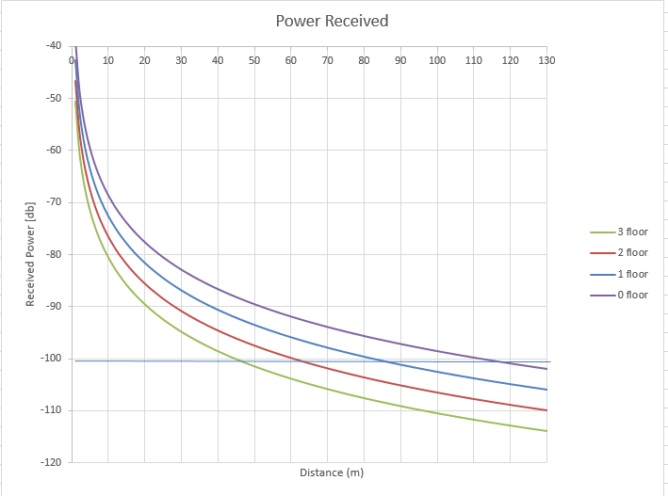
Indoor Mobile ITU-based Received Power Model
Sensitivity + Fading margin

Slide 22
Indoor Mobile network Construction Consideration
Sensitivity + Fading margin: -100 [db]
Acceptable distance is any distance where: received power >= -100 [db]
Mobile network needed capacity low focus on sigal strength.
Number of Floor | Signal futherest distance [m]
0 | 120
1 | 80
2 | 60
3 | 45

Slide 23
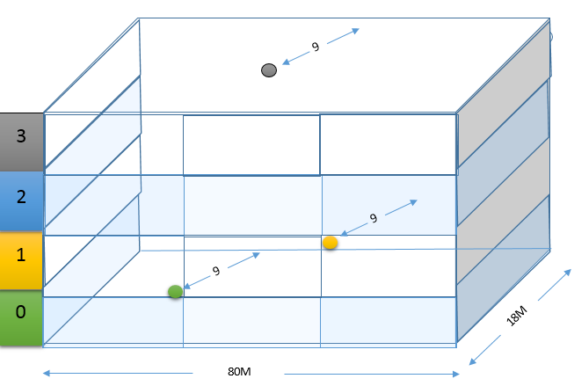
Kjeller AS Proposed Mobile Network

Slide 24
Conclusion & Evaluation
Random construction of wireless network is costly from economical and quailty prespective.
Number of used APs alone is not enough to assure required QoS.
Overall consideration for different parameters should be followed for effective indoor Wi-FI network design.
Differenet wireless network types (mobile, Wi-Fi) have different considerations.
Wireless network environment changes require changing in the constructed wireless network (change APs position, add new APs,….) to assure certain QoS.
ITU model is suitable path loss model for indoor wireless network.

Slide 25
References
T. S. Rappaport, Wireless Communications: Principles and Practice, 2nd ed. Singapore: Pearson Education, Inc., 2002.
K. Feher, Wireless Digital Communications: Modulation and Spread Spectrum Applications. Upper Saddle River, NJ: Prentice Hall, 1995.
S. Haykin and M. Moher, Modern Wireless communications. Singapore: Pear- son Education, Inc., 2002.
J. W. Mark and W. Zhuang, Wireless Communications and Networking. New Delhi: PHI, 2005
Digital Transmission Systems, Third Edition, David R. Smith From coverage to quality: building the future network Δ, Femtocells Building the Quality Network for Mobile Operations ­ Oslo, 28 Oct 2010.
http://www.cisco.com/c/en/us/products/collateral/wireless/3g-small-cell/data_sheet_c78-726607.html 16/02/2015

Slide 26
References
Ayaz Khan Afridi, "Macro and Femto Network Aspects in Realistic LTE Usage Scenarios Δ", Master Thesis, Network Services and System in Department of Electrical Engineering, Royal Institute of Technology (KTH), Stockholm, Sweden, May 2011.
Presentation: Josef Noll, From coverage to quality: building the future network, Femtocells - Building the Quality Network for Mobile Operations - Oslo, 28 Oct 2010
http://www.metageek.net/products/wi-spy/, 16/02/2014
http://www.rfcafe.com/references/electrical/wireless-comm-specs.htm. 18/12/2014
http://en.wikipedia.org/wiki/ITU_Model_for_Indoor_Attenuation , 16/02/2015
http://www.merunetworks.com/collateral/data-sheets/ds-wireless-lan-access-points-ap1010_ap1020.pdf 16/02/2015

