Slide 1
SP3 - Technology Line WP22 - Development and Implementation of Technologies
Progress Summary M27-M42
Josef Noll (UiO), Maunya D. Moghadam (UiO), Maghsoud Morshedi (EyeNetworks)

Slide 2
Main Objectives WP22
Overall
Overview of developments in the technology lines (helicopter perspective)
High level perspective
Roadmap to Market Introduction - “Managed Wireless”
Market Innovations
M27-M42 - Innovative Aspects & Market perspective
Market roadmap for selected products
Example: “Guarantee 500 Mbit/s everywhere”
Innovative Aspects
identification from technology development
Tangible innovations with clear market perspective

Slide 3
WP22 Achievements and main results M27-M42
Documentation
Roadmap to Market Introduction - “Managed Wireless”
Market Innovations
Innovations and market perspective
Managed & (security) monitored wireless
“Guarantee 500 Mbit/s everywhere”, AI-based analysis
Identify faulty IoT devices
X-burst innovative cross-technology communication (TUG)
heterogeneous wireless environments
Multimodal positioning system (GUT)
port of Gdansk, hospitals
$∑$18 tangible innovations with clear market perspective
Example: Managed and Secured Wifi
SW update
guaranteed
1 Gbit/s Wifi
access
monitoring

Slide 4
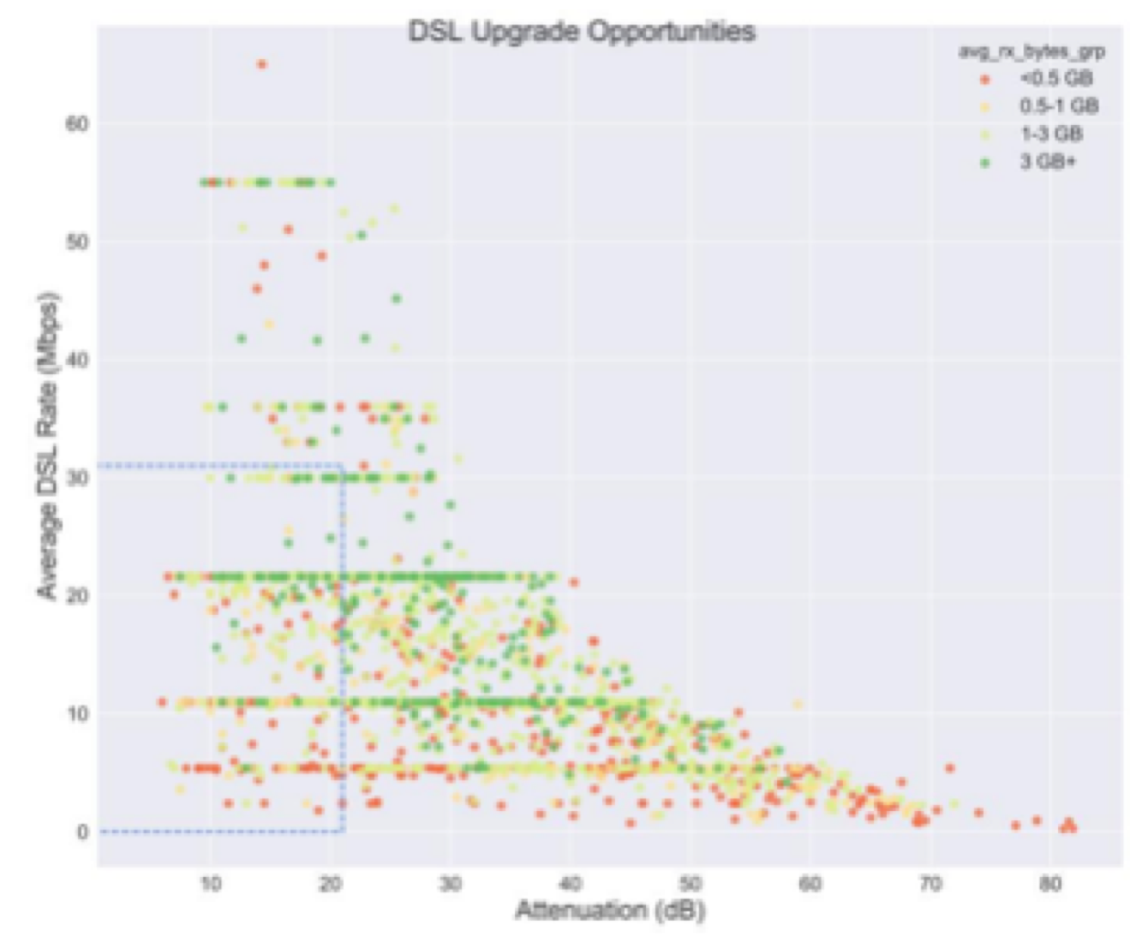
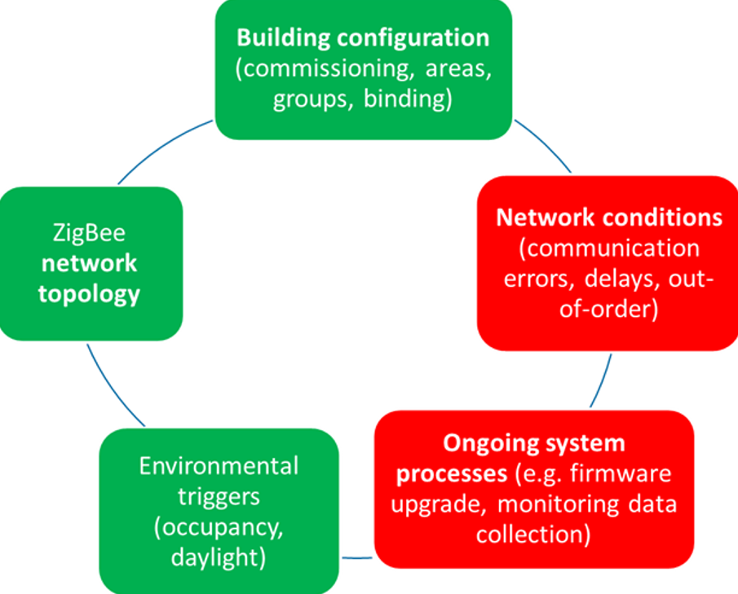
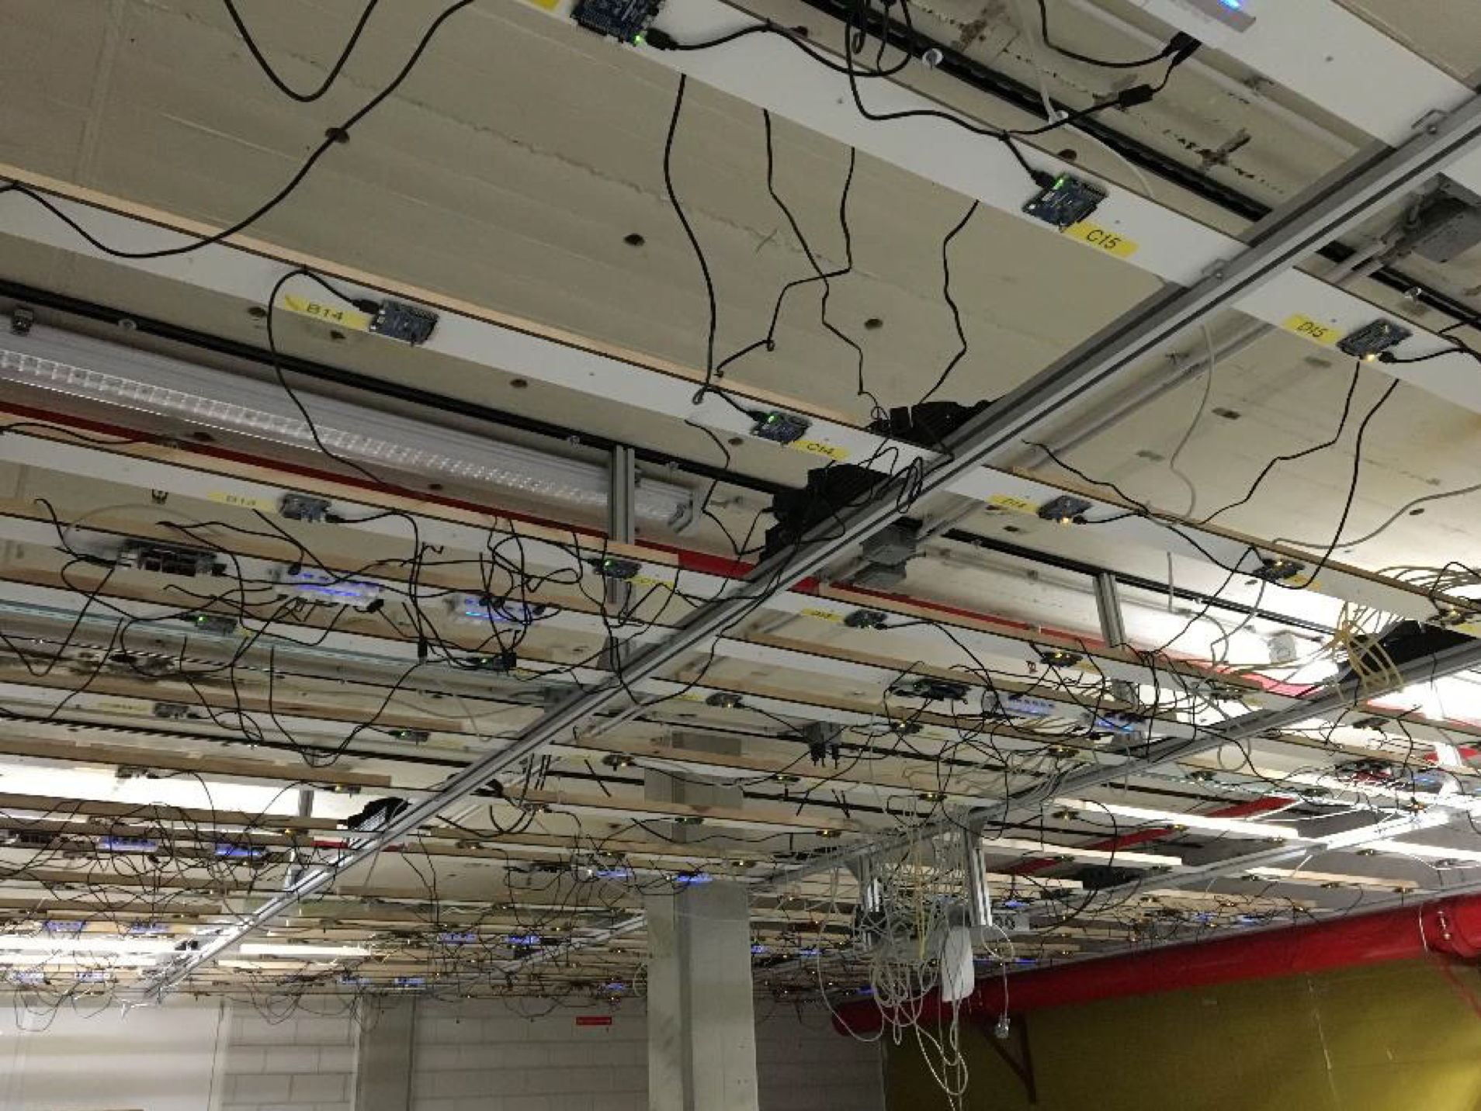
WP22 - Conclusion and Potential (M1-M42)
Boosting Security, Privacy, Safety and Trust for IoT through 18+ tangible market innovations
Planned exploitation after SCOTT
Managed & (security) monitored wireless
“Guarantee 1Gbit/s everywhere”
Fault injection techniques
Novel stress testing

Slide 5
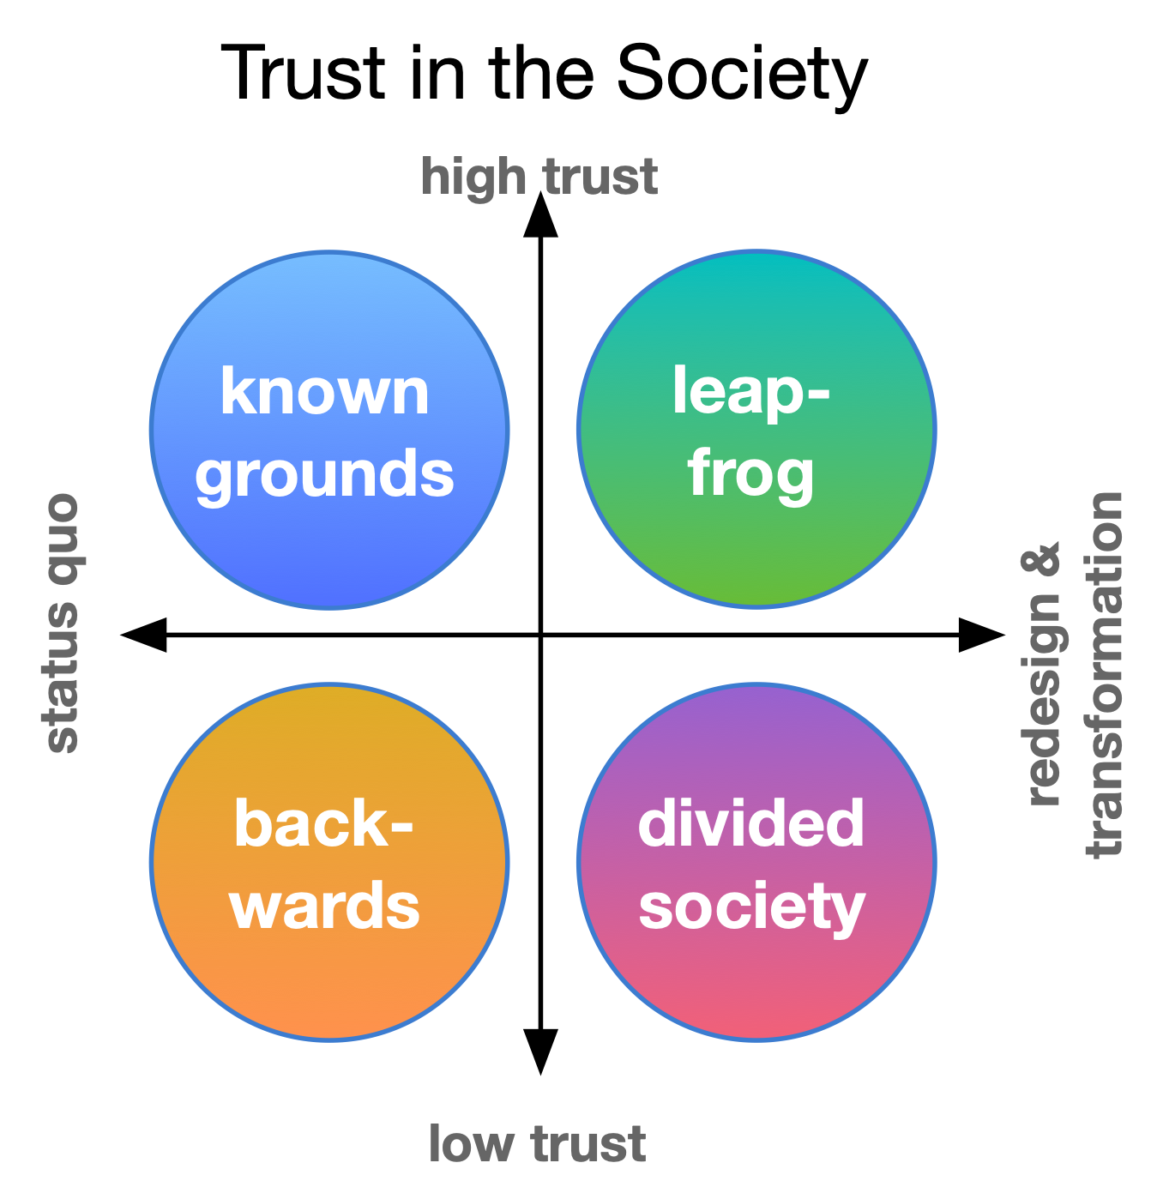
Novel topic in the discussion
Norway 2040
Societal Security
Trust in Society
6G and SDGs

Slide 6
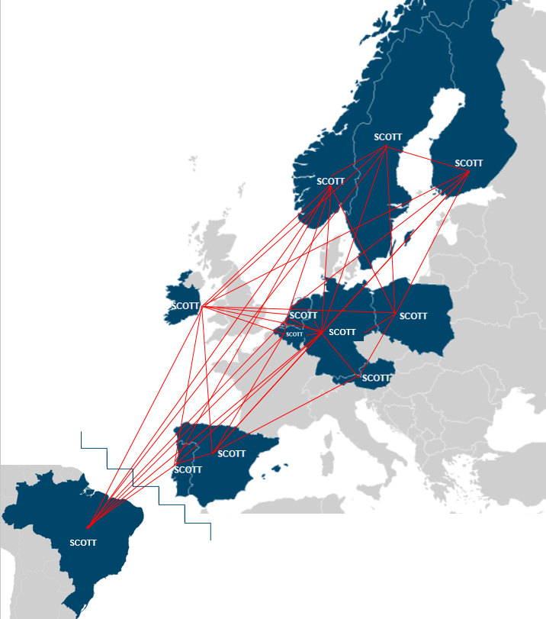
www.scott-project.eu

