Slide 1
Argument structure for the SPD trust case
IoTSec
Consortium meeting
11. October 2018
Rune Winther
Øivind Berg
Multiconsult
Senior Researcher Energy Economics
rune.winther@multiconsult.no
+47 91665762
Oivind.berg@smartinnovationnorway.com
+47 995 21 679

Slide 2
Topics
What a trust case is, and is not
Two trust cases under development
Structuring the argument
Implementation in NOR-STA

Slide 3
What a trust case is, and is not
A trust case can be defined as: A structured argument, supported by evidence, intended to justify that a system is acceptably trustworthy for a specific application in a specific operating environment
  Modification of def. of safety case in def-stan 00-56
A trust case is NOT a formal proof that the system has certain characteristics
  There are methods for making trust cases “more formal”, and to assess confidence
The main benefit of a trust case is that the argumentation becomes explicit and available for scrutiny and evaluation
  It should be convincing, not an absolute proof

Slide 4
Two trust cases under development
#1: Smart grid is adequately secure, private and dependable
  A very general case
#2: Company X’s AMS system is adequately secure, private and dependable
  Focus is on the NVE guideline: «Veileder til sikkerhet i avanserte måle- og styringssystem»

Slide 5
#1: Smart grid is adequately SPD
A very simple system model: Smart grid = Power grid + IoT
The structure of the trust case argument:
Argue over each subsystem and their interaction
For each subsystem, argue over the main elements of each subsystem
For each of the main elements, argue over S, P and D separately
For each of S, P and D, argue over each life cycle phase separately

Slide 6
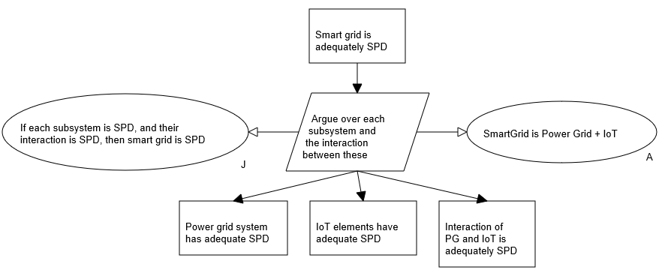
Top-level claim

Slide 7
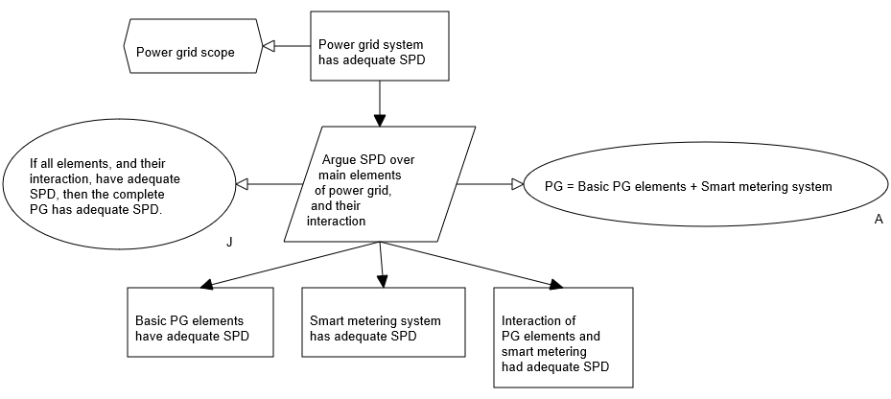
Power grid level

Slide 8
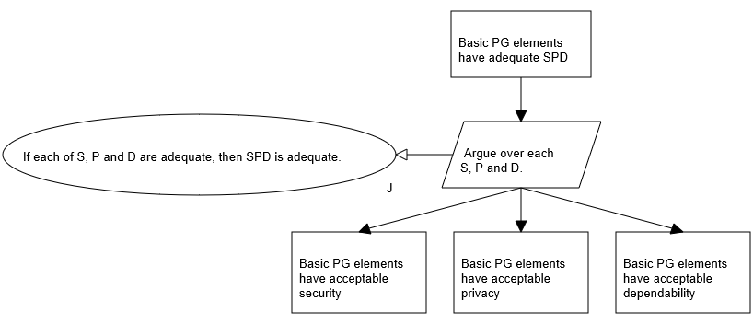
Basic PG elements

Slide 9
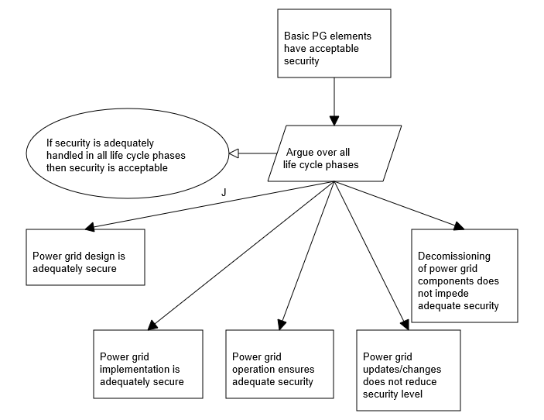
Security of basic PG elements

Slide 10
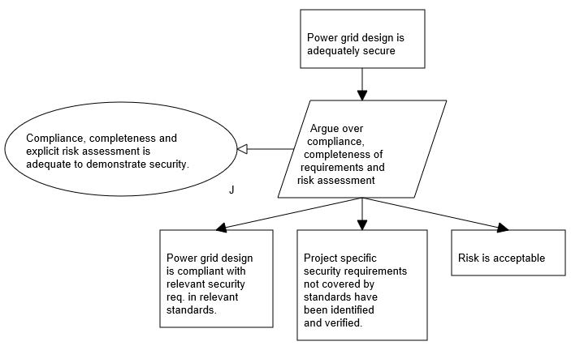
Security of design

Slide 11
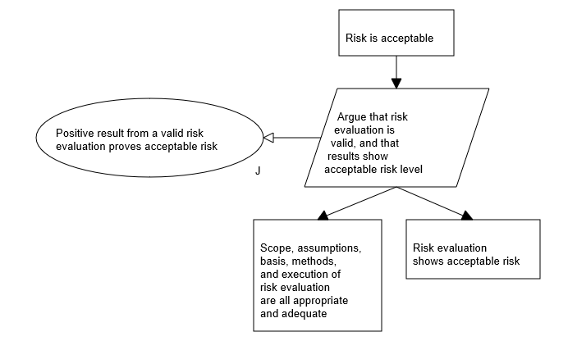
Risk assessment shows acceptable risk

Slide 12
#2: Company X’s AMS system is adequately SPD
Originally, the goal was a compliance case, i.e. an argu-mentation structure proving a specific guideline had been followed
Goal changed, because it wasn’t apparent that following the guideline would be adequate to «claim SPD»
Question: Can we use a trust case to evaluate whether following the guideline is adequate?

Slide 13
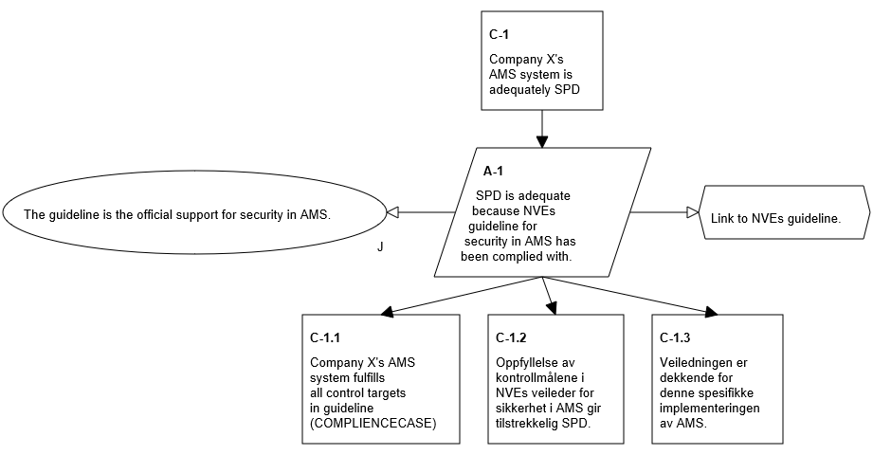
The top level claim

Slide 14
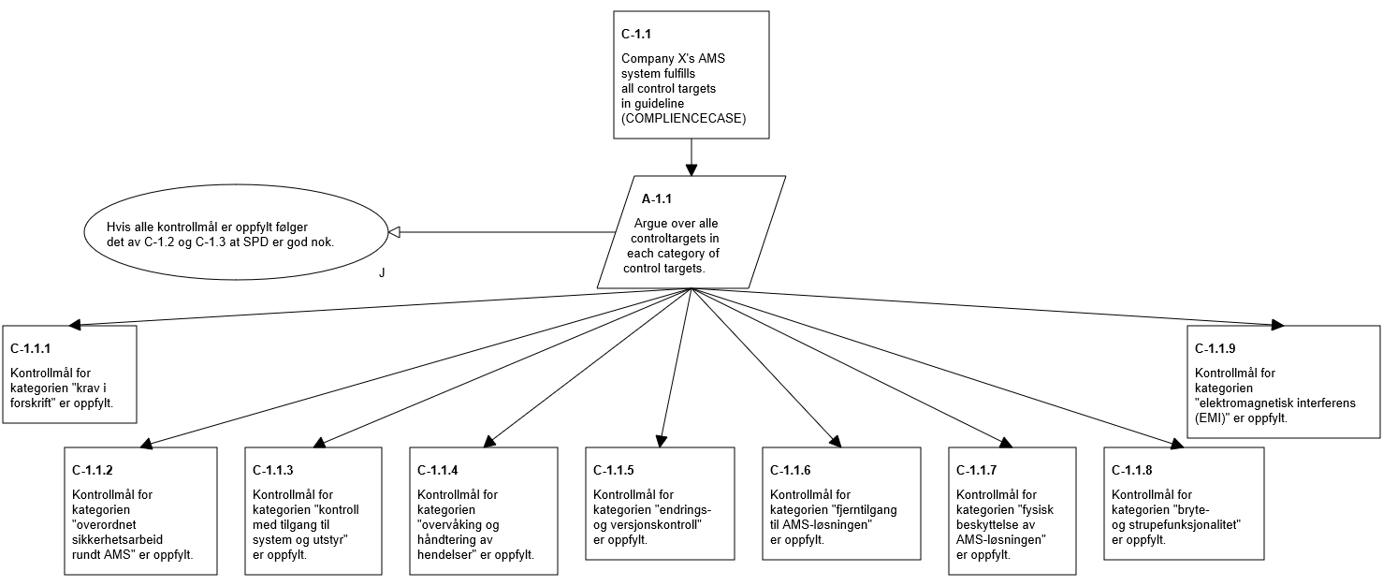
The compliance case

Slide 15
Evaluating the adequacy of the guideline
Strategy: Establish an argumentation for adequacy, and check whether following the guideline will provide all necessary evidence
Argumentation levels
Each of S, P and D
Each attribute in S,P and D
Each part of the system, for each attribute
This work is not finished

Slide 16
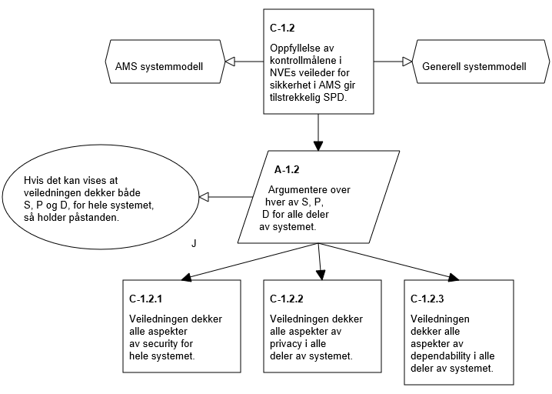
Claiming adequacy

Slide 18
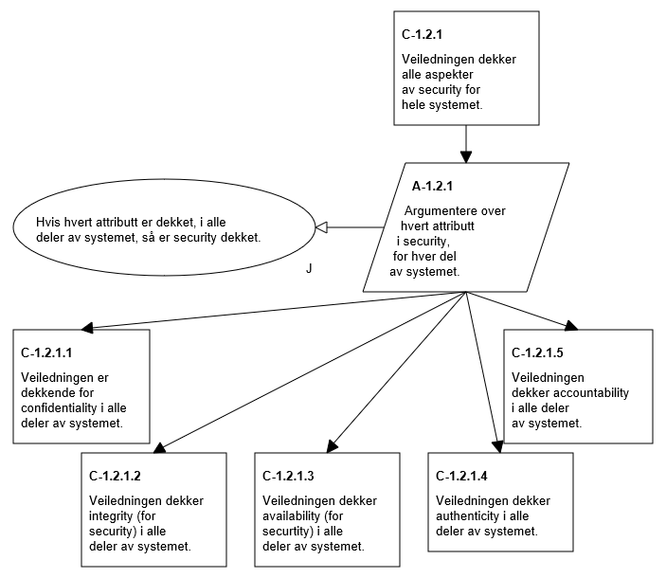
Security

Slide 19
Observations
Constructing explicit arguments is demanding
The number of nodes will easily reach “hundreds”
Explicit arguments support completeness, and identifies weaknesses
Structures should be (relatively) easy to convert to patterns, for reuse in SPD trust cases
Basic system models are necessary for constructing trust cases
Need to be conscious about the use of compliance cases
  Is compliance adequate for having trust?

