Slide 1
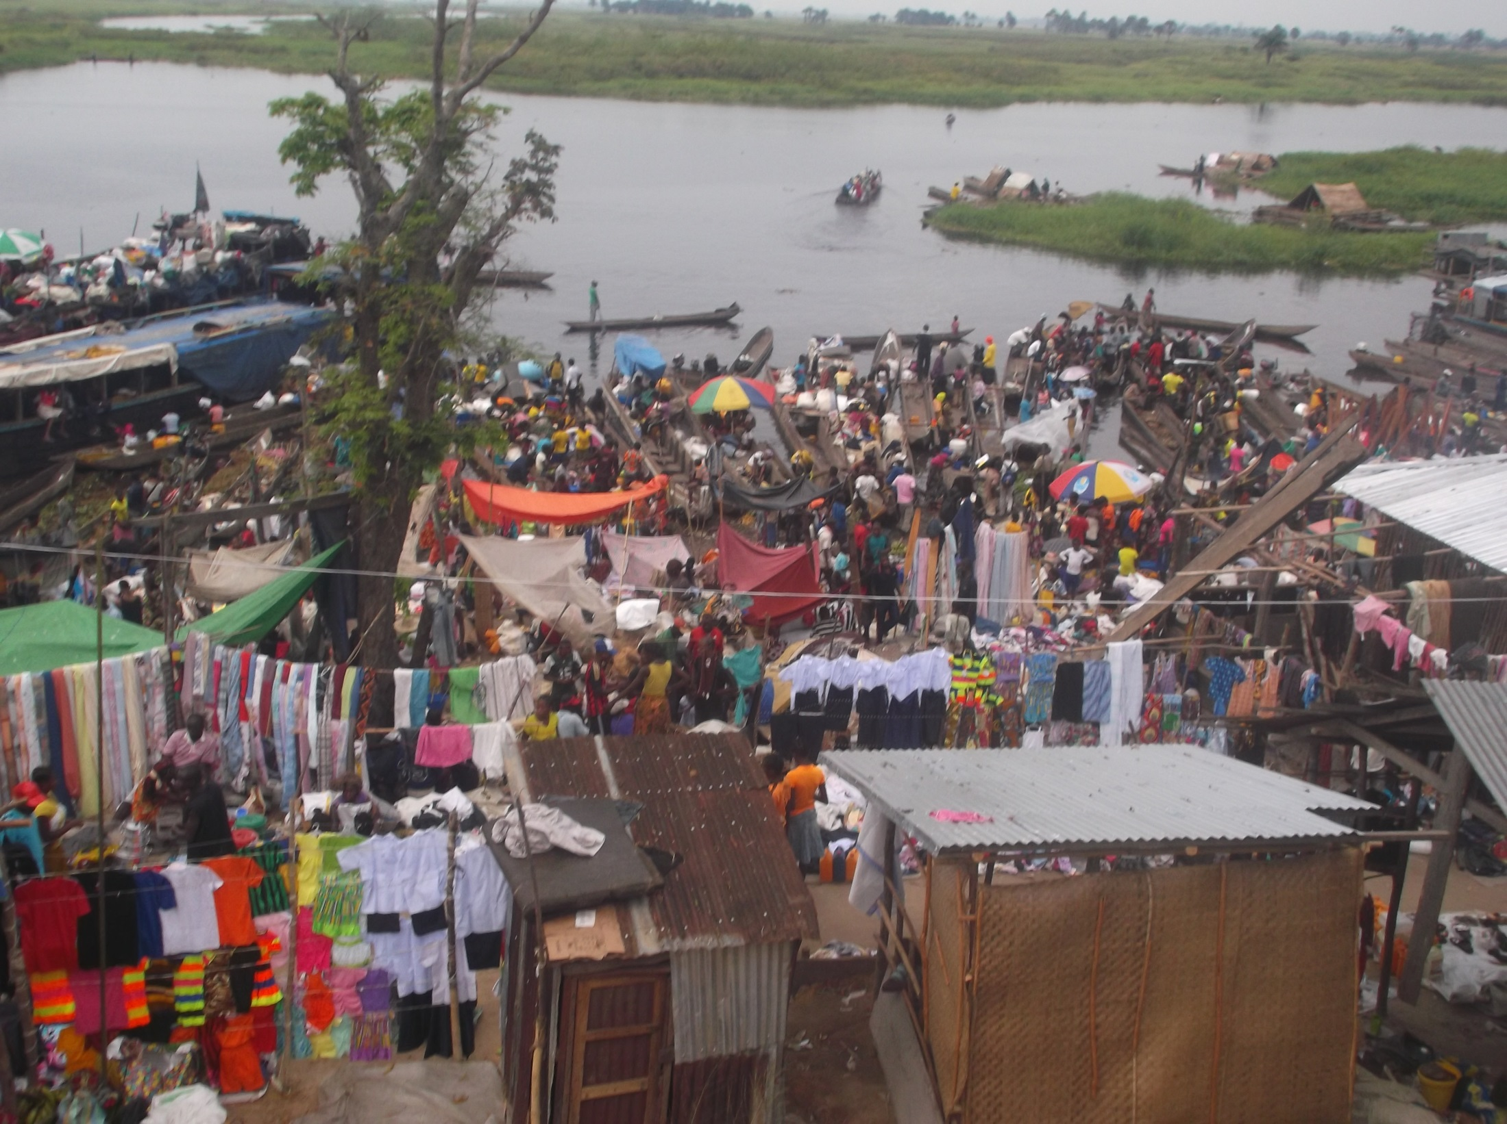
PANU – Bandundu Province DRC
IPX’s 100% Solar 0mni Directional 3 TRX- Tower
Built : July 2014 (one year)
Subscribers: 3200
Digi Inception Oslo September 2017

Slide 2
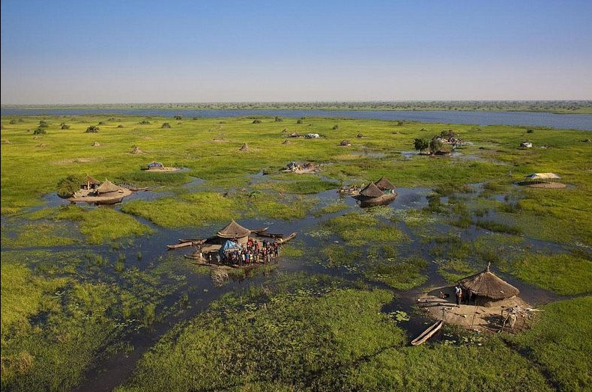

Rural Africa Telco, Esco, & TV

Slide 3
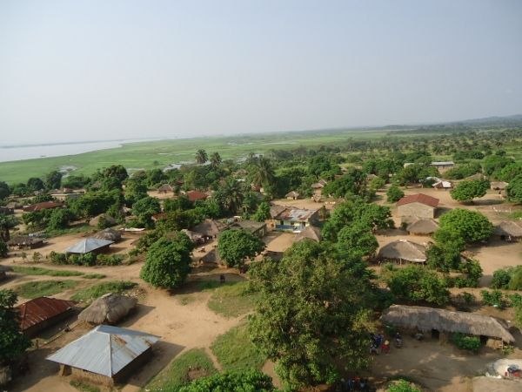
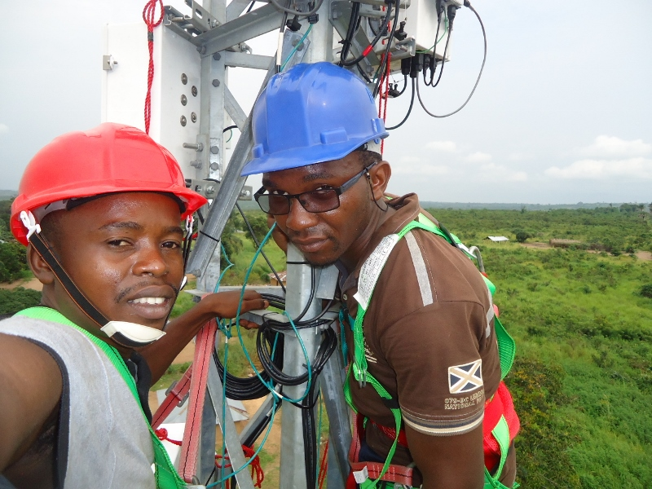
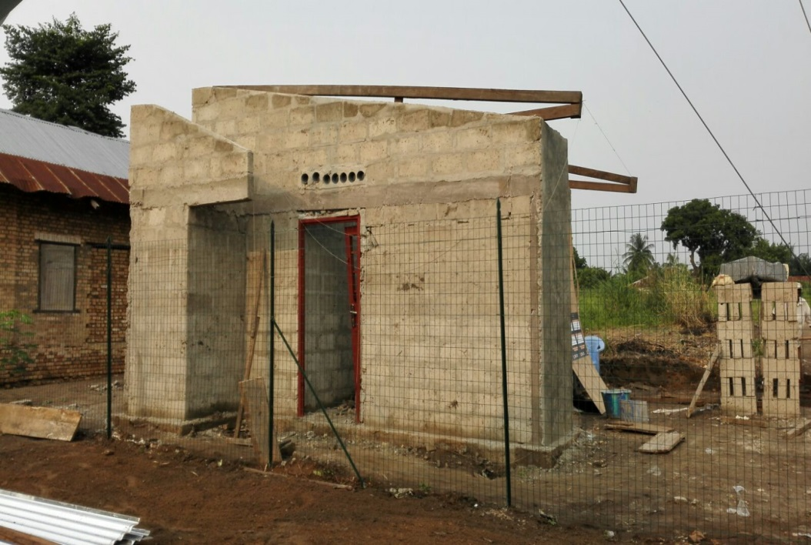
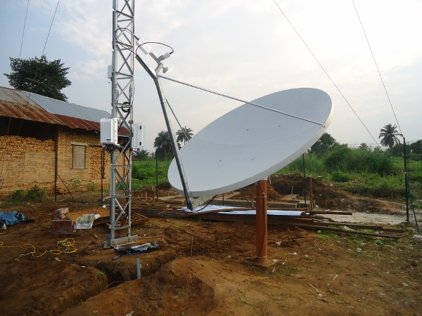
Ngabenge
Tshumbiri
Bolobo
Bolobo

Slide 4
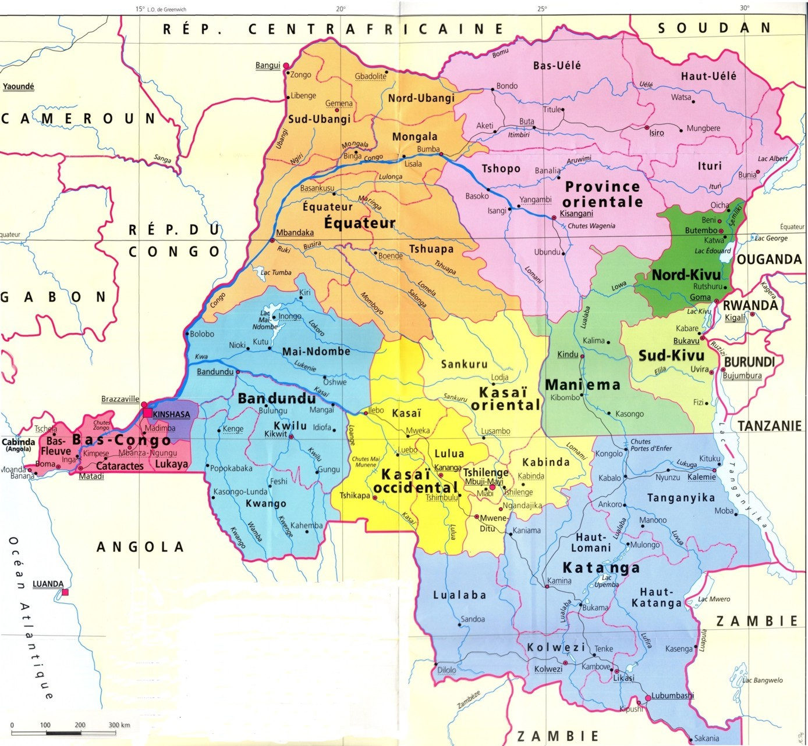




THE CHALLENGE
Oct 2013
Tout droit réservés RascomStar-QAF All rights reserved
4
Notes:
4

Slide 5
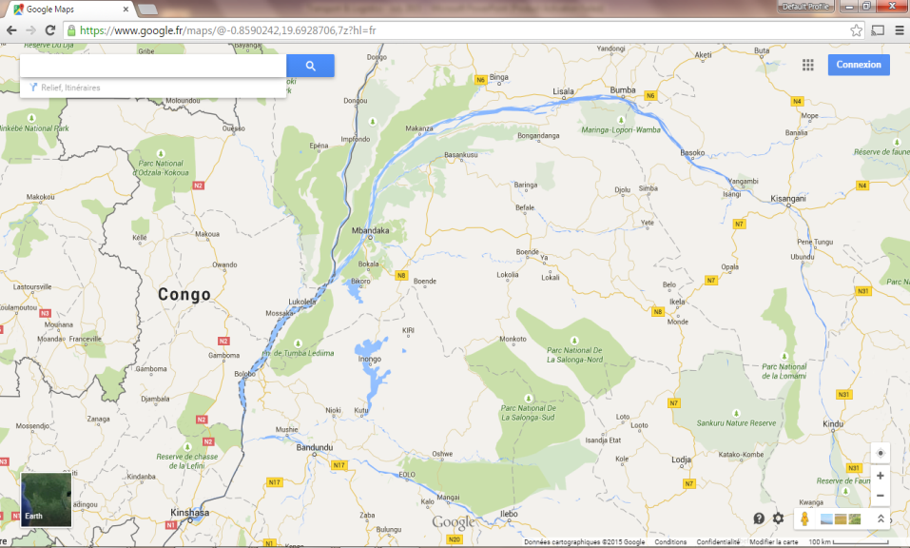

8 Sites along Congo and Kasai Rivers (17 more upcoming)
Circled are Kinshasa and Bandundu –Ville our first regional Hub serviced by weekly commercial flights;

Slide 6





IPX ORGANISATION
HQ
Kinshasa
HQ level
Commercial flights
Boats & barges
etc
HUB
NIOKI
HUB
KIKWIT
HUB
BDD Ville
HUB
LISALA
HUB level
3 x Flying Technicians/HUB
Village level
15 – 20 villages per HUB
Village
Village
Village
Village
Village
Village
Village
Village
Village
Village
Village
Village
Village
Village
Village
Village
Village
Village

Slide 7
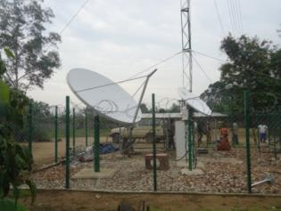

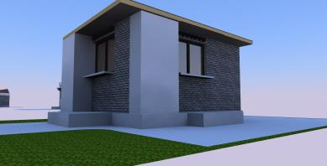
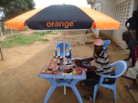
Village Level
1x Village Manager
1x IT & Electricity
Technician
1x Sales
1x Site & Shop Security
1st line Support
Sales/Tech. support
Resellers network
Distribution

Slide 8


…Scale
1. IPX upgrades Pilot’s CAPEX (Oct 2014)
Notes:
8

Slide 9
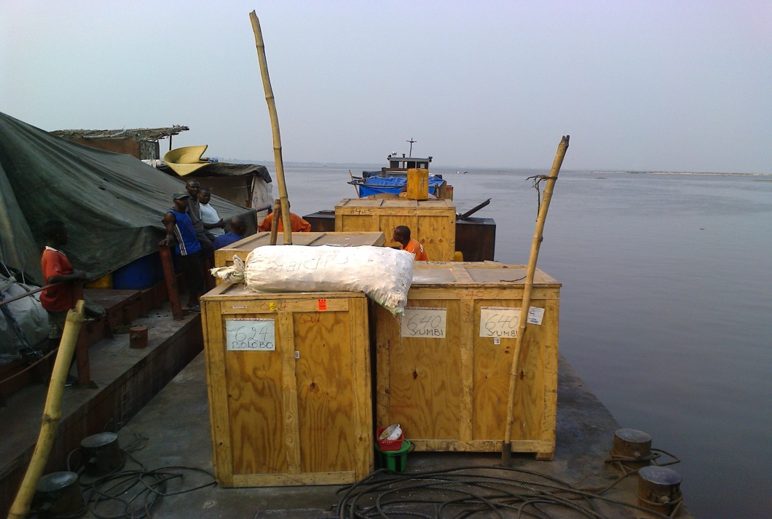
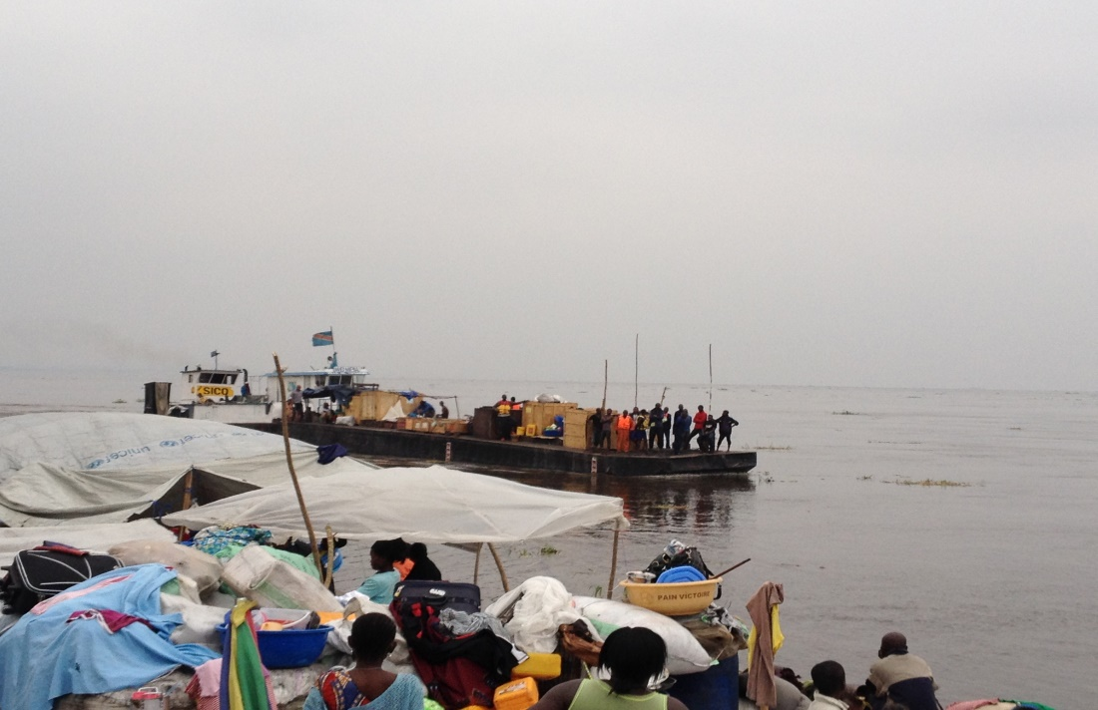
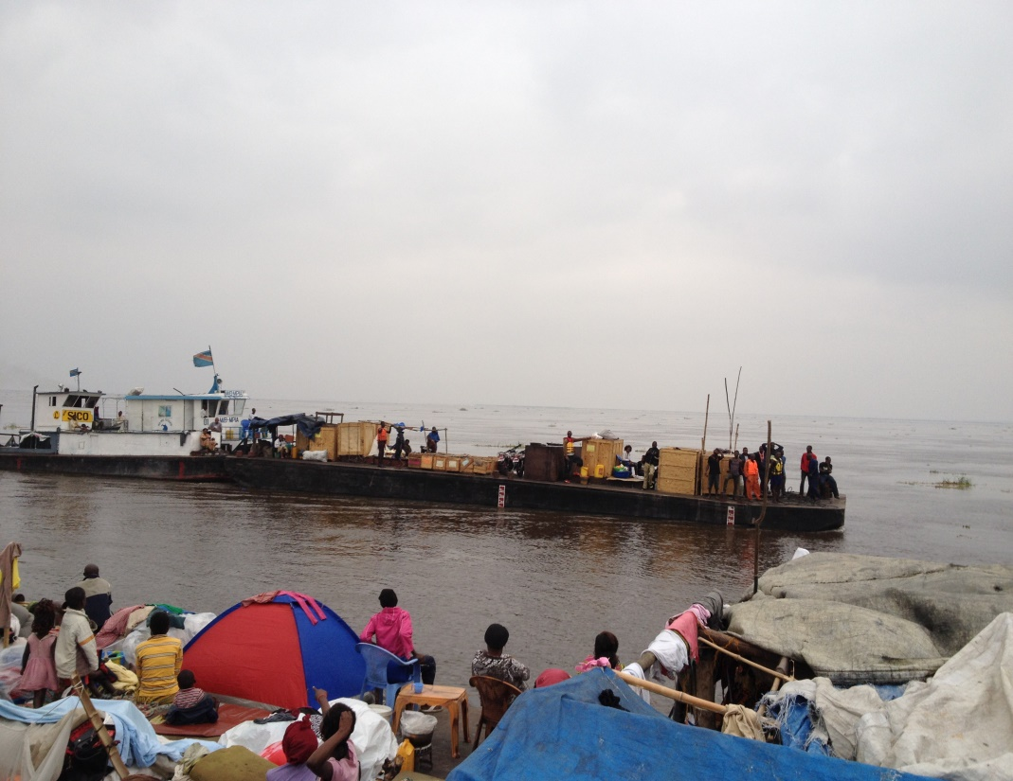
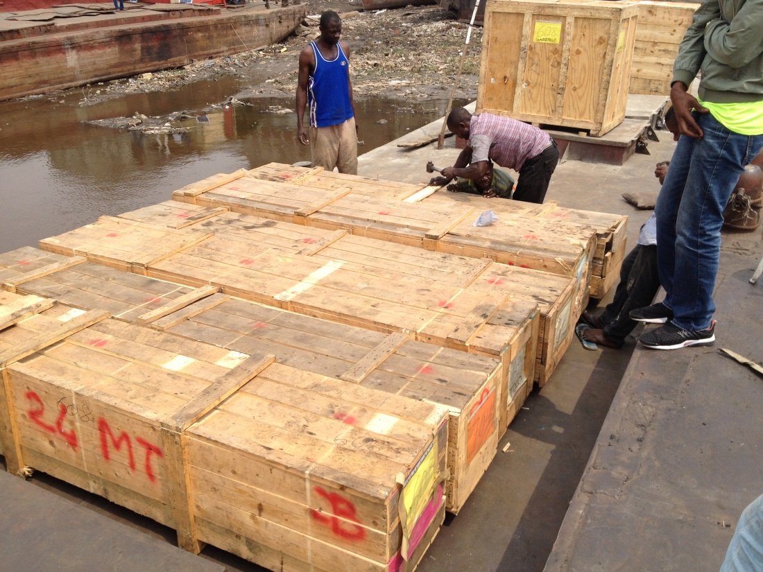

Slide 10
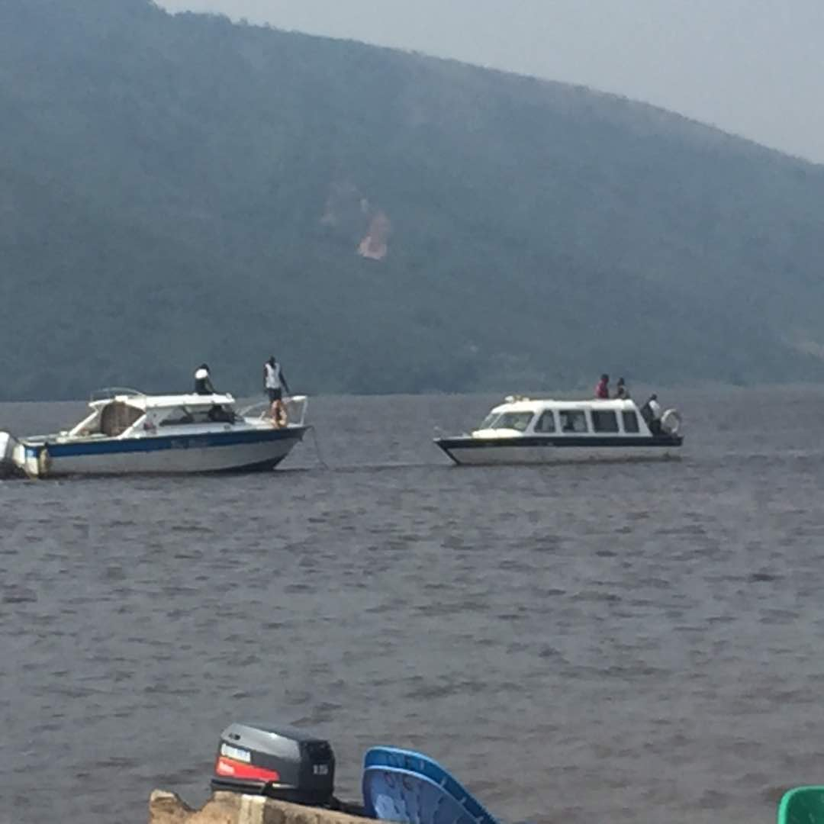
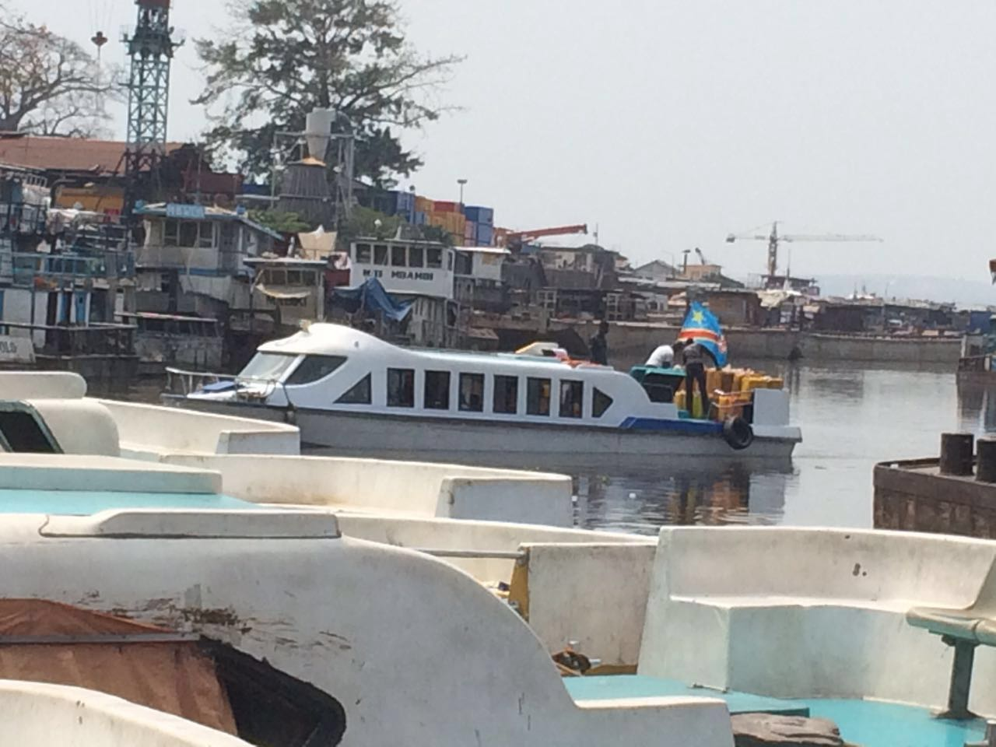

Slide 11
30 Sites selection
1 | Kasongo - Lunda |  | Kin by Truck
2 | Tembo | HUB | Kin by Truck
3 | Kahemba |  | Kin by Truck
4 | Kamonia | HUB : Tshikapa | Kin by Truck
5 | Tshibinda |  | Kin by Truck
6 | Gabenge (-) |  | by Boat-Barge
7 | Bolobo | HUB : NIOKI | by Boat-Barge
8 | Yumbi |  | by Boat-Barge
9 | Mbali-Iboma (-) |  | by Boat-Trucl
10 | NtandeMbelo (-) |  | by Boat-Truck
11 | Isaka |  | by Boat-Barge
12 | Bokoro |  | by Boat-Barge
13 | Mongombele |  | by Boat-Barge
14 | Oswhe |  | by Boat-Barge
15 | Kemba (-) |  | by Boat-Barge
16 | Bokala (check) | Bandundu Ville | by Boat-Barge
17 | Semendua |  | by Boat-Barge
18 | Semendane |  | by Boat-Barge
19 | Mabenga |  | by Boat-Barge
20 | Mbien |  | by Boat-Barge
21 | Pana-Otraco (-) |  | by Boat-Barge
22 | Eolo |  | by Boat-Barge
23 | Panu | HUB: Kikwit | by Boat-Barge
24 | Malodi-Mukedi |  | Kin by Truck
25 | Yuki |  | by Boat-Barge
26 | Mangai |  | by Boat-Barge
27 | Dibaya-Lubwe |  | by Boat-Barge
28 | Kambangi |  | by Boat-Barge
29 | Malembe (2 rives) |  | by Boat-Barge
30 | Makanza | HUB: Lisala | by Boat-Barge
31 | Mobeka (-) |  | by Boat-Barge
32 | Lusengo |  | by Boat-Barge
33 | Binga*** |  | by Boat-Barge
34 | Businga*** |  | by Boat-Truck
35 | Karawa*** | via Businga | by Boat-Barge
36 | Bwamanda *** | via Gemena | by Boat-Truck
Load A: sites no 6 – 11.
Load B: sites no 12 - 15
Load C : sites no 16 to 29

Slide 12
IPX Manpower Headcount
Year
1 ----- 2 -------3 -------4 ------5 -------6 ------7 ------8 -----9-------10
Manpower in HQ |  | 17 | 28 | 43 | 63 | 63 | 63 | 63 | 63 | 63 | 63
Manpower in HUBs |  | 12 | 68 | 132 | 136 | 136 | 136 | 136 | 136 | 136 | 136
Manpower in Villages |  | 50 | 1 350 | 2 850 | 2 900 | 2 900 | 2 900 | 2 900 | 2 900 | 2 900 | 2 900
TOTAL MANPOWER IPX EXTENSO |  | 79 | 1 446 | 3 025 | 3 099 | 3 099 | 3 099 | 3 099 | 3 099 | 3 099 | 3 099

Slide 13
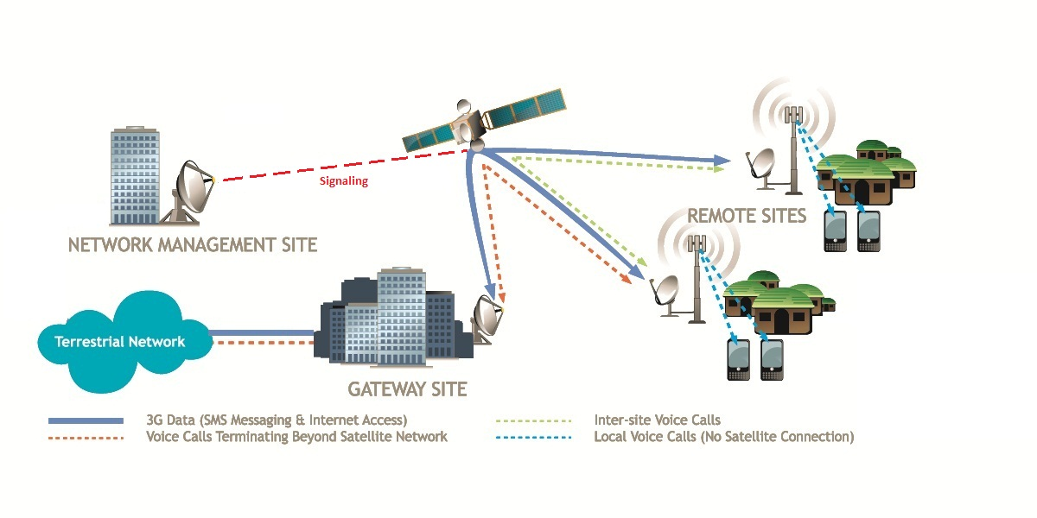


IPX B Model: an interconnected Sub-Network
Inbound
IPX operated
- Distribution
- Support
IPX’s urban-based Central Hub (7.3m Dish – see red circle above) acts as an interconnect gateway to IPX’s villages /sites ; Inbound /Outbound calls are charged to ORANGE on an agreed a asymmetrical tariff;
IPX Sub-network is interconnected to Orange and all national operators via Orange network (only Orange SIM can connect to IPX BTS initially);

Slide 14
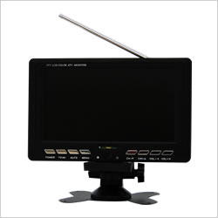
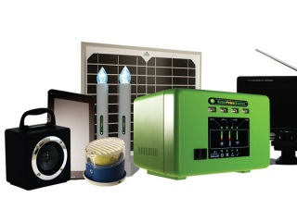
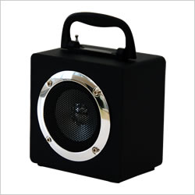



IPX EcoSystem : enabling towers ….
Energy / Solar Kit
TV : UHF-VHF
GSM
Infrastructure
RADIO : FM
$
Cash Transfer
Gov. Employees
Multi-Operator
(after exclusivity period)
Towerco
Distribution
Communications in these areas are often limited to radios powered by expensive dry cell batteries. Many low-income households spend a large percentage of their income on these inefficient and unhealthy energy solutions. At the end-user
level, access to clean energy products and services, as well as access to finance to purchase these products, are key factors that need to be addressed.

Slide 15
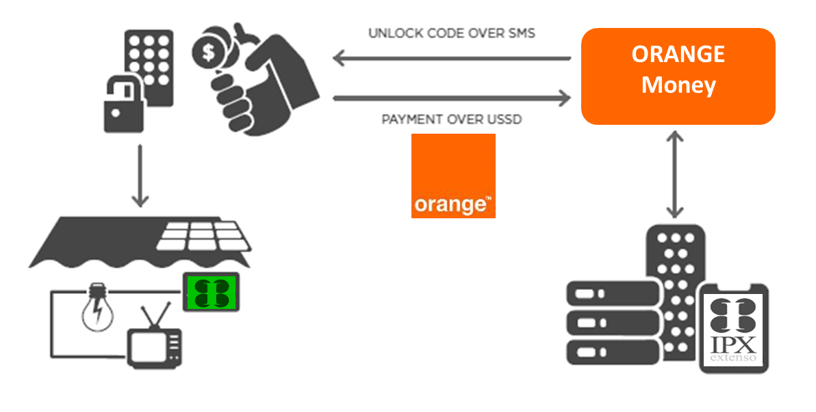
IPX’s Business Model: Value Chain
Solar-as-as-Service And / or Lease-to-own :
PAYG model offers rapid uptake is boosted by high demand for access to convenient, flexible financing ;
The Customer can acquire a 50 W Home Solar Kit (KSK) worth USD 175 (landed cost) for a USD 40 initial deposit, plus a weekly (or daily) instalment of +- USD 2,5 fee for 24 months;
Once installed and set-up on customer’s rooftop, the kit gets unlocked for a given period (days, weeks, months) dependent on payment made exclusively via Orange Money;
After the 24 months period, the customer owns the HSK, but is invited to pay USD 1/week to retain a life long swap insurance;

Slide 16
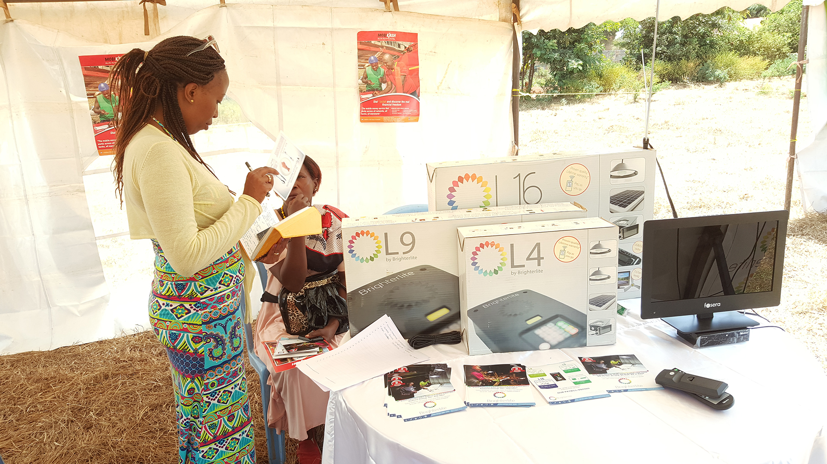
…enabling rural Radio & TV

