Slide 1
IoTSec Taxonomy Proposal
IoTSec
Consortium meeting
11. October 2018
Rune Winther
Øivind Berg
Multiconsult
Senior Researcher Energy Economics
rune.winther@multiconsult.no
+47 91665762
Oivind.berg@smartinnovationnorway.com
+47 995 21 679

Slide 2
Topics
Background and goal
Considerations
Causes vs. consequences
About the proposal
Practical issues
The proposal

Slide 3
Background and goal
We want to establish a trust case (explicit argument) for security, privacy and dependability in smart grids
The starting point is the claim “Smart grid is adequately secure, private and dependable (SPD)”
A convincing trust case requires a precise understanding of this claim
Thus, we need a taxonomy for SPD, specifically suitable for building trust cases

Slide 4
Considerations
No ambition to establish a «globally» accepted taxonomy
Focus is on our needs to formulate a precise claim in the trust case
Should, as far as possible, be based on existing taxonomies
«Pick and choose»
The taxonomy must cover all of SPD, but also be usable for each of S, P and D separately
Essential that the structure directly supports the construction of trust cases

Slide 5
Causes vs consequences
The difference between safety and security can be described as:
Security: The effect the world has on a system
Safety: The effect a system has on the world
From the perspective of the system, this means that:
Security is about causes
Safety is about consequences
When establishing the taxonomy we need to be conscious about whether we characterize causes, consequences, or both

Slide 6
Security – Can go both ways…
Security defined by the CIA triad
Loss of confidentiality, integrity and availability can be interpreted as primarily being characterizations of consequences
Security defined as “protection against threats”
Focus is primarily on causes
Neither is more correct, but we need to be consistent, and ensure that terms are understood in the same way by all stakeholders

Slide 7
About the taxonomy proposal
Primarily focused on characterizing consequences
Sort of…
Typically the loss of some characteristic
Top-level claim will often be about the absence of negative effects
Primarily based on
Laprie et.al, “dependable and secure”
PIPS-project
Stallings, W. Cryptography and network security: principles and practice

Slide 8
Practical issues
Since the taxonomy is focused on consequences, we need to ensure that all relevant causes are included in the trust cases
Whether unwanted events are intentional or unintentional should be explicitly addressed in the trust case
Should we extend the taxonomy to address both causes and consequences?
Confidentiality is in the taxonomy only associated with security, but is usually also part of dependability

Slide 9
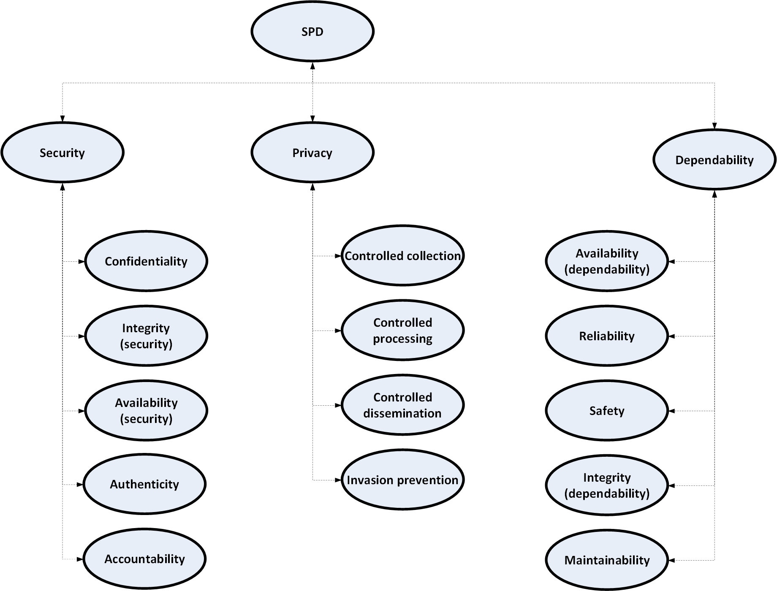
The proposal - Overview

Slide 10
The taxonomy – Definitions - Security
Security
Confidentiality | The absence of unauthorized disclosure of information.
Integrity (security) | Absence of unauthorized system alterations. Note: Unauthorized system alterations can be internal or external, as well as intentional or unintentional.
Availability (security) | Availability for authorized actions only.
Authenticity | The property of being genuine and being able to be verified and trusted; confidence in the validity of a transmission, a message, or message originator. This means verifying that users are who they say they are and that each input arriving at the system came from a trusted source.
Accountability | The security goal that generates the requirement for actions of an entity to be traced uniquely to that entity. This supports nonrepudiation, deterrence, fault isolation, intrusion detection and prevention, and after-action recovery and legal action. Because truly secure systems are not yet an achievable goal, we must keep records of their activities to permit later forensic analysis to trace security breaches or to aid in transaction disputes.

Slide 11
The taxonomy – Definitions - Privacy
Privacy
Controlled collection | The individual has control on what, and how, personal information is collected.
Controlled processing | The individual has control on how, and for what purpose, personal information is used.
Controlled dissemination | The individual has control on what, and how, personal information is disseminated.
Invasion prevention | Protection against disturbance/intrusion of an individual’s solitude or seclusion

Slide 12
The taxonomy – Definitions - Dependability
Dependability
Availability (dependability) | Readiness for correct service.
Reliability | Continuity of correct service.
Safety | Absence of catastrophic consequences on the user(s) and the environment.
Integrity (dependability) | For safety: The probability of a safety-related system satisfactorily performing the required safety functions under all the stated conditions within a stated period of time. General: Absence of improper system alterations.
Maintainability | Ability to undergo modifications and repairs.

