Slide 1
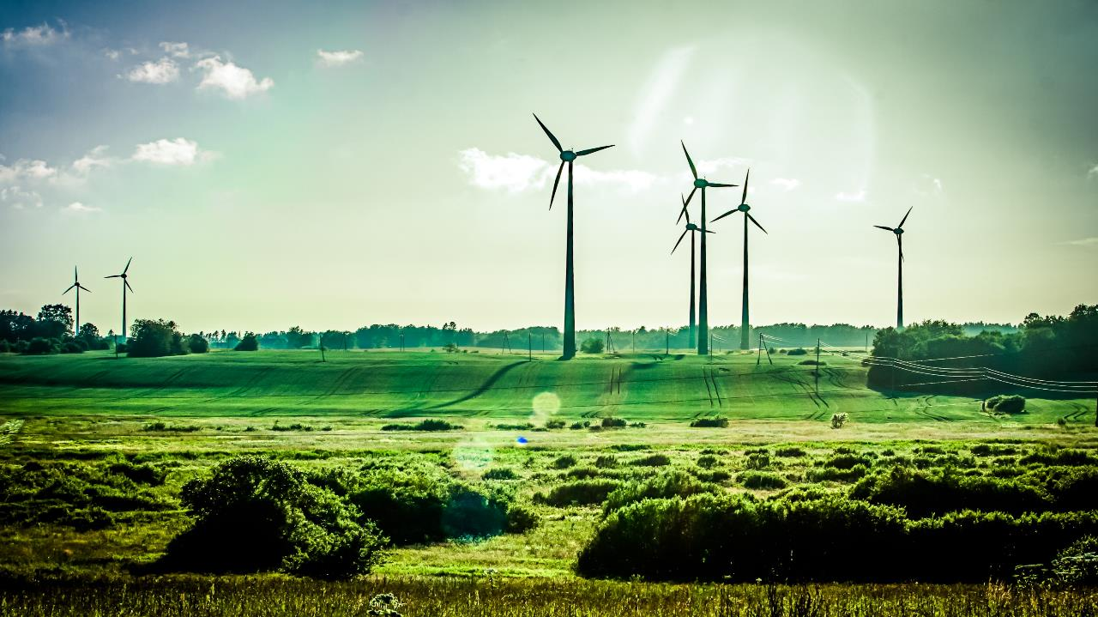
Diditalization of the energy sector
Digital living, business & Sustainability

Slide 2
Digitization industries
Disruptive digitization enables
radically new business models

Slide 3
Digitization industries
Music industry:
From cassette and CD to streaming
within few years
(iTunes, Spotify, YouTube…)

Slide 4
Digitization industries
Film industry:
From cassette and DVD to streaming (NetFlix, C MORE, Amazon Prime…)

Slide 5
Digitization industries – radically new business models
Internet of Things + Big Data Analytics + Cloud Computing + Mobile services + Social Media
=
Google Maps (map/GPS-industry)
UBER (taxi industry)
AirBnB (hotel industry)
Facebook (media industry)
Google (advertising industry)
Driverless cars(transport industry)

Slide 6
Industry 4.0
The 4th Industrial Revolution

Slide 7
Industry 4.0
1st IR mechanization of production using water & steam power

Slide 8
Industry 4.0
2nd IR
mass production with the help of electricity

Slide 9
Industry 4.0
3rd IR
the digital revolution, automation of production,
robots

Slide 10
Industry 4.0 – Robots 3rd Industrial Revolution

Slide 11
Industry 4.0
4th IR
intelligent networking of product development and production, logistics and customers.

Slide 12
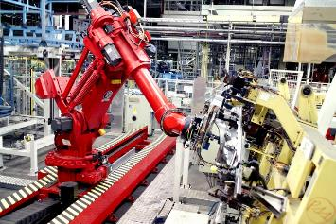
Industry 4.0 – 4th Industrial Revolution
Robots communicating with
robots

Slide 13
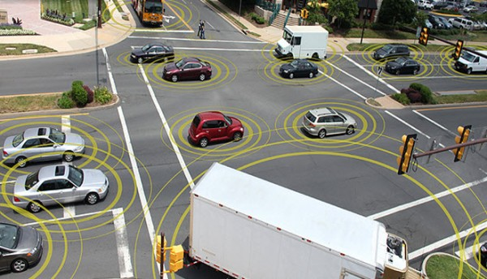
Industry 4.0 – 4th Industrial Revolution
Communicating driverless cars

Slide 14
Industry 4.0 – 4th Industrial Revolution
Communicating driverless cars
Cars communicate with roads, other cars, traffic information systems, their passengers, parking and charging reservation systems, …

Slide 15
Industry 4.0 – 4th Industrial Revolution
Communicating driverless cars
Cars communicate with roads, other cars, traffic information systems, their passengers, parking and charging reservation systems, …
Internet of Things
+ Big Data Analytics + Cloud Computing + Mobile services + Social Media

Slide 16
Energy Industry 4.0 – 4th Energy Industrial Revolution
Internet of Things + Big Data Analytics + Cloud Computing + Mobile services + Social Media
=
New business models
New actors
End customer focus
From kWh sales to sales of services

Slide 17
R&I projects 2009 - 2017
Energy Trade and Environment 2020 (2009-2011) (RCN RENERGI)
Manage Smart in SmartGrid (2010-2012) (RCN RENERGI)
IMPROSUME (2010-2012) (EU ERA Net)
DeVID (2012-2014) (RCN ENERGIX)
VRI-2 Østfold (2011-2013) (RCN VRI)
Smarter Remmen I (2011-2013) (Statsbygg)
Smart energy optimization of municipal buildings (2013) (RCN Oslofjord fund)
The future of smart energy prosumers (2013) (RCN Oslofjord fund)
Klimareg (2013-2015) (RCN Oslofjord fund)
135 M€
VRI-3 Østfold (2014-2016) (RCN VRI)
Smarter Remmen II (2014-2016) (Statsbygg)
Smart Rural Grid (2014-2016) (EU FP7)
Smart Energy Hvaler (2014-2016) (Hvaler kommune, Fredrikstad Energi, NCE Smart)
National Smart Grid Laboratory (2014-2018) (RCN RESEARCH INFRASTRUCTURE)
ChargeFlex (2015-2017) (RCN ENERGIX)
EMPOWER (2015-2017) (EU Horizon 2020)
FlexNett (2015-2017) (RCN IPN ENERGIX)
IoTSec (2015-2020) (RCN Forskerprosjekt IKTPLUSS)
MATCH (2016-2018) (EU - Horizon 2020)
PERMIDES (2016-2018) (EU Horizon 2020)
INVADE (2017 – 2019) (EU Horizon 2020)
INJECT (2016 – 2018) (Innovation Norway)
CINELDI (2016-2024) (RCN Centres for Environment-friendly Energy Research FME)
SCOTT (2017-2020) (JU ECSEL)
E-REGIO (2017-2019) (ERA-Net)
RESOLVD (2017 – 2020) (EU Horizon 2020)

Slide 18
Horizon 2020 - EMPOWER – €6.1 mill.
EMPOWER develops a completely new market system for local trading of energy and flexibility

Slide 19
Horizon 2020 - EMPOWER
Increased feed-in
of renewable energy from wind and PVs

Slide 20
Horizon 2020 - EMPOWER
Based on Big Data,
Cloud Computing
and Artificial Intelligence

Slide 21
Horizon 2020 - EMPOWER

Slide 22
What is the background for
?

Slide 23
In the future,
most of the energy we use
will be produced where it is used.

Slide 24
On average 80% of all energy use in residential and office buildings will be covered by local energy production.
Central power supply will only be used as a reserve.

Slide 25
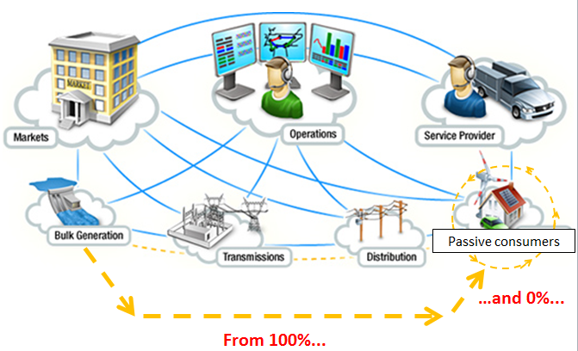
Passive consumers

Slide 26
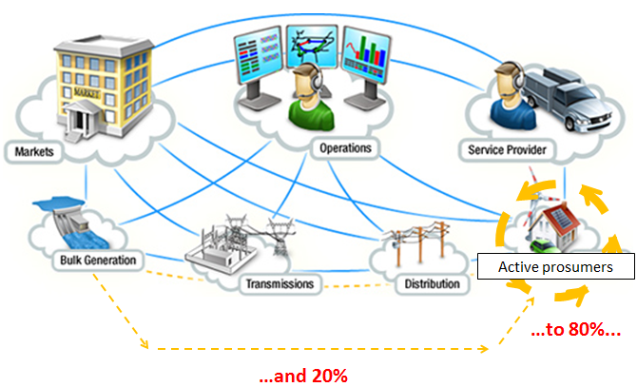
Active prosumers

Slide 27
What does it mean for a DSO to loose 80% of their grid rental charges ?

Slide 28
What does it mean for central energy producers to loose 80% of their revenues?

Slide 29
Decentralized renewable energy production and storage will soon revolutionise the energy sector.

Slide 30
New roles in the energy market:
prosumers, aggregators, SESP, ESCOs, …
Many new business models.
Energy companies will have to adapt
- or get swallowed by their competitors.

Slide 31
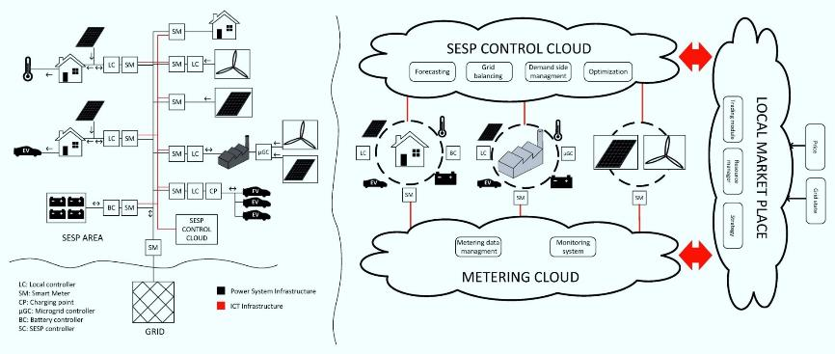
New local market model

Slide 32
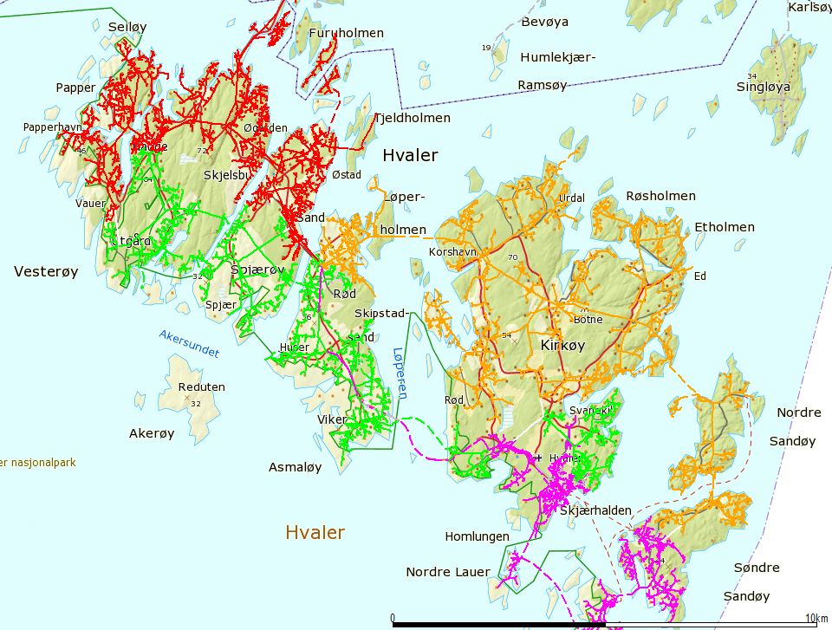
Hvaler
4 major islands
6 800 installasjoner med AMS
4.300 summer houses, where as 70 % of owners
live beyond the county.
50 kV radial supply
1 secondary station30 MW
18 kV HS nett (110 km air)
206 sub-stations

Slide 33
Smart Energy Hvaler
Co-operation between DSO, municipality and NCE
Norway's premier demo area for smart grids and local energy production
Part of several national and international Research projects (DeVID, FlexNett, ChargeFlex, EMPOWER, Mikro grid Sandbakken, m.fl)

Slide 34
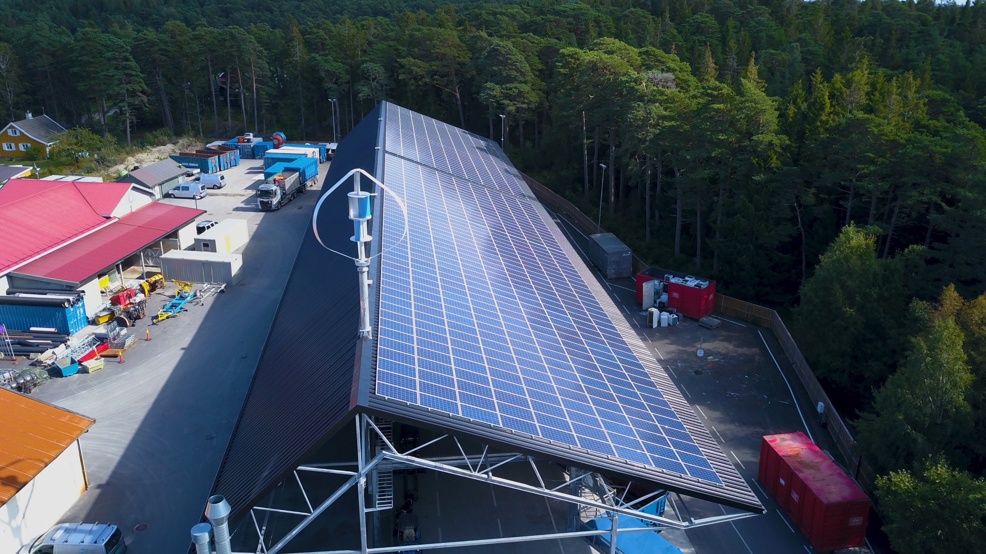
Sandbakken Mikrogrid - Hvaler

Slide 35
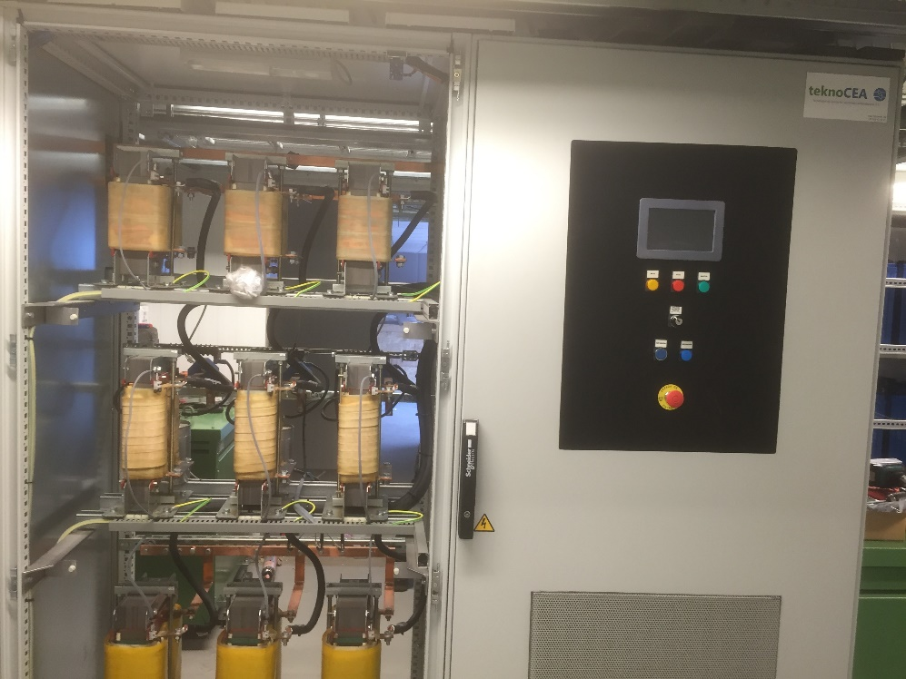
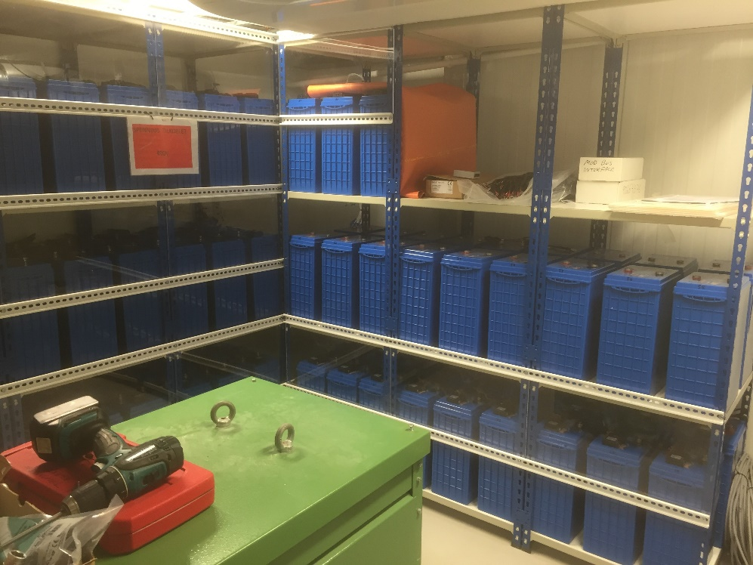
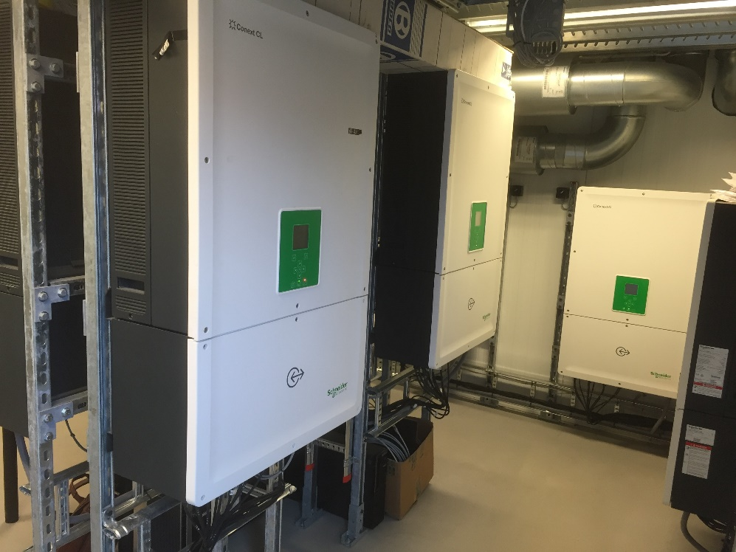
Mikrogrid Power Router

Slide 36
Minister of Petroleum and Energy Terje Søviknes

Slide 37
Empowering the Prosumer
INVADE Energy storage
16M€ 3 years
Intelligent control of energy storage in electric cars and batteries to strengthen mobile, distributed and centralized energy storage capabilities in the distribution grid
Objectives: Increase the share of renewable energy in the grid

Slide 38
NCE India energy delegation – Powergrid MoC
New Delhi 6.2.17

Slide 39
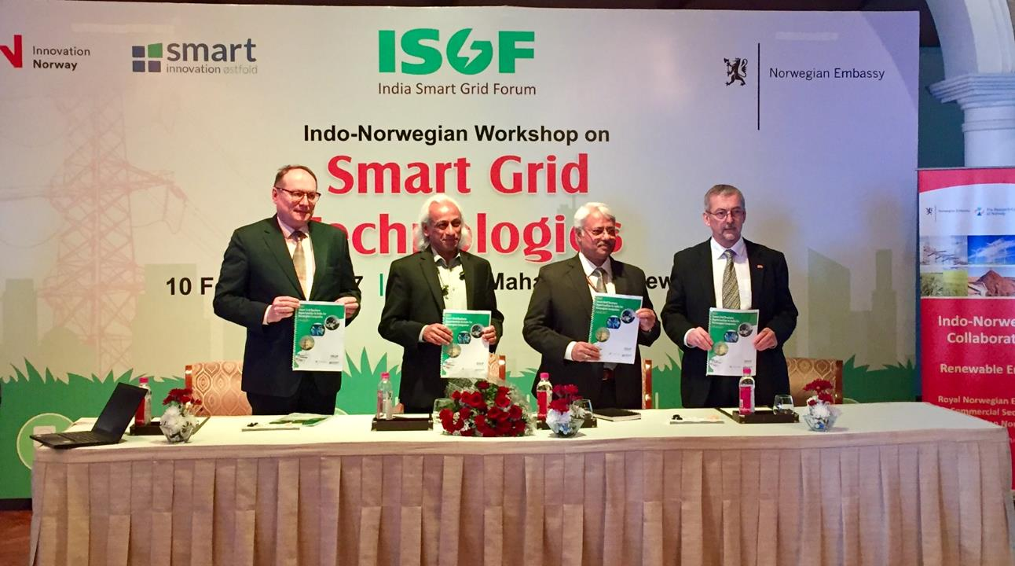
New Delhi 10.2.17

Slide 40
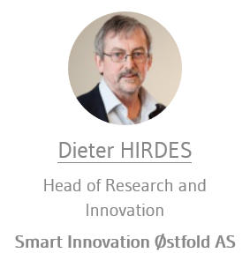
Brussel 20.6.17

Slide 41
Horizon 2020 Advisory Group on Energy (AGE)
Gives advice to the EU Commission on energy research
30 members from 28 countries
Meets 4-5 times per year
Prepares recommendations and reports
Digitalization of the energy sector is a central issue

Slide 42
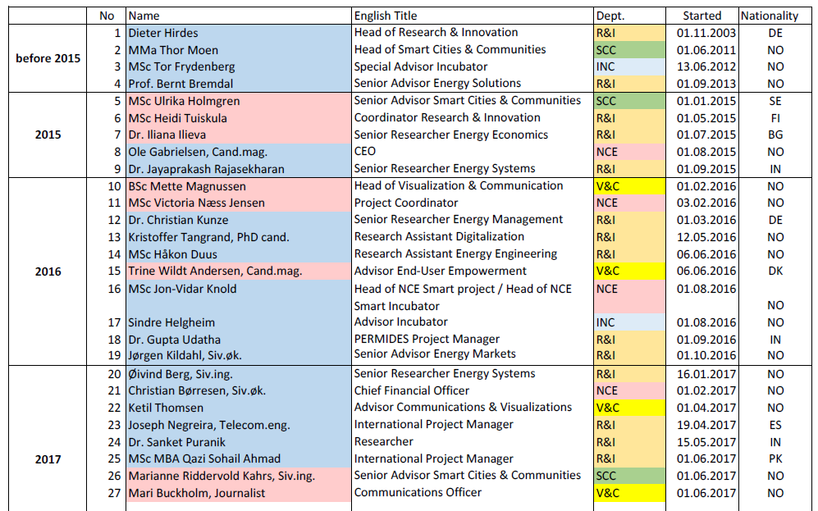
31 employees from 9 countries

Slide 43
Dieter Hirdes
Head of Research & Innovation
Member Horizon 2020 Advisory Group on Energy
Coordinator INVADE Horizon 2020 Project
Coordinator EMPOWER Horizon 2020 Project
m: +47 905 50 268
e: dieter.hirdes@ncesmart.com
www.ncesmart.com

