Slide 1
Annual Report – Videoconference
23 Oct 2014

Slide 2
Agenda
10:00 Project overview /goals Reidun Gangdal
10:10 Key achievements / problems of Year 1 Hai Ying Liu
Nuria Castell
Mirjam Fredriksen
Arne Berre
Josef Noll
Reidun Gangdal
10:30 Outreach to target groups / feedback Erol Cagatay
10:50 Planned activities for Year 2 Nuria Castell
Arne Berre
Josef Noll
Erol Cagatay
11:00 Comments on Interim Report / Deliverables Commission
11:30 Conclusions / Actions All

Slide 3
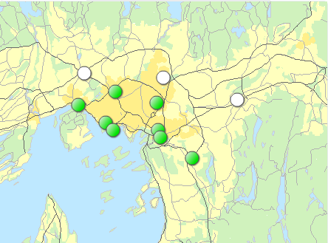
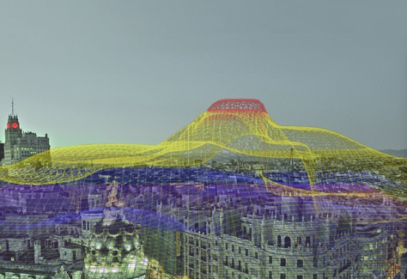
Citi-Sense-MOB vision
Important problems:
Opportunities and challenges:
The quality of life in cities is affected by the negative impacts of increasing traffic levels.
Large-scale air pollution measurement in urban environments
People who live, work and play near major roadways may experience health effects from traffic pollution.
New research conducted in 10 European cities has estimated that 14% of chronic childhood asthma is due to exposure to traffic pollution near busy roads.
More data, more noise but also more redundancy
Key challenges in public participation
Key challenges in information systems
Merge different types of information: from global (satellites) to street-level (sensors)
Few monitoring stations
No real-time data near-road
Air pollution model development
Policy making and urban planning
Transportation and air quality policies

Slide 4
The Citi-Sense-MOB consortium will..
…develop, test and demonstrate new mobile services that exhibit the potential for mobile technologies…
…to provide citizens and authorities with information related to environmental quality (air pollution/climate gas emissions) to support green growth in the Oslo area
Develop key end user mobile device applications
Develop and demonstrate innovative mobile services based on GMES and GNSS systems services from GEOSS
“Large-scale demonstrators in support of GMES and GNSS based services”
Sep 1st 2013 – Aug 31st 2015
Budget: 715,000 €

Slide 5
Partners
Beneficiaries | Major role
Kjeller Innovasjon | 1 Coordinator
NILU | 2 Air quality and tech. project lead
SINTEF | 3 IT infrastructure
UNIK | 4 Technical development
MOVATION | 5 App development
Suppliers
Ingenieros Asesores S.A.
ADN Context-Aware Mobile Solutions, S.L.
Target groups
Oslo Kommune RUTER Nobina

Slide 6
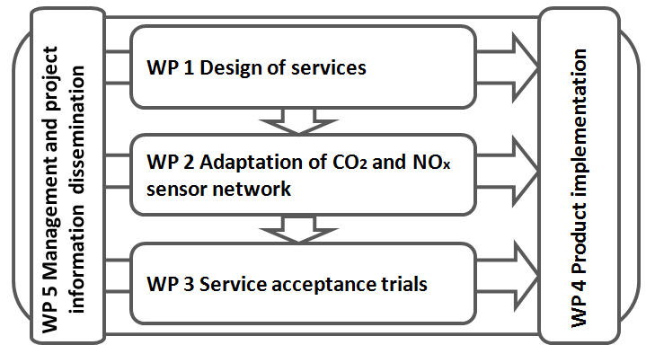
Project organization
WP 1: NILU
WP 2: NILU
WP 3: NILU
WP 4: SINTEF
WP 5: Kjeller Innovasjon

Slide 7
Key Achievements / Issues - WP1
Design of services
Overview of the system design, requirements, specifications and architecture for the COT
Exploring the COT (Citizen Observatory Toolbox):
The concept for COT
A set of COT (e.g., data, web apps, mobile apps, maps, services, methodologies, etc.)
Service design concept (i.e., use of ATONE –method for service design)
The COT target groups

Slide 8
Key Achievements / Issues - WP1
Key achievements
Submitted D1.1
Article on ‘Mobile technologies and services for environmental monitoring: The Citi-Sense-MOB approach’
Presentation on ‘Mobile technologies and services for supporting green mobility in Oslo: the Citi-Sense-MOB approach’ was given at Renewable Energy Research Conference (RERC), Oslo, 16-18 June, 2014

Slide 9
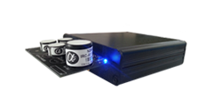
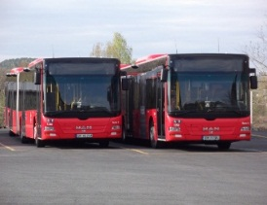
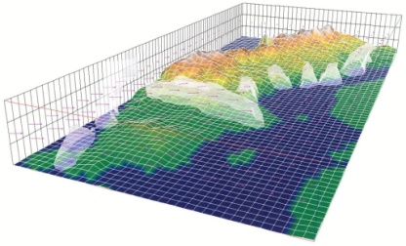
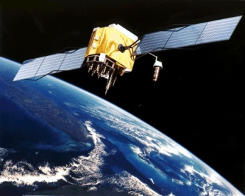
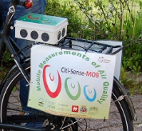
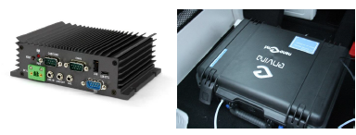
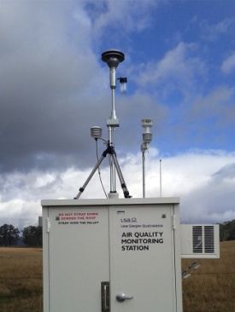
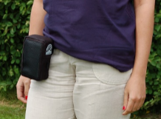
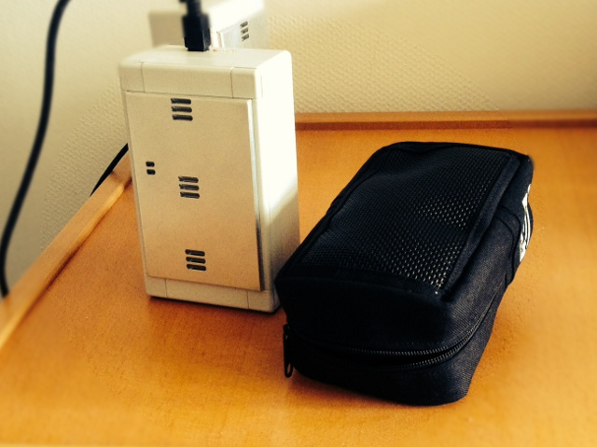
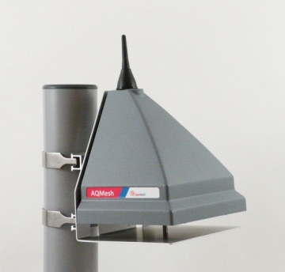
Key Achievements / Issues - WP2
Implementation and evaluation of low-cost sensors for monitoring the environment on mobile platforms.
Dunavnet EB700 (On bikes)
Environmental Parameters
CO, CO2, NO, NO₂, O₃, SO₂, Pre, T, RH
Power consumption
External supply of 8-28V DC
Communication
GPRS
UrVamm (On buses)
Environmental Parameters
CO, NO₂, T and RH
Power consumption
External supply of 12-24V DC
Communication
GPRS
Data Fusion
Ateknea PSP (personal)
Environmental Parameters
CO, NO2, O3, T and RH
Power consumption
Battery 3.7V LiPo 1300mAh
Communication
Bluetooth

Slide 10
Key Achievements / Issues - WP2
Key Achievements
D2.1 and D2.2 have been submitted
First road trials performed: bus, bike and personal
Implementation and laboratory calibration
Peer reviewed paper and talks in conferences
Issues
Pre-commercial units. 4 months delay in installation
Data communication problems with the bus installation

Slide 11
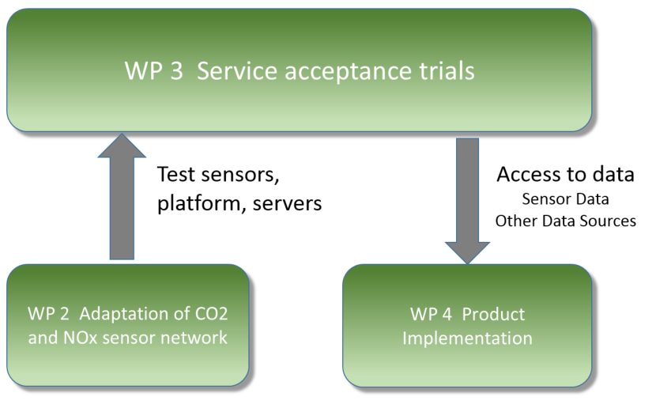
Key Achievements / Issues - WP3

Slide 12
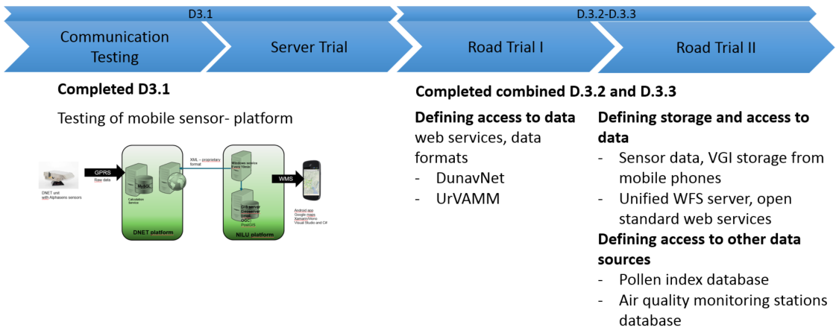
Key Achievements / Issues - WP3
Key achievements
Issues
Due to sensor and platform delays, D3.2 and D.3.3 combined and finished M13 (M4-6)

Slide 13
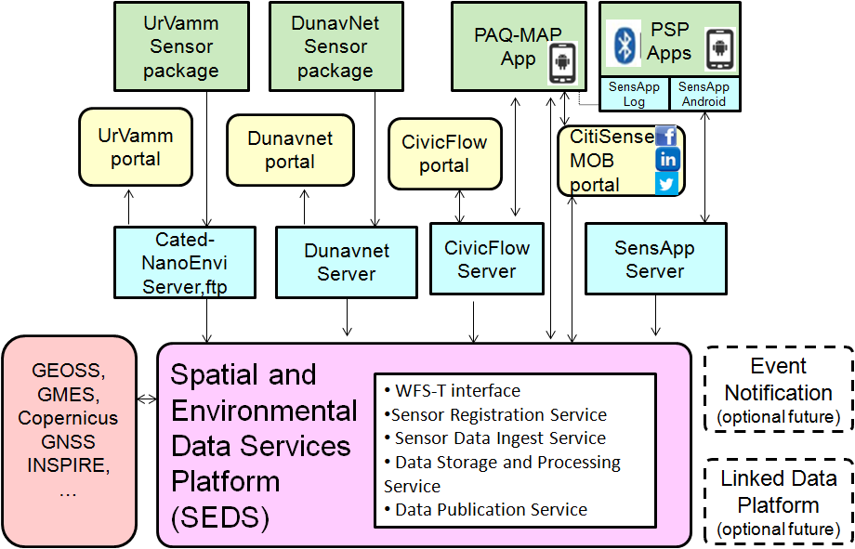
Key Achievements / Issues – WP4

Slide 14
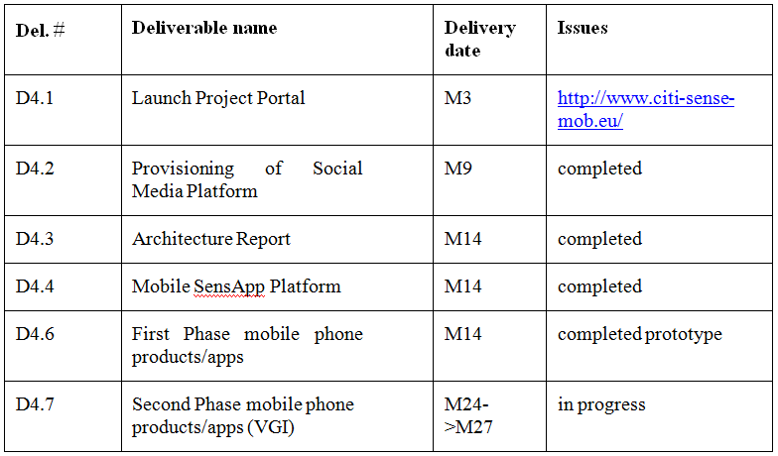
Key Achievements / Issues – WP4

Slide 15
Key Achievements / Issues - WP4
(Josef Noll)

Slide 16
Outreach to target groups
Bus ?
Bicycle
More personal due to
carrier involvement
On person
Interest
Groups
Local Government
Oslo Kommune
Others
Data User
Data Miners
App developers
End User
Kindergartens
Cyclists
Respiratory d.

Slide 17
Outreach to target groups
Activities
Meetings with focus groups
Oslo Kommune
Ruter/Nobina
Health consultants
Parking Wardens
Presentations
Renewable
OIW
Enviro
Media
NRK
Gemini magazine
OIW
Internet/Social media
Homepage
Facebook
Linkedin
Twitter

Slide 18
Planned activities for Year 2
NOV 2014
DEC 2014
JAN 2015
FEB 2015
MAR 2015
APR 2015
MAY 2015
JUL 2015
AUG 2015
Preparation for traffic wardens
Traffic wardens and cyclists
Possible bus installation
Workshop with Kindergartens
VGI work starts
Workshop with data miners/app developers
Distribution of more sensors
Test of new PM sensor
D 2.3
New app version distributed
Workshop with users
D 5.4
New app version distributed
D 4.5
D 4.7
INCREASING APP USE

Slide 19
Planned activities for Year 2
NOV 2014
DEC 2014
JAN 2015
FEB 2015
MAR 2015
APR 2015
MAY 2015
JUL 2015
AUG 2015
SEP 2015
OCT 2015
NOV 2015
DEC 2015
Preparation for traffic wardens
Traffic wardens and cyclists
Possible bus installation
Workshop with Kindergartens
VGI work starts
Workshop with data miners/app developers
Distribution of more sensors
Test of new PM sensor
D 2.3
New app version distributed
Workshop with users
D 5.4
New app version distributed
D 4.5
D 4.7
INCREASING APP USE

Slide 20
Planned activities for Year 2
(Nuria Castell)

Slide 21
Planned activities for Year 2
More sensors & data & VGI
App release
Social Media Integration & App feedback
Update of the App
Toolbox def. for developers and data users
Revisit target groups
Mapping target groups
Roadmap of novel services
Dissemination
Exploitation

Slide 22
Planned activities for Year 2
Discussions with other cities
Planned activities with Oslo Kommune
Reaching out to cyclists
Workshops with developers
Workshops/seminars for kindergartens

Slide 24
Comments on deliverables

Slide 25
Conclusions / Actions
(All)

