Slide 1
The history of digital Health in Tanzania and the improvement of quality health care
Bernard Ngowi
NIMR Tanzania

Slide 2
Introduction
90 per cent of the world’s population has access to mobile phone networks.
Of the world regions, the African mobile phone market has the highest growth rate.
The exponential increase in mobile phone use on the continent has inspired a new industry of health-related electronic applications and programmes for mobile phones, ranging from tools for data collection, public health education and communication, to specialized diagnostic tools.

Slide 3
Digital health
Digital health, also known as mHealth/eHealth, is the use of ICTs to improve human health, health systems, health services and wellness for the individuals and across populations.
Tanzania is setting the stage worldwide for integrating eHealth as a component of the national health system.
In 2009 the eHealth Community of Practice Group (CoP) was established as an official working group
In 2011, Tanzania began developing a global first –National mHealth Strategy.

Slide 4
Digital Health Tanzania Partnership
Innovative public-private-partnership, working closely with the Ministry of Health Community Development Gender Elderly and Children Tanzania, USG CDC, and numerous Tanzanian and international public and private sector partners
Convenes multiple sectors, combining expertise and resources to implement sustainable and scalable public health programs that leverage the booming mobile phone infrastructure in Tanzania

Slide 5
The partnership
Scale nationally, mobile-centric information solutions that leverage mobile phones primarily, as well as PCs, smart phones, the web, and fixed line phone
Work in concert with initiatives underway in the MOHCDGEC and COSTECH, including integration with the national enterprise architecture
Leverage expanding private sector interest in ‘digitalHealth’’ to develop long-term sustainable PPPs
Collaborate with other governmental and non-governmental implementing partners

Slide 6
Tanzania mHealth Community of Practice
Over 90 members from over 30 organizations across government, industry and non governmental sector
Co-chaired by Ministry of Health Community Development Gender Elderly and children and D-tree International
Quarterly meetings and 4 technical working groups
Share experiences and challenges and identify potential collaborations
http://groups.google.com/group/tanzania-mhealth

Slide 7
Notes:
Who is involved in mHealth in Tanzania

Slide 8
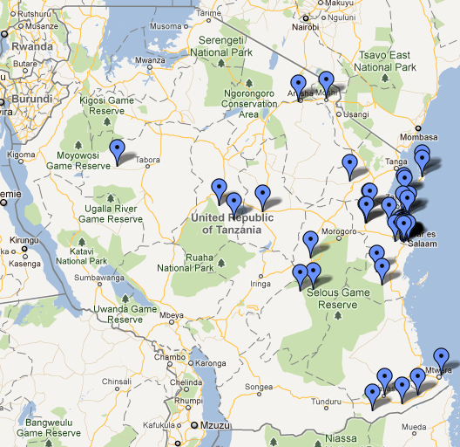
Map
Disease surveillance
Logistics
Telemedicine
Clinical decision support
Health messaging
Community Health workers
Mobile money
More!
Notes:
Where are mHealth projects in Tanzania

Slide 9
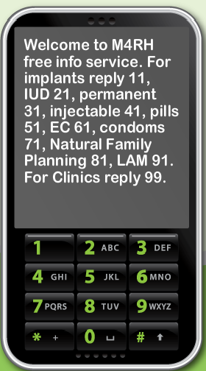
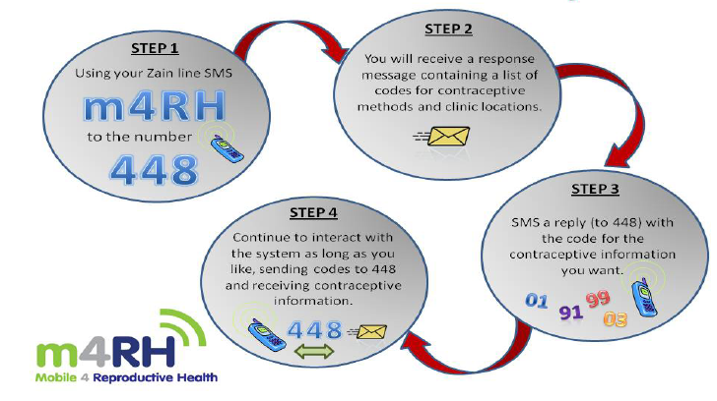
Direct to client communications

Slide 10
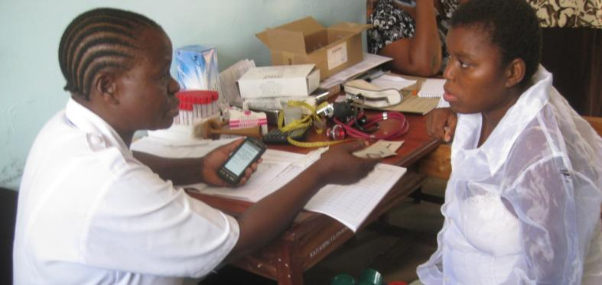
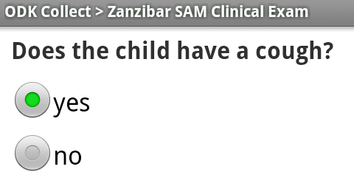
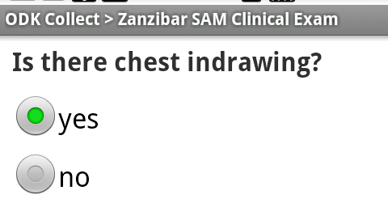
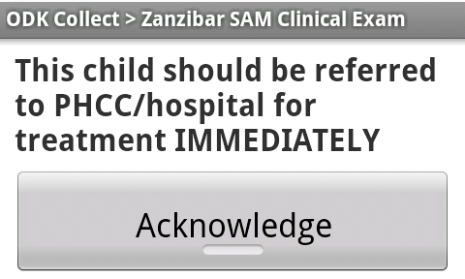
Clinical Decision Support

Slide 11
Integrated Disease Surveillance and response
Health facility workers report disease surveillance data by making a free call from the field using any mobile phone
Diseases reported follow WHO standards:
Diseases of Public Health Importance
Epidemic-prone Diseases
Diseases Targeted for Eradication / Elimination
Real-time SMS & email alerts are generated by the system for follow-up and action

Slide 12
Other reporting System uses by MOHCDGEC
Integrated logistics system (ILS)
District health Information System (DHIS2)
Care and treatment Clinic Database (CTC2)
Electronic Tuberculosis and Leprosy Reporting System (ETBLR) System (underdevelopment)
Electronic Medical record (EMR) (underdevelopment through funds from Bill and Mellinda)

Slide 13
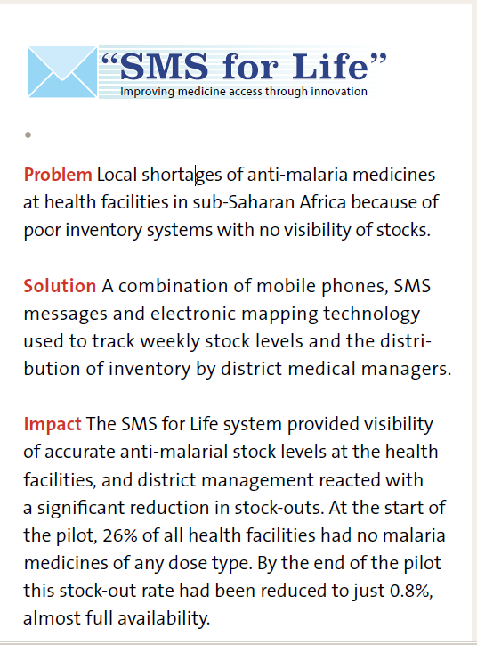
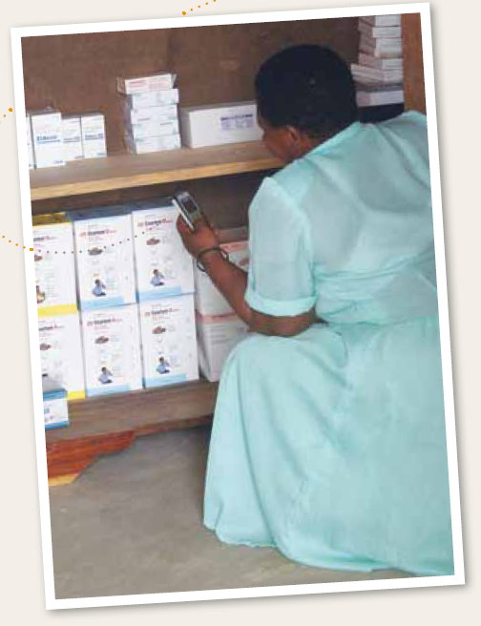

Slide 14
Example of ongoing Inspirational digitalHealth project
Since 2009, UNFPA in Tanzania has been partnering with Comprehensive Community-Based Rehabilitation in Tanzania (CCBRT) Disability Hospital on the Mpesa Fistula Ambassador Programme.
The project has been tremendously successful in increasing access by women suffering from fistula to life changing surgery at CCBRT. Using Vodacom’s M-PESA mobile-to-mobile banking technology, money is sent to women with fistula to cover the cost of their transport to CCBRT Disability Hospital in Dar es Salaam

Slide 15
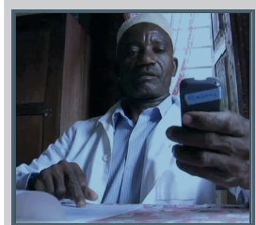
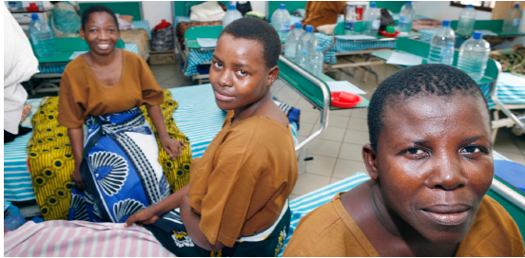
Mobile money to facilitate care
Notes:
Using M-PESA money transfer women from the poorest communities receive the funds for transport costs to hospital. Within an hour of referral, funds are sent via M-PESA to cover the families travel costs to hospital. On arrival the patient presents their ticket value and if correct the hospital forwards a $3.3 incentive payment via M-PESA to the referring doctor. Using this simple infrastructure the number of patients treated for obstetric fistula at CCBRT rose from 162 surgeries in 2009 to 268 surgeries in 2010, an increase of 65% in just one year. However, thousands of women continue to suffer.

Slide 16
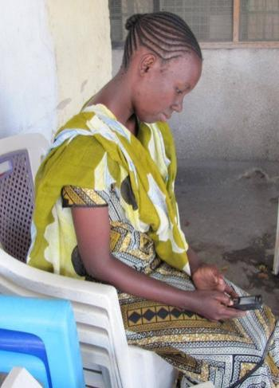
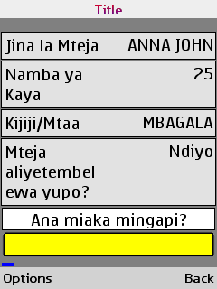
Community Health Workers
Over 250 HBCPs in Dar using mobile phones to provide care
Reminder option for pending referrals and visits to clients
Supervisors Update and reminders for overdue visits (SMS)

Slide 17
Tanzania National digital Health Vision
mHealth in Tanzania, driven by the general public, will improve healthcare outcomes throughout the nation. Specifically, mHealth will be:
Impactful
Sustainable
Scalable
Secure
Transparent
Coordinated
Innovative

Slide 18
Challenges Identified from other digital health interventions
Scale up
Lack of Data Standards/Interoperability
Trust
Knowledge Gap
Communication
Privacy and Security
Lack of private sector incentives
Infrastructure: power and network coverage
Funding
MoHSW Procurement
Human Resources Gap
Managing Collaboration
Phone Adoption

Slide 19
Tusen Takk
Ahsanteni

