Slide 1
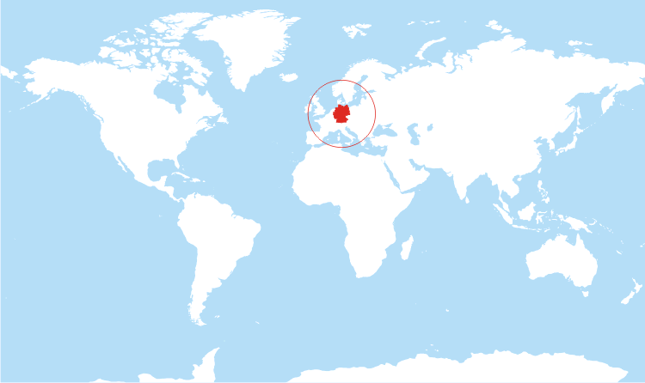
The Centres for Global Health Munich/Oslo

Slide 2
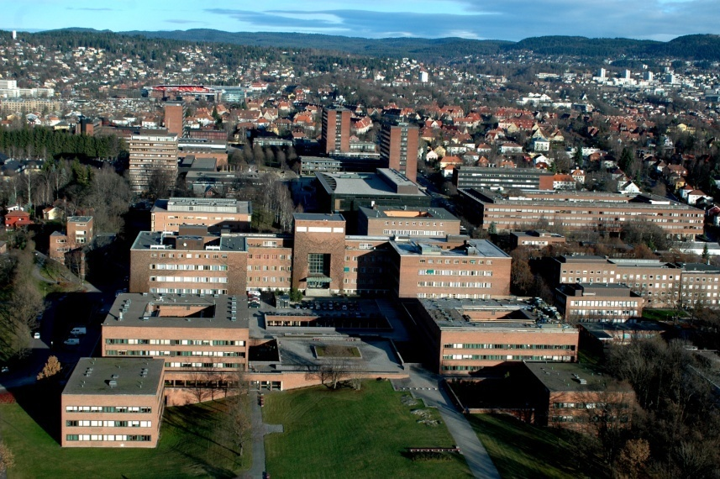
The University of Oslo
Founded in 1811
8 faculties & 2 museums
Strong track record of pioneering research & scientific discovery: 5 Nobel Prize winners
8 National Centres of Excellence
Strategic focus on research in the field of energy & life sciences
A non-profit research university, access to good public funding schemes
Extensive EU research project portfolio
800 courses in English, 40 Master’s degree programmes entirely in English & several PhD programmes
2016 for UiO
28 000 students
2954 PhD candidates
7000 staff
Notes:
The University of Oslo was founded in 1811 as the first university in Norway. UiO is the highest ranked institution of education and research in Norway and one of the World's Top 100 universities, according to the Shanghai World Ranking1. Today it is Norway’s largest public institution of research and higher learning with 8 faculties, 2 museums, 28 000 students, 7000 employees and an operating annual budget of NOK 6.6 billion. With five Nobel Prize winners, UiO has a strong track record of pioneering research and scientific discovery. As a classical university with a broad range of academic disciplines, UiO has top research communities in most areas. Moreover, UiO currently has eight National Centres of Excellence and a strategic focus on interdisciplinary research in the field of energy and life sciences in particular. As a broadly based, non-profit research university, UiO has access to good public funding schemes. Lab and office facilities, libraries and technical support are at the high end. UiO also has an extensive EU research project portfolio.
Since 2007 UiO has been awarded approx. 200 research projects funded by EU Framework Programmes. In Horizon 2020 UiO has been awarded 25 projects. The overall number of ERC grant-holders is 32. UiO offers more than 800 courses in English at all levels, around 40 Master’s degree programmes taught entirely in English and several PhD programmes. UiO focuses on research-based education and attracts highly qualified researchers and students nationally and internationally.
2016 Ranking¹:
67th: World
22nd: Europe
¹Shanghai World Ranking

Slide 3
Faculty of Medicine
Nationally Designated Research Centres:
Jebsen Foundation Research Centres
Cancer Stem Cell Innovation Centre
Cardiac Research Centre
Centre for Psychosis Research
Centre for Vaccine Research
Center for Cardiology Research
Centres of Excellence
Centre for Molecular Biology and Neuroscience (CMBN)
Centre for Immune Regulation (CIR)
Centre for Cancer Biomedicine (CCB)
Centre for Research Driven Innovation
Cancer - stem cell innovation center
Institute of Basic Medical Sciences
Institute of Clinical Medicine
Institute of Health and Society
Key figures for the Medical Faculty for 2016
2203 Registered students (1271 medical, 903 Master, 73% women)
1325 PhD candidates
190 PhDs graduating (63,7% women)
1386 academic staff
190 Technical + 288 Admin staff
2233 Scientific publications
753 Active research projects with external funding
Notes:
The Institute of Basic Medical Sciences has seven prioritized areas of research:
Biostatistics, epidemiology and modelling of biological systems
Cellular and molecular biology
Behavioural sciences
Organ physiology
Neuroscience
Nutrition science
Immunobiology
The Institute of Clinical Medicine
Closely integrated with Oslo University Hospitals (8 divisions) & Akershus University Hospital (3 divisions)
Together responsible for 60% of health and medical sciences research publications in Norway
The Institute of Health and Society
Research based masters program (Mphil)
Joint degree European Master in Health Economics &Management
Health Economics, Policy, &Management
International Community Health
Nursing Sciences
Health Sciences
Health Administration (MHA)
Home base for the Centre for
Global Health
Health management & economics (BS)
Finances 130 000 000 USD
Proportion of the budget funded by external sources 33 %

Slide 4
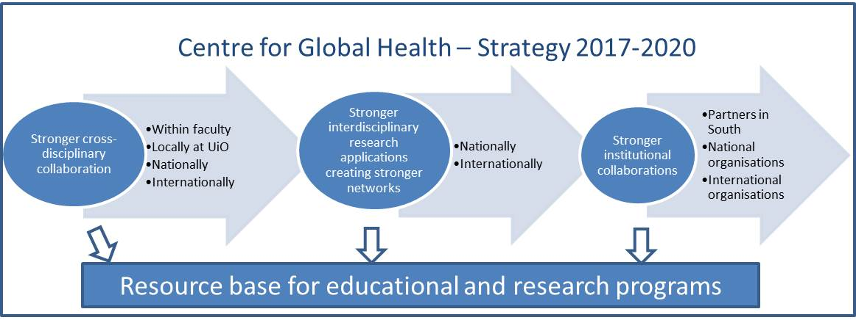
The Centre for Global Health, UiO
Sustainable Development Goals (SDGs)
Reconceptualising international and public health within the global context
Building an intellectual space for researchers working on global health
Notes:
Global Health is about worldwide improvement of health, access to quality treatment for everybody, reduction of inequity, protection against global threats and improvement of political stability.
It carries the legacy of public and international health, prioritising health outcomes, but also considers the interactions between health and global political, economic and environmental domains.
It transcends all areas of health disciplines including medicine (both humans and animals), social sciences, public health, environmental health, health system research, health economics, policy making and global governance
Success and progress in the field of Global Health presents new challenges at national and international levels, requiring the skills and knowledge of these interdisciplinary teams.
CGH formally established at the UiO in 2014/15, but quite dormant until a year back when the UiO recruited the Director and the Coordinator externally.

Slide 5
Strategic areas
Non-communicable diseases
Global mental health
Mother and child health
Infectious diseases
Nutrition
Migrant health and social inequalities
One-health
Digital health
Health systems and global governance
Contemporary history and anthropology Education in global health
Global Paediatrics

Slide 6
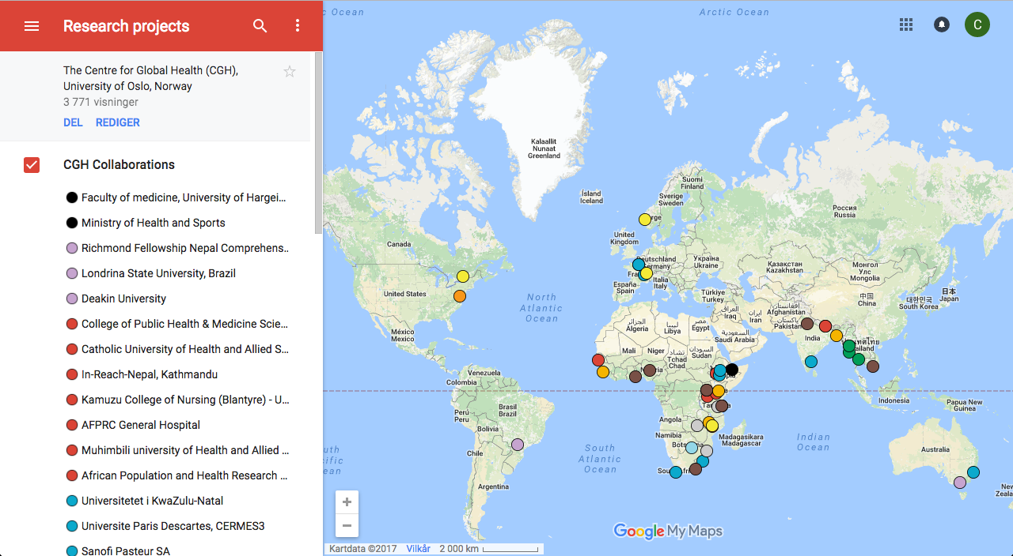
Centre for Global Health, UiO research (Google link)

Slide 7
Why collaborate with the CGH, UiO?
Access to relevant and updated information
Entry to a centralised Global Health hub
Platform for creating collaborations across various disciplines
Information on comprehensive funding opportunities in Global Health
Support for interdisciplinary proposal writing
Support for organizing seminars and conferences
Dissemination through CGH channels

Slide 8
Some of our affiliations
NORWAY
Norwegian Research School of Global Health
Peace Research Institute Oslo (PRIO)
Norwegian Forum for Global Health Research
Norwegian Institute of Public Health (FHI)
Basic Internet Foundation
EUROPE
Department of Mental Health and Substance Abuse, WHO
Department of the Control of Neglected Tropical Diseases, WHO
Institute of Tropical Medicine, Antwerp, Belgium
Department of Veterinary Disease Biology, University of Copenhagen, Denmark
Global South
University of Public Health, Myanmar
Muhumbili University of Health and Allied Sciences, Tanzania
Sokoine University of Agriculture, Tanzania
University of Hargeisa, Somaliland
Eduardo Mondlane University, Mozambique
University of Zambia, Zambia
Capetown University, South Africa
Stellenbosh University, South Africa

Slide 9
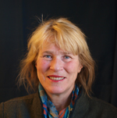
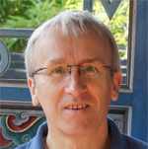
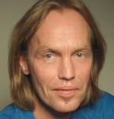
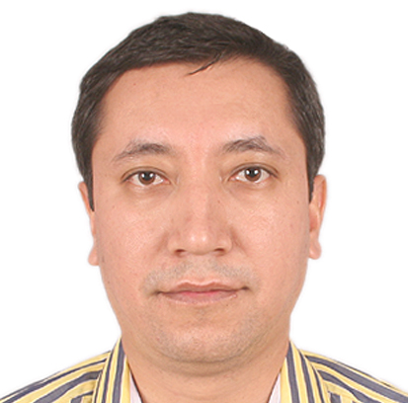
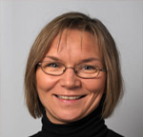
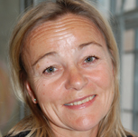
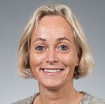
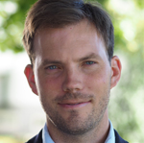
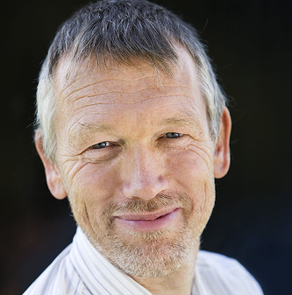
CGH core group & implementation
Prof. Andrea Winkler, Head of the CGH
Ingeborg Haavardsson, Coordinator
Prof. Johanne Sundby, Inaugural / deputy head;
Maternal & child health
Prof. Christoph Gradmann, Strategic Advisor;
Contemporary history & anthropology
Signatory theme leaders
Prof. Espen Bjertness,
NCDs
Assoc. Prof. Suraj Thapa,
Mental health
Prof. Nanna Lien,
Nutrition
Prof. Britt Nakstad,
Paediatrics
Assoc. Prof. Bernadette Kumar,
Migrant health & social inequalities
Prof. Anna Margarita Dyrhol Riise,
Infectious Disease
Assoc. Prof. Trygve Ottersen,
Health systems & global governance
Prof. Josef Noll,
Digital health
Notes:
The Institute of Basic Medical Sciences has seven prioritized areas of research:
Biostatistics, epidemiology and modelling of biological systems
Cellular and molecular biology
Behavioural sciences
Organ physiology
Neuroscience
Nutrition science
Immunobiology
The Institute of Clinical Medicine
Closely integrated with Oslo University Hospitals (8 divisions) & Akershus University Hospital (3 divisions)
Together responsible for 60% of health and medical sciences research publications in Norway
The Institute of Health and Society
Research based masters program (Mphil)
Joint degree European Master in Health Economics &Management
Health Economics, Policy, &Management
International Community Health
Nursing Sciences
Health Sciences
Health Administration (MHA)
Home base for the Centre for
Global Health
Health management & economics (BS)

Slide 10
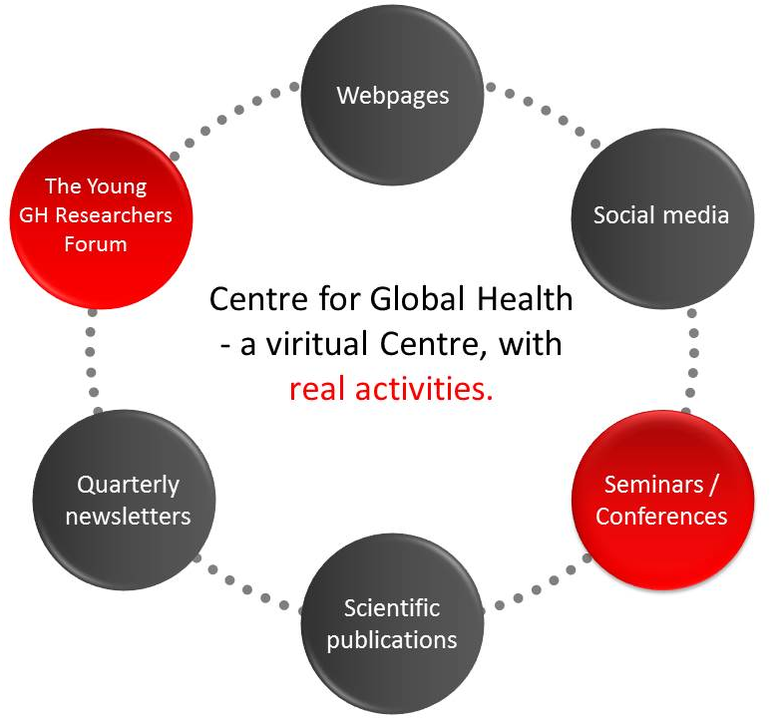
Communication

Slide 11
Technical University of Munich
14 Faculties
172 Degree Courses
40 100 Students, 34% female, 24% international
8 900 Graduates per year
1 000 PhD Theses per year
Milestones
1877 "Technical University"
1967 TUM School of Medicine, University Hospital
1970 Presidential Constitution, "Technische Universität München"
2002 TUM Branch in Singapore: TUM. Asia Pte. Ltd.
2005 TUM Institute for Advanced Study (IAS)
TUM elected "University of Excellence" TUM International Graduate School of Science and Engineering (IGSSE)
2009 TUM School of Education / TUM Graduate School
2010 TUM University Foundation / Munich School of Engineering (MSE)
2012 TUM again elected "University of Excellence“ / Munich Center for Technology in Society (MCTS)
2014 Hochschule für Politik München – Bavarian School of Public Policy
2015 Munich School of Bioengineering

Slide 12
Students by Departments

Slide 13
Excellence Initiative
Organized by the German federal &
state governments
Enabling universities to realise cutting-edge research projects & to raise their profile in the international science community
2006: institutional strategy “TUM. The Entrepreneurial University”
cutting-edge research (TUM Institute for Advanced Study)
encouragement of up-and-coming young scientists
culture of entrepreneurship
2012: “TUM. Talents in Diversity” strategy
to attract elite international scientists to strengthen TUM’s status as a technical research & teaching hub
Health & Nutrition • Energy & Natural Resources • Environment & Climate • Information & Communications • Mobility & Infrastructure
Set up of TUM’s Integrative Research Centers & Faculty Tenure Track career system
Set up of TUM’s International Graduate School of Science and Engineering & TUM Graduate School
Notes:
Organized by the German federal and state governments, the Excellence Initiative aims to strengthen Germany’s research landscape for the long run. Thanks to Excellence Initiative funding, universities can make cutting-edge research projects a reality and raise their profile in the international science community. The program supports activities in research and teaching that will enhance Germany’s overall performance in science and higher education and thus its international competitiveness.
The Excellence Initiative was launched in 2005 and is jointly run by the German Research Foundation and the German Council of Science and Humanities. There are two rounds of funding: 2006/07-2012 and 2012-2017. Total funding for the first-round projects was 1.9 billion euros. The budget for the next five years will amount to 2.7 billion euros.
The Excellence Initiative focuses on three lines of funding: “Graduate Schools," “Clusters of Excellence,” and “Institutional Strategies." The latter provides for the project-related buildup of top-level university research. The title “University of Excellence” is awarded to universities that have successfully established at least one Cluster of Excellence, at least one Graduate School and a promising “Institutional Strategy."
Number of projects funded for the period 2012-2017:
45 Graduate Schools
43 Clusters of Excellence
11 Institutional Strategies
Number of projects funded for the period 2006/07-2012:
39 Graduate Schools
37 Clusters of Excellence
9 Institutional Strategies
TUM Faculty Tenure Track
TUM has launched a paradigm shift in Germany’s higher education sector by replacing the traditional appointment system with an end-to-end career system. This gives young scientists the opportunity to progress from assistant professors (W2) to associate professors (W3) and full professors within six years. To be eligible for this Tenure Track system, candidates normally must have postdoctoral research experience outside Germany. To climb up the career ladder, candidates must undergo evaluations based on strict quality criteria. By the year 2020, TUM will create 100 additional Tenure Track professorships, opening up promising opportunities to the most talented and driven individuals.

Slide 14
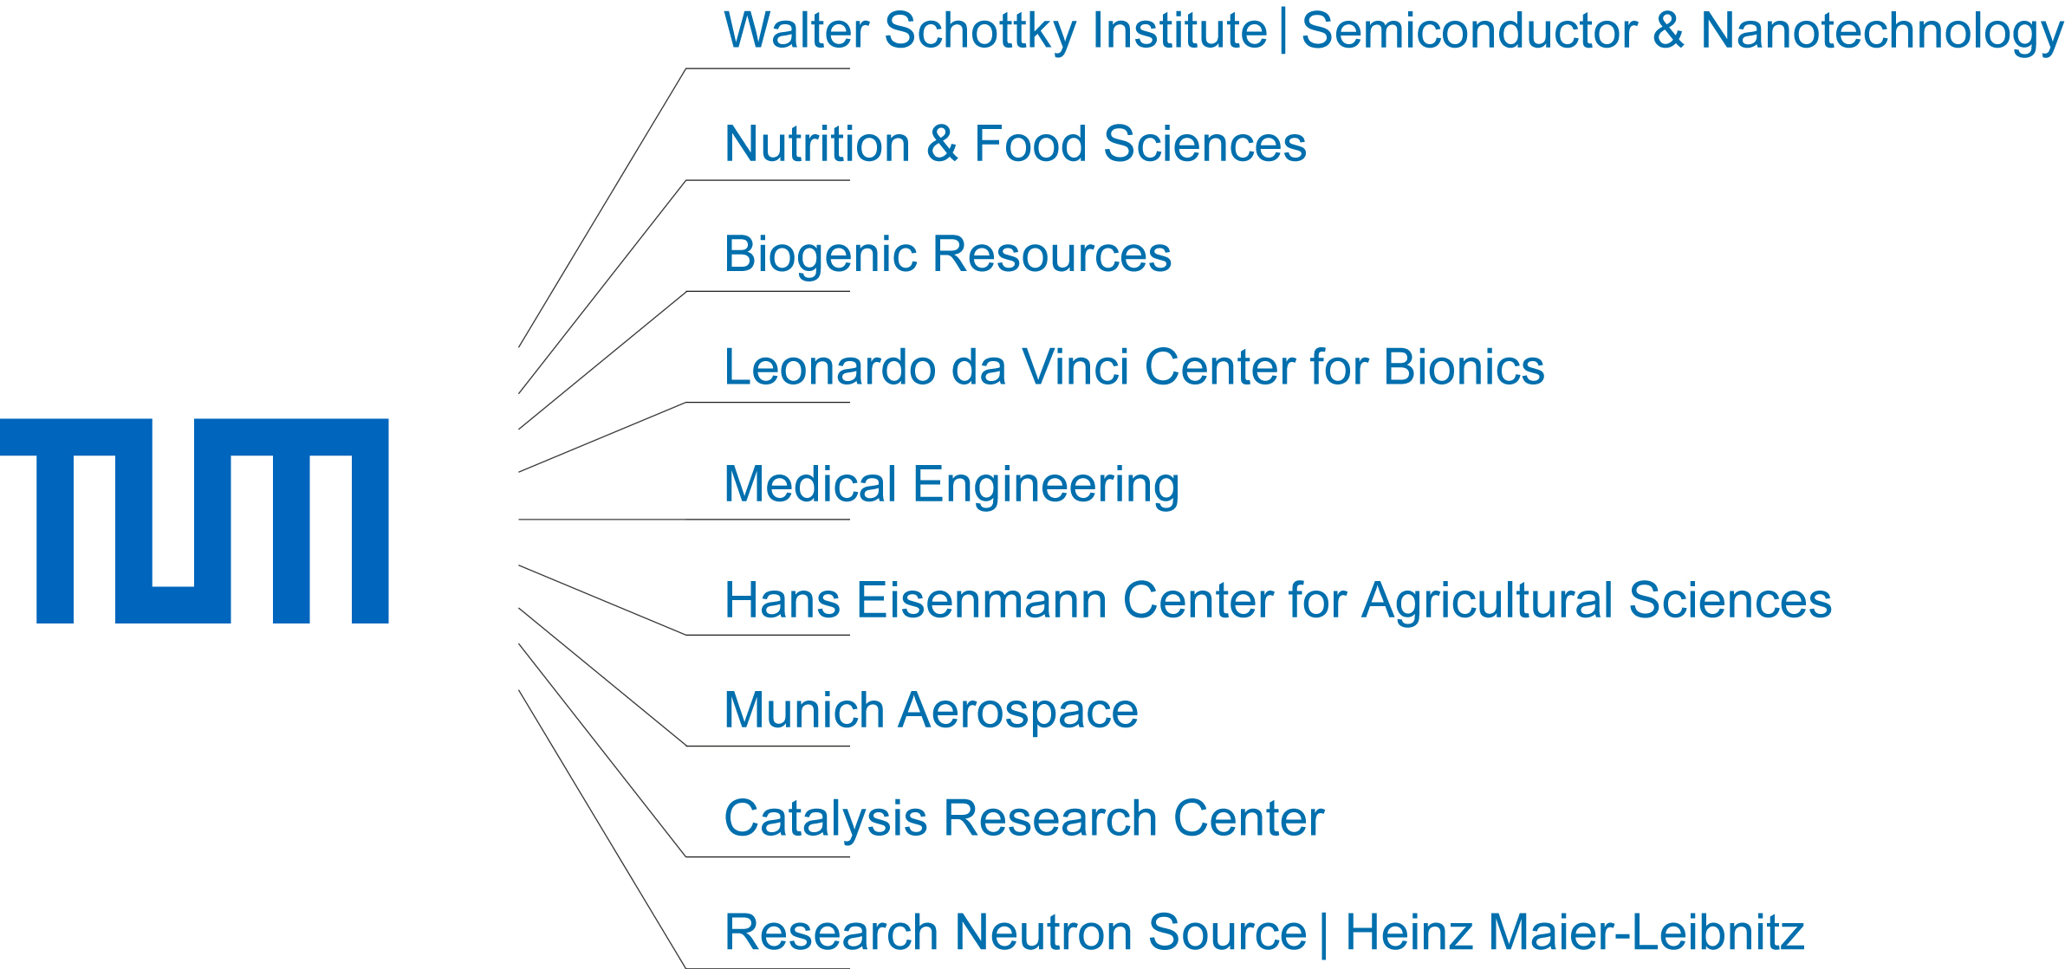
Integrative Research Centers
Interdisciplinary Research & Teaching
symbiosis of scientific cultures
themed education and research centres
societal challenges
(e.g. energy research)
integrating master and PhD programs
(TUM Graduate School)
Notes:
Munich School of Engineering
Research-Oriented Teaching
Engineering Science BSc
Industrial Biotechnology MSc
Human Factors Engineering MSc
Research
Power Generation Technologies
Energy-Efficient Building
Power Storage
Renewable Energies
Electromobility
MCTS
Research-Oriented Teaching
Philosophy of Science & Technology MA
Science and Technology in
Technologized Societies MA
Research
Water, Land, Biodiversity
Plant Biotechnology
Neurotechnologies
Risk & Security
Robotics
Public Dialogue
IAS
Benchmark for Scientific Excellence Catalyst for International Alliances Stimulus for Frontier Research Initiatives
Actively connecting:
Young Talent - Senior Experience
Munich - World
Academia - Industry

Slide 15
TUM.Global
Notes:
Global Tech
Founded in 2009, the Global Alliance of Technological Universities is a network of the world’s leading technological universities. As Germany’s foremost technical university TUM was admitted to the alliance in 2013 and has held the presidency since 2015.
The Alliance addresses global societal issues to which science and technology could offer solutions. These issues include biomedicine and health care, sustainability and global environmental change, security of energy, water and food supplies, security, and changing demographics.
The TUM Global Incentive Fund supports TUM scholars and scientists in exploring and intensifying new and existing international cooperations within the GlobalTech Alliance.
EuroTech
In 2006, TUM founded the EuroTech Universities Alliance together with the Technical University of Denmark (DTU). Today, the Alliance is a strategic partnership of four leading European universities of science and technology:
Danmarks Tekniske Universitet (DTU)
Technische Universiteit Eindhoven (TU/e, seit 2008)
École Polytechnique Fédérale de Lausanne (EPFL, seit 2011)
Technische Universität München (TUM)
Together they are committed to finding technical solutions which address the major challenges of modern society. Their intensive collaboration across research, education and innovation support the EU’s goal of smart, sustainable and inclusive growth.
At each of the EuroTech Universities, funding is available for the initiation of new collaborative projects with the Alliance partners. At TUM, the TUM Global Incentive Fund supports initiatives that further strengthen and develop the collaboration between the partners and actively engage the joint office in Brussels.

Slide 16
Medical Faculty
Enrolled students: over 1.500 (approx. 2/3 female & 1/3 male)
5.2% of total number of TUM students (2015)
Professorial positions: 46 chairs and 38 extra chairs
Academic staff: over 1.200
Other staff: over 2.800
Organizational units: 24 clinics, 6 independent departments and 18 institutes (10 of that belonging to TUM)
TUM School of Medicine, together with the university hospital, is one of the strongest medical research locations in Germany
The guiding principle for its future is a results-oriented synergy of
research
teaching
patient care

Slide 17
Center for Global Health
Founded: 2017
Structure: university-wide centre for integrative research and teaching
Team: Co-Directors: Prof. Dr. Dr. Andrea S. Winkler; Prof. Dr. med. Clarissa Prazeres da Costa
Coordinator: Katharina Klohe, MSc.
Vision: - to contribute to positive change in the world by addressing global health challenges in an interdisciplinary way
- to foster novel research approaches & the training of the next generation global health leaders
Topics: to reflect the strengths and expertise already present at TUM, such as NTDs, climate change and health, governance, AMR
Teaching: establishment of a Masters programme and PhD Programme

Slide 18
DigI work in Tanzania - update
Overall Question: Can digital health intervention strengthen weak health systems in resource poor settings?
Aim:
- To design, implement and assess digital health interventions to improve the knowledge/attitude/perception (KAP), health-seeking behaviour.....of people suffering from T. solium taeniosis/cysticercosis, HIV/AIDS, TB and Anthrax in the selected villages in Tanzania.
-To produce the customized content for the health messages and to make a plan for rolling out the T. solium taeniosis/cysticercosis, HIV/AIDS, TB and Anthrax health messages. (Protocol, March, 2017)
Notes:
: Increase awareness on One Health to 80% in risk population from identified priority zoonotic diseases areas at all levels, by June, 2020. Agreed in March

Slide 19
Activities started (September 2017 – Dr. Sukums)
Site visit to Izazi and Mtera
Revision and adaption of the project protocol to fit Tanzanian context
Negotiation with Internet service providers/Telecom operators
Preparation of health education materials
Adaption of health education materials to mobile apps and text messages
Monthly meetings (Gotomeeting)

Slide 20
DigI Health research activities
Systematic review of digital health platforms in Africa
The project protocol - revision and adaption
Design (longitudinal or randomized controlled trials)
Intervention (exact definition; maybe different interventions a) conventional teaching, b) InfoInternet)
Outcomes (only KAP or also behavior change)
Diseases (all four or should we focus on two)
Health messages (which format?)
How do we avoid contamination?
Application to Regional Ethics Committee
Review of health education materials of chosen diseases

Slide 21
DigI Health research activities
Production of content to InfoInternet
- Streamline the content
One-page written in English and local language
Voice and illustrations for the illiterate
Animation for children / others
Design of research tools (questionnaires etc)
Performance of the study
Baseline investigations
Randomization
Intervention (definition of what exactly this would be)
Post-intervention examinations

Slide 22
DigI - Activities to come (Sept, 2017 – Dr. Sukums)
1. Finalization of the protocol
2. Preparation of detailed/revised work plan and budget
3. Application for ethical clearance
4. Approval of health educational materials
5. Finalize the negotiation with Internet service providers/Telecom operators
6. Baseline surveys
a) To establish availability of network connectivity,
b) To establish knowledge and practice with regards to the diseases mentioned above
c) To understand knowledge in the population on the use of digital health
7. Implementation of the mobile apps for the project
8. Monitoring and evaluation

Slide 23
DigI Health research – upcoming milestones
Finalization of the protocol
Approval of health messages
Ethical approval in Norway – REK
Baseline studies in TZ
Monitoring and evaluation of the Pilot A
RCT in Tanzania
DigI Health research – clarifications needed
Any students in Tz? If so, who?
Publications – we should start now (joint publications on digital health)
What is meant by platform? The challenges of multidisciplinary work…
What exactly is the InfoInternet?
Trial design
Financing of the trial?

