Slide 1
Presentation Video WIFI
SD 4:3 640x480p : 307200 pixels (~0.3 MP) per frame -> compressed -> 2 - 5 Mb/s
HD 16:9 1280×720p: 921,600 pixels (~0.92 MP) per frame -> compressed -> 5 – 10 Mb/s
Compression
H.264

Slide 2
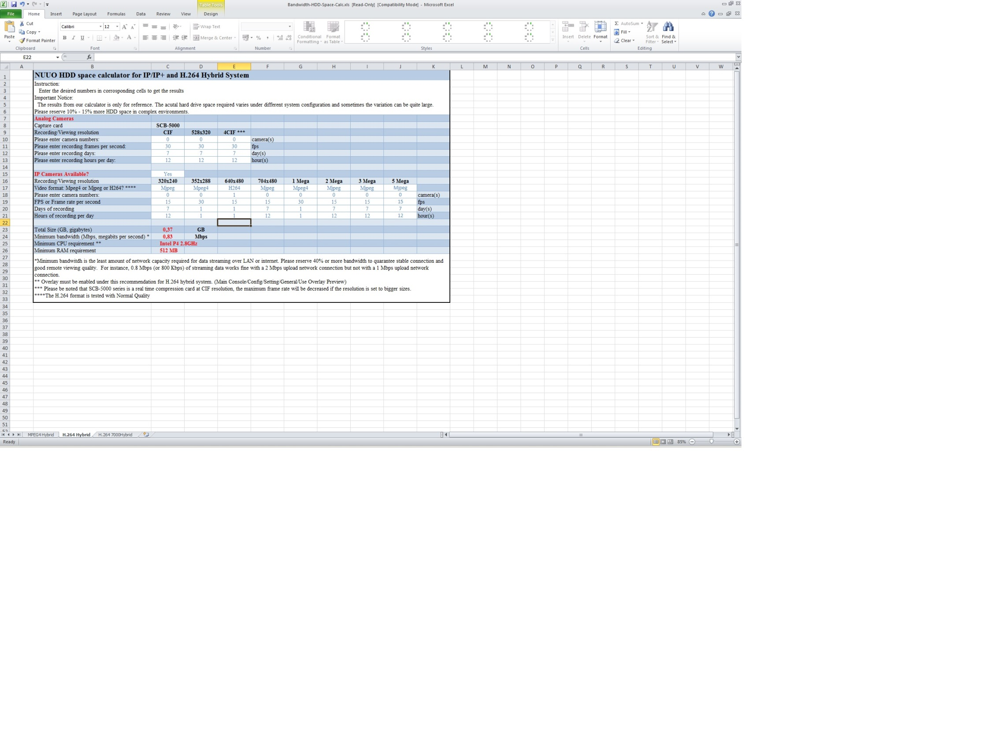

Slide 3
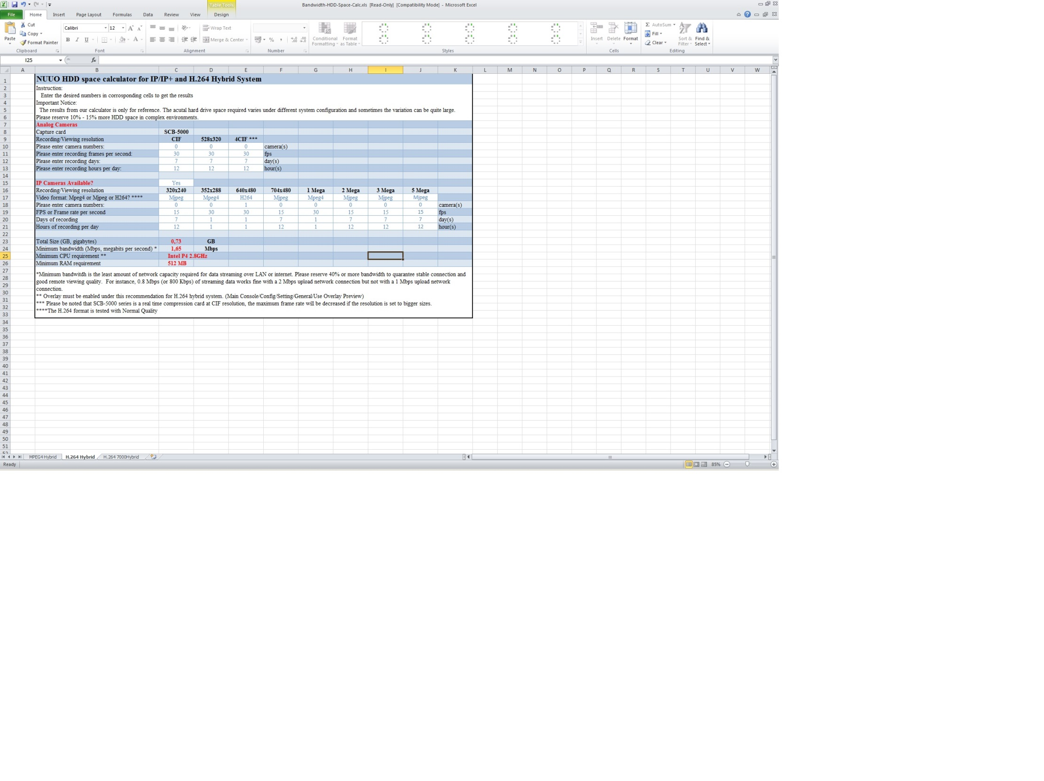

Slide 4
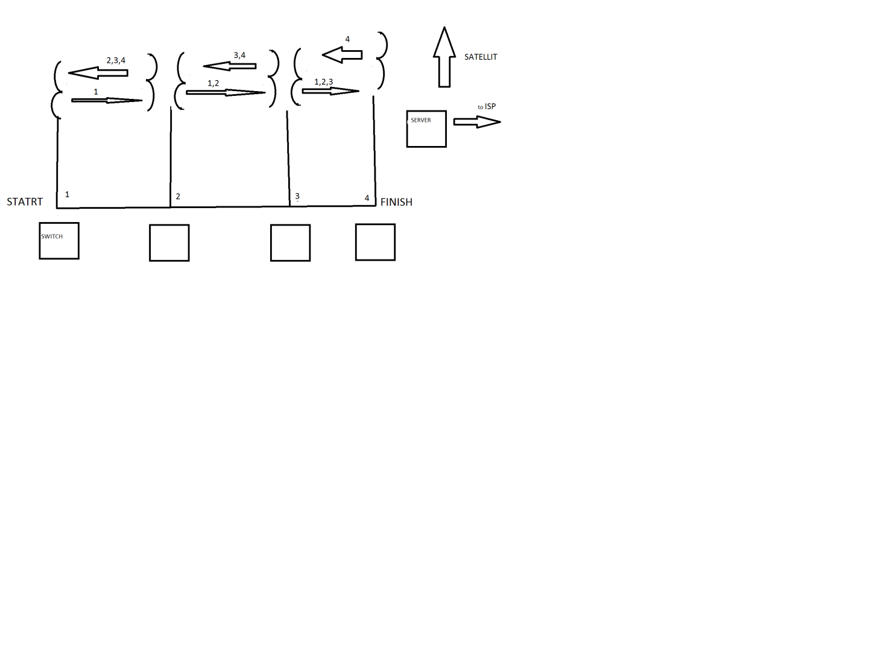
1.3 Gbs+
24 GHz
1,2’,3,4,
1,2,3’,4
1’,2,3,4
2km – 14dBi ant.
1,2,3,4’
WIFI AP
AP
2,4GHz
3 non overlap. channels
Active user range ~ 200 m
back to AP

Slide 5
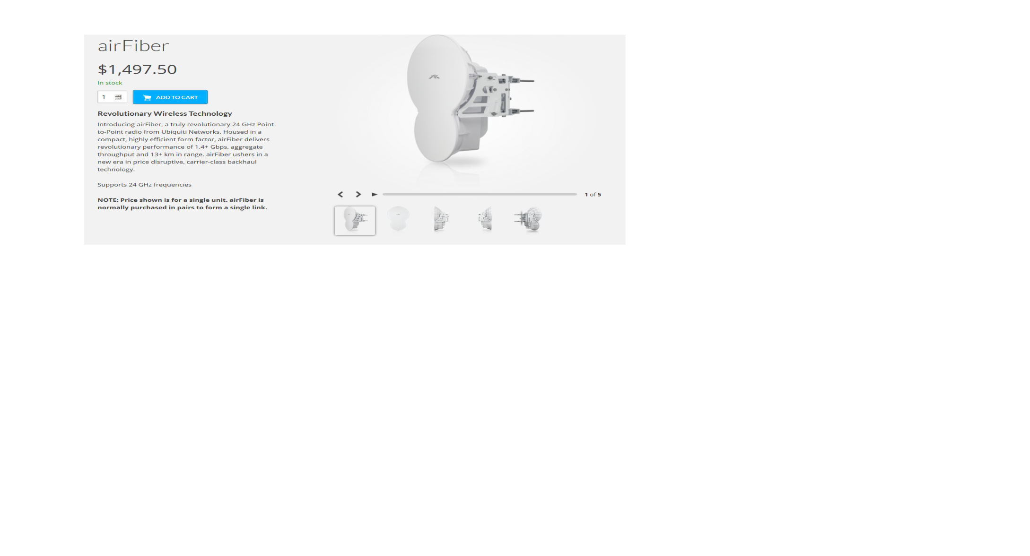
Operating Frequency | 24.05 – 24.25 GHz
Data Port | (1) 10/100/1000 Ethernet Port
Maximum Throughput | 1.4+ Gbps
Maximum Range | 13+ km
TX Gain | 33 dBi
RX Gain | 38 dBi
Beamwidth | < 3.5°
Front-to-Back Ratio | 70 dB
Polarity | Dual-Slant Polarization
Cross-Polarity Isolation | > 28 dB

Slide 6
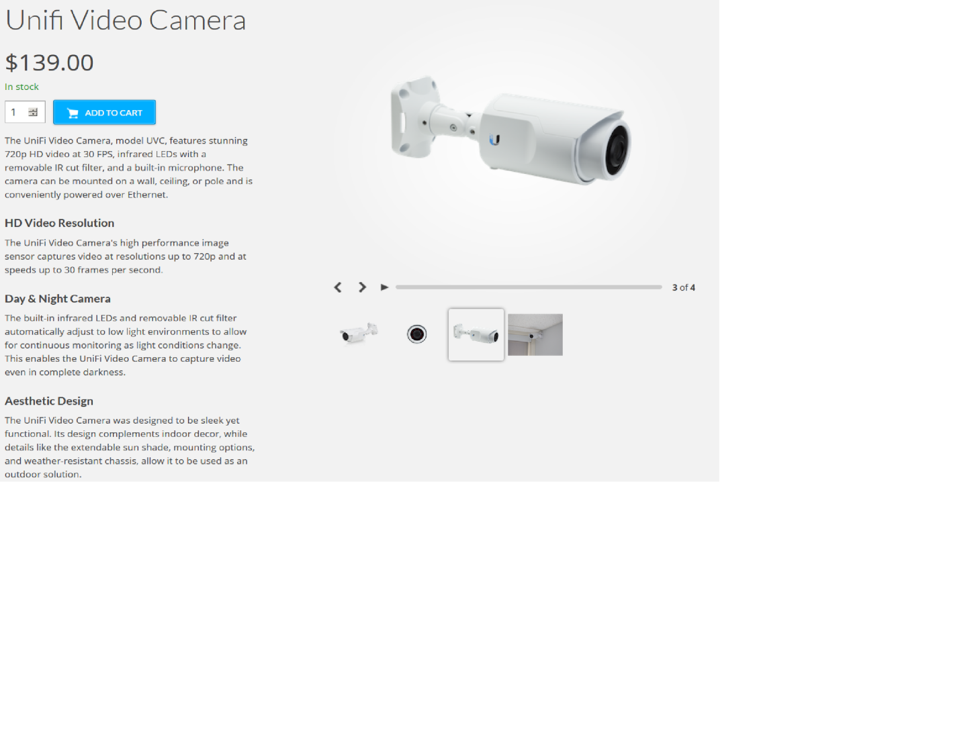
Video Compression | H.264
Resolution | 720p HD (1280 x 720)
Maximum Frame Rate | 30 FPS

Slide 7
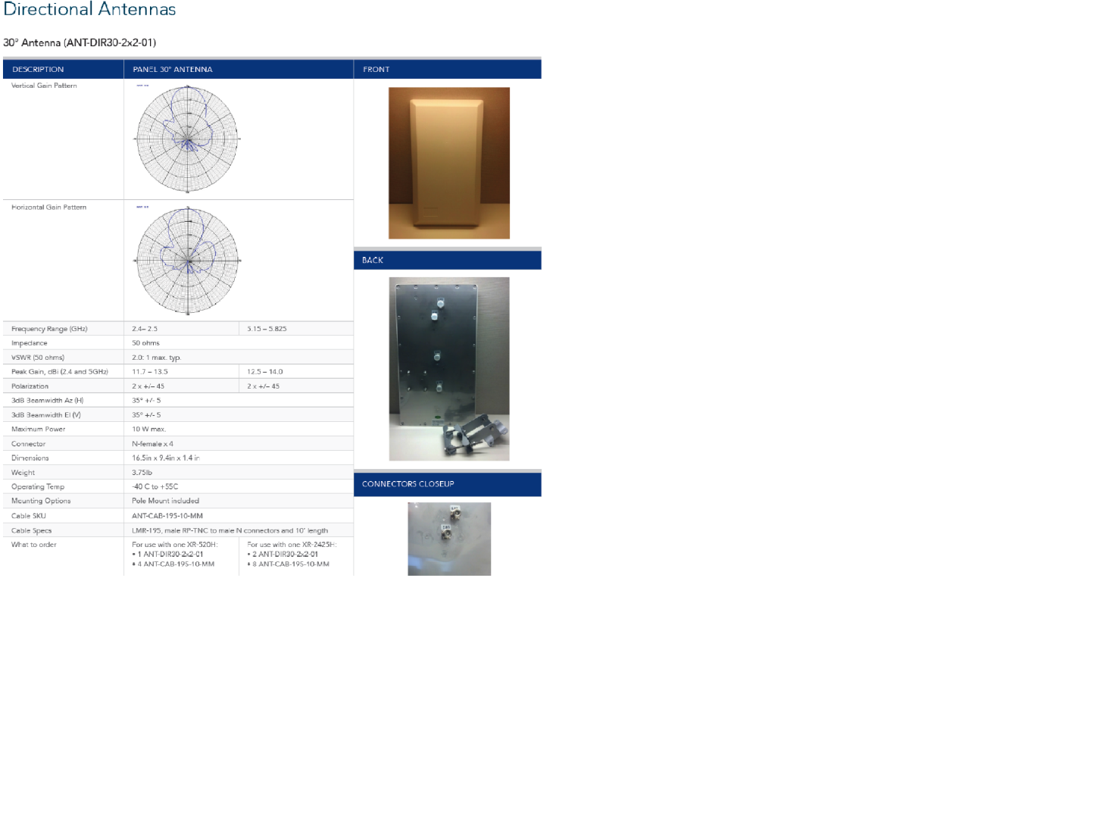

Slide 8
