Slide 1
Wireless Machine-to-Machine Communications in Industrial Environments
Stephen S. Kimogol

Slide 2
Machine to Machine
Machine-to-Machine (M2M) - no human intervention whilst devices are communicating end-to-end.
Machine - sensors and actuators
To – facilitates end-to-end connectivity between machines(network).
Machine – extracts, process and display information.

Slide 3
Wired M2M
Wired technologies have matured over the years and are widely used in M2M communication.
Wired technology is more traditional and widely used due to its robustness and availability.
Used especially in critical environments where security or explosive hazards must be considered
static in their setup, costly to change, and demanding infrastructures and topologies

Slide 4
Wireless M2M
cost-effective and seamless to install and operate
ubiquity: with wireless M2M, the position and status of anything processed in the factory is known at every stage

Slide 5
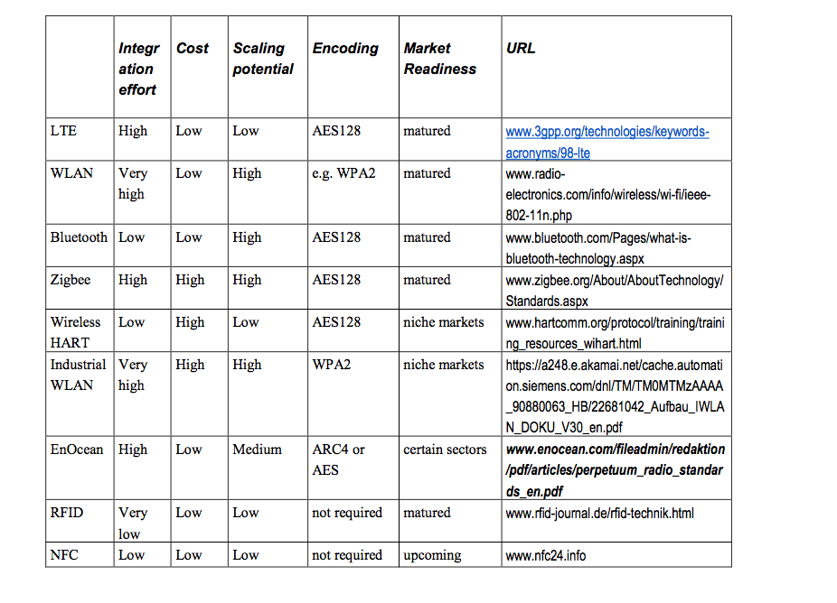
Overview of wireless technologies [2]

Slide 6
Wireless M2M in industrial Env.
In wireless M2M links transfer vital information between machinery, control, and monitoring devices.
Severity of transmissions conditions in industrial environments (environment layout) affect the received signal.
The building structure in industrial environments differ from office or outdoor environments.

Slide 7
Electromagnetic interference
Source of Electromagnetic interference:
Electrical engines, Power converters, Charging devices for battery-driven equipment, Frequency converters etc.
Electromagnetic interference from modern PCs, wireless headphones, wireless door openers, remote-controlled cranes
Electromagnetic interferences in office environments differ significantly from industrial environments.
Several wireless solutions for industrial applications use frequencies in the 30–80 MHz and 400–450 MHz bands.
[1]

Slide 8
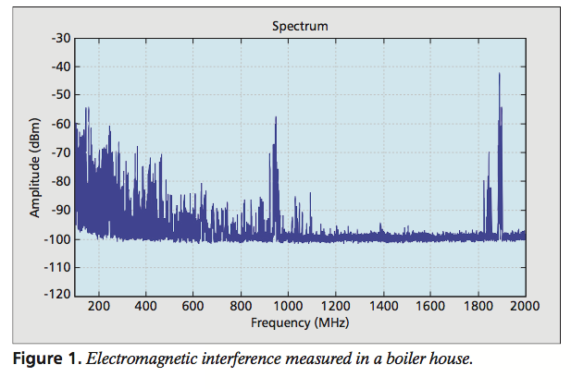
Electromagnetic interference measured in a boiler house. [1]

Slide 9
Multipath propagation
Transmitted signal can take different paths to reach the receiver (due to reflection, diffraction, scattering).
Reflection – radio wave strikes a barrier with a dimension > the wave length of the radio wave
Diffraction – OD <= WL: sharp irregularities, edge.
Scattering - wave strikes obstacles with dimension < wave length of the radio wave.

Slide 10
Propagation and environment
The highly reflective environment: metallic structures covering the floor, the walls, and the roof.
The highly absorbent environment is typically seen in a storage hall where electromagnetic absorbent material is stored
In a highly reflective environment, the number of multipath components is > number of multipath components in highly absorbent environments.

Slide 11
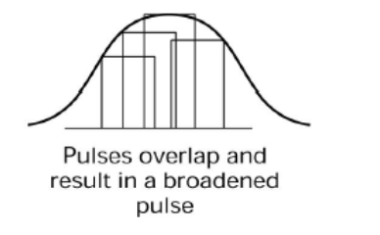
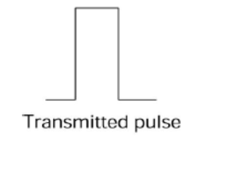
Delay
Delay components experience is higher in the case of highly reflective channels.
Envelope of the overlapping pulse showed a broadened pulse – leads to intersymbol interference (ISI)

Slide 12
Root mean square (RMS) delay spread
Root mean square (RMS) delay spread and maximum excess delays are typical parameters that describe the time dispersion in the channel.
The RMS delay spread - how long the impulse response of the radio channel is on the average.
The maximum excess delay gives information about the time at which delayed components can arrive at the receiver after the first radio wave component.

Slide 13
Delay spread

Slide 14
Symbol rate
High symbol rate (bit rate) -> high bandwidth (broadband)
Low symbol rate (bit rate) -> low bandwidth (narrowband)
channel bandwidth = 1/5*rms delay spread
Large spreading of signal -> small channel bandwidth
Small spreading of signal -> high channel bandwidth

Slide 15
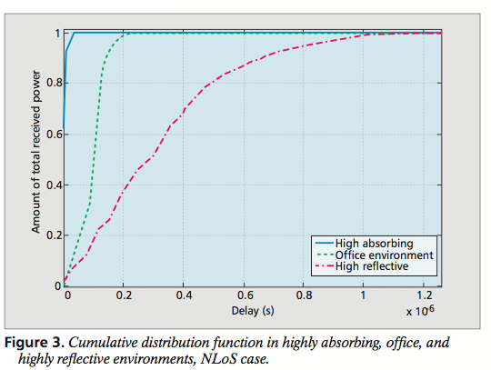
Cumulative distribution function in highly absorbing, office, and highly reflective environments, NLoS case. [1]

Slide 16
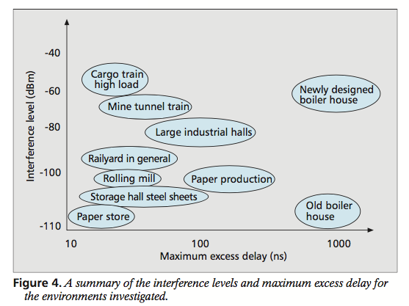
A summary of the interference levels and maximum excess delay for the environments investigated. [1]

Slide 17
Wireless M2M
Choice of wireless technologies depend on the radio interference properties of these environments.
Physical contents of production environments affect wave propagation.
Thickness –influences attenuation
Dimension of objects – reflection
Capacity and Robustness

Slide 18
wireless solutions in industrial Environments
-Different industrial processes react to time delay in data transfer.
-It is essential to be aware of manner in which different wireless technologies react to interference.
- Environment with high interference levels and have requirements for low time delay, technologies based on retransmission to handle interference should be avoided - will cause time delays [1].

Slide 19
Wireless solutions in industrial environments
WLAN - produce high data rates if no interference occurs, but can result in very high delays when interference is present.
WISA by ABB: adapted for real-time monitoring and remote control of time-critical industrial applications
ISM bands tend to be popular since several cheap solutions are available in the market, unlicensed
Drawback: interference from other users due to widespread usage of these license- free bands. [1]

Slide 20
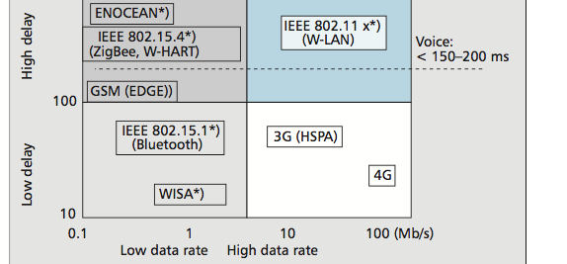
Comparison of different wireless standards in terms of time delay when electromagnetic interference is present. [1]

Slide 21
References
1. Peter Stenumgaard, José Chilo, Javier Ferrer-Coll, and Per Ängskog “Challenges and Conditions for Wireless Machine-to-Machine Communications in Industrial Environments” IEEE Communications Magazine, vol. 51, no. 6, 2013. http://ieeexplore.ieee.org/document/6525614/
2. M. Weyrich, J.-P. Schmidt, and C. Ebert, ‘‘Machine-to-machine communication,’’ IEEE Software, vol. 31, no. 4, pp. 19–23, Jul./Aug. 2014.
http://ieeexplore.ieee.org/abstract/document/6834707/
3. Miaoudakis, A., A. Lekkas, G. Kalivas, S. Koubias (2005). “Radio channel characterization in industrial environments and spread spectrum modem performance”. In 10th IEEE Conference on Emerging Technologies and Factory Automation, ETFA 2005. vol. 1, pp. 87-93. http://ieeexplore.ieee.org/document/1612506/

Slide 22
THANK YOU

