Slide 1
WP26 – Title of the Technology Line Progress summary M27-M38(M42)
Author(s) (Company)

Slide 2
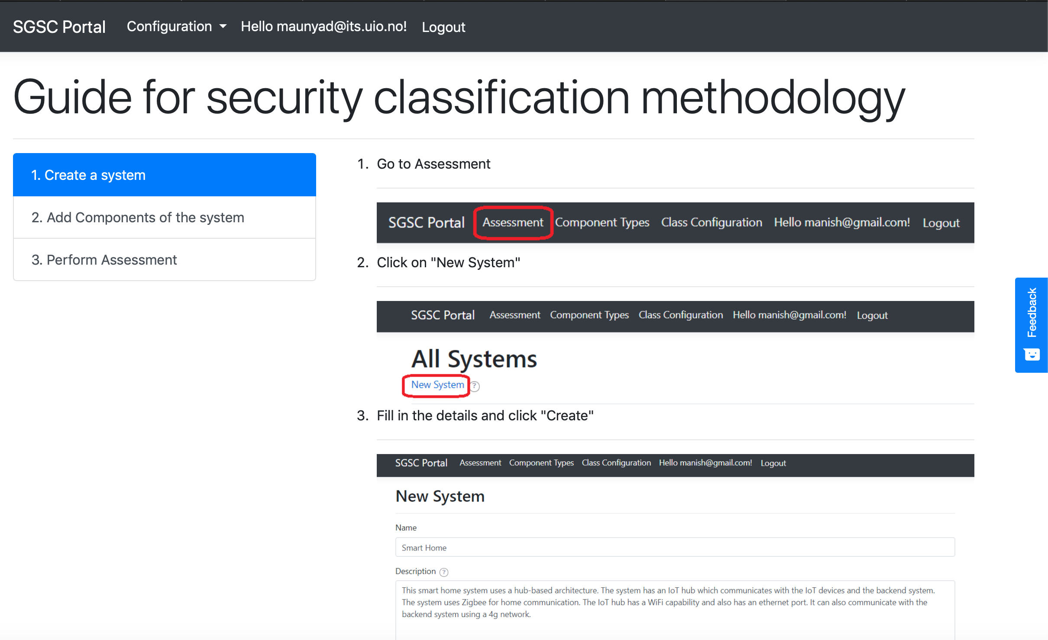
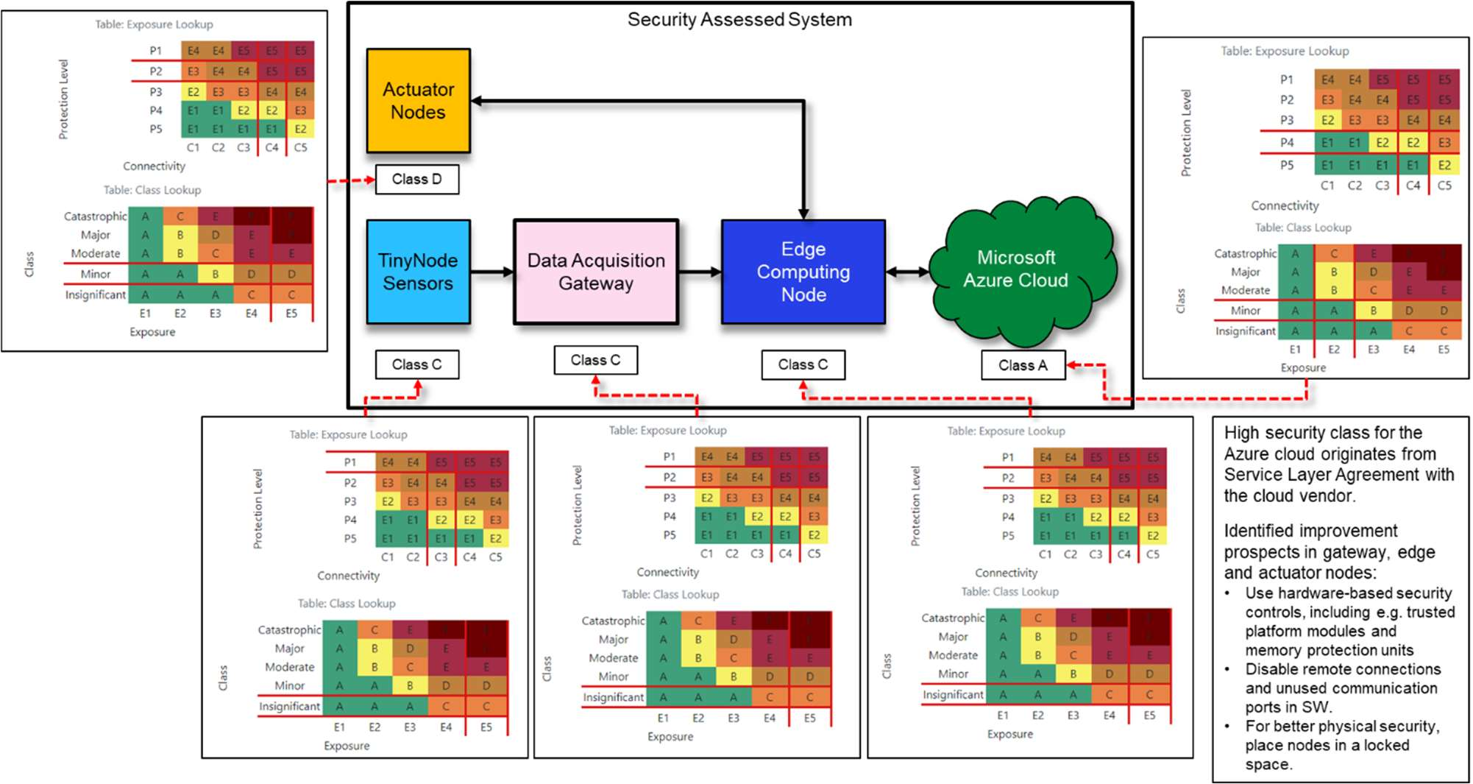
BB26.F: Security Classification
Goals:
Have a methodology for IoT system Developers and Designers to guide to secure their systems; (NOT necessarily for security experts)
Have a simple tool to help Decision Makers when evaluating to purchase a system or component (NOT so heavy as certification or risk assessments)
Have a security classification automated tool for integration in a DevSecOps environment (NOT so slow as penetration-testing, but dynamic & matching the SDLC - Long term goal)
Achievement: a dedicated online tool has been created to support European companies, and particularly SMEs: https://sgscapp.azurewebsites.net/
It was applied in
WP21 lead by Philips Research on Assisted Living and Community Care Systems
WP9 lead by VEMCO on Secure Connected Facilities Management
WP7 Lead by VTT on Air Quality Monitoring
Teaching at University of Oslo: Course TEK5530 -- Measurable Security for the Internet of Things
External SMEs´ IoT systems such as Navinord, Inero Software, ISS RFIS in Poland
(They found the methodology usable and beneficial)

Slide 3
BB26.G: Privacy Labelling
Purpose: “Make it easy for people to take well informed choices wrt. Privacy”
Privacy Labels
Look like nutrition facts or energy consumption labels
Promote 'Privacy as an added value/feature' allowing to differentiate from market competitors
Are legally binding, tied to privacy agreements
Use AI (Natural Language Processing) to automatically create the label from the agreement text
Working with
EuroPriSe (from Germany) to
enhance GDPR certifications with measurable and usable privacy
PrivacyLabels.org (from Netherlands) who
provide to companies a web interface to create privacy labels through a self-evaluation process
Stakeholders that we reached include
Lay people,
Law firms,
Regulatory and Certification bodies,
Businesses
SCOTT
Page 3
Notes:
For people concerned about privacy when choosing an IoT product, Privacy Labels make it easy to do truly well informed choices.
Privacy Labels look like nutrition facts labels when factual details are being presented and look like energy consumption labels when only comparing based on graded scales.
Privacy Labels promote 'Privacy as an added value/feature' allowing to differentiate from market competitors.
Privacy Labels are legally binding, tied to privacy agreements, so that it cannot become a means of deceit.
AI and Natural Language Processing techniques are used to automatically translate between privacy agreements and privacy labels.
We are working with bodies like EuroPriSe (from Germany) to enhance GDPR certifications with measurable and usable privacy, going beyond the yes/no compliance.
We are working with PrivacyLabels.org (from Netherlands) who provide to privacy conscious companies a way to create privacy labels through a self-evaluation process guided by a web service.
Stakeholders include Lay people, Law firms, Regulatory or Certification bodies, and Businesses.
Presentation title
3
17/02/20

