Slide 1
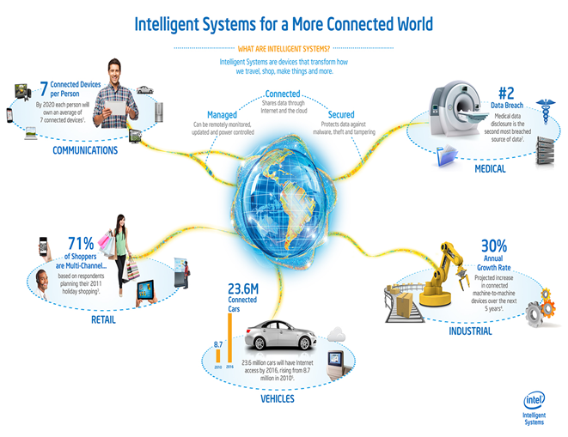
A Framework for Measurability of Security
Seraj Fayyad and Josef Noll
April 2017

Slide 2
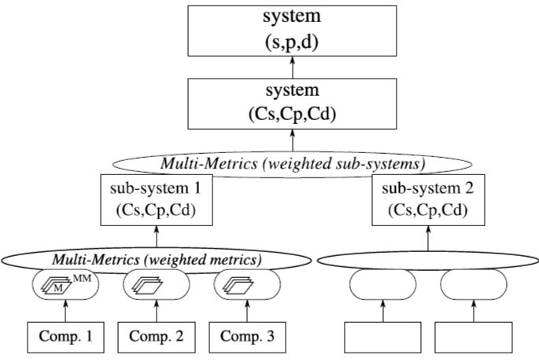
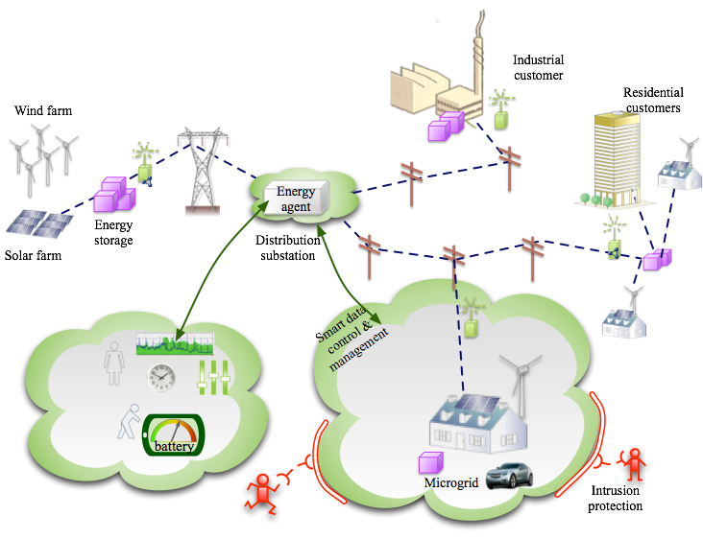
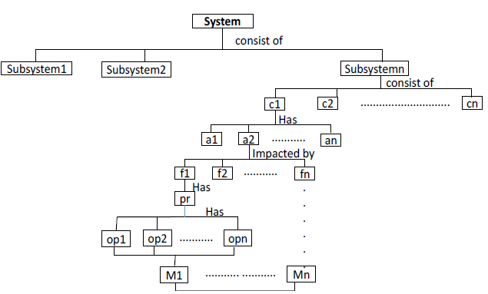
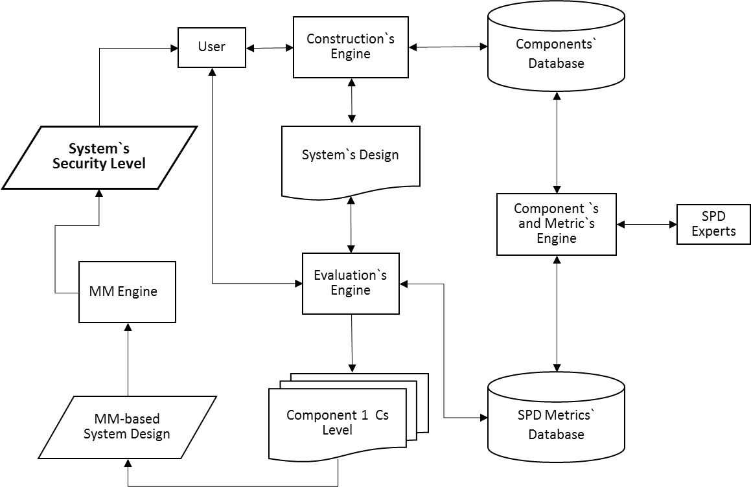
Automatic and less experts-dependent evaluation for is needed to enhance system security
Security evaluation for IoT system
Multi metrics approach
From component to metric
Framework structure

Slide 3
Evaluation of the security for IoT systems have various challenges
Examples:
Heterogeneity among system components.
Complexity of the system
Changeability of the system
System scale

Slide 4
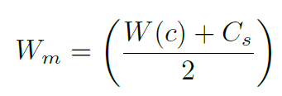
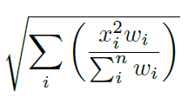
Multi Metrics approach considers evaluation challenges within IoT system For Security, Privacy and Dependability (SPD)
Many parameters determine the significant (Weight) of the component or subsystem (interconnection equation)
Metric significant (Wm) based on the significant of its component and on the evaluated Cs
In MM X and W is evaluated by expert, who run the whole evaluation.

Slide 5
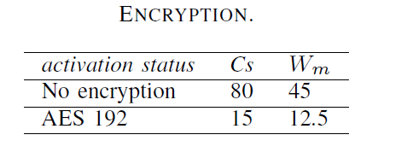
Using component type, correspondence security metrics could be identified
System
consist of
Subsystem1
Subsystem2
Subsystemn
consist of
Component types (Input, Output, Processing, Storing, Transmission, System)
c1
c2
.............................
cn
Has
a1
a2
...........
an
Impacted by
f1
f2
...........
fn
Has
pr
.
.
.
.
.
.
Has
op1
op2
...........
opn
M1
........... ...........
Mn

Slide 6
Multi Metrics based security measurability framework, automatic and less experts-dependent evaluation

Slide 7
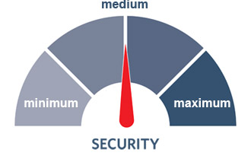
In conclusion: Using MM framework system admin could reevaluate system security without being expert in in security
Expert sets the Cs resulted from different options for a given security parameters.
System admin structure the system using the framework
MM Framework evaluates the security level of the system base on system structure.
Acknowledgement: this work was done as apart of IoTSec project
Questions?

