Slide 1
SCOTT NO meeting Measurement
Toktam Ramezani
30/11/2017

Slide 2
Topics
Assessment of technology
Relation to SP1- SP2- SP3
Suggestion
Measurable security and labeling
Application in UC
Theory
UiO PM

Slide 3
Apssessment levels for BB
Definition of assessment levels for BB implementation
Calculation of scores

Slide 4
SP1 Timeline
Update of BB descriptions
TODAY
D1.1
In parallel: SCOTT specification and implementation (BBs, UCs)
D2.1
Requirement entry on SharePoint – Iteration 1
D3.1
D4.1
D5.1
March 1, 2018, Deadline for Y1 assessment
Alignment on TL level
D1.2
Alignment on SCOTT level
D2.2
D3.2
Requirement entry on SharePoint – Iteration 2
D4.2
D1.4
D5.2
Alignment on TL level, Iteration 2
Alignment on SCOTT level
Y1 Assessment
D1.3
June 1, 2017
July 1, 2017
Aug 1, 2017
Sep 1, 2017
Oct 1, 2017
Nov 1, 2017
Dec 1, 2017
Jan 1, 2018
Feb 1, 2018
Mar 1, 2018
Apr 1, 2018
May 1, 2018
June 1, 2018
July 1, 2018
Aug 1, 2018
Sep 1, 2018
t

Slide 5
SCOTT Structure / Assessment
UC WP7
UC WP8
UC WP9
UC WP21
UC Score = z
…
TL A
Security and Safety
BB A.1
RQ A1.1
…
Requ. 1, Score = 1
RQ A1.2
Requ. 2, Score = 2
BB A.2
RQ A1.x
…
1 BB has
x requirements
Requ. 3, Score = 3
…
Requ. 4, Score = 4
Requ. 5, Score = 1
BB A.x
…
BB Score = y
Requ. 6, Score = 2
TL B
Distributed Cloud Integration
BB B.1
RQ B1.1
Requ. 7, Score = 3
RQ B1.2
…
Requ. 8, Score = 4
BB B.2
RQ B1.x
…
…
Assessment on 3 levels
Individual requirements
BB
UC
We will use a bottom-up approach
→ In the following we focus on the assessment of individual requirements
BB B.x
…
TL C
Autonomy / Energy Efficiency
BB C.1
RQ C1.1
…
RQ C1.2
BB C.2
RQ C1.x
…
…
BB C.x
…
TL D
Reference Architect.
BB D.1
RQ D1.1
…
RQ D1.2
BB D.2
RQ D1.x
…
…
BB D.x
…
Demos
Demo a - TBD
…
Demo b - TBD

Slide 6
Tracking implementation progress
Requirements tracking scale
UC activities beyond BB?
Proposal 1 – Draft proposal in D1.1 |  | Proposal 2 – Adding more granularity |  | Proposal 3 – Normalize values
 |  | 6 | Confirmed/validated by UC | 100% | Confirmed/validated by UC
4 | Verified by lead UC(s) (at least by one lead UC) | 5 | Integrated in UC demonstrator; method considered in demonstrator | 90% | Integrated in UC demonstrator; method considered in demonstrator
3 | Implemented on BB level | 4 | Fully implemented on BB level (to be documented in M32 in D23.5, D23.6, D24.3, D25.3, D26.3) | 75% | Fully implemented on BB level to be aligned with SP3 / M32 in D23.5, D23.6, D24.3, D25.3, D26.3)
2 | Partly implemented (i.e. implementation ongoing) | 3 | Implemented on BB level to large extent (to be documented in M22 in D23.3, D23.4, D24.2, D25.2, D26.2) | 50% | Implemented on BB level to large extent (to be aligned with SP3 / M22 in D23.3, D23.4, D24.2, D25.2, D26.2)
 |  | 2 | Implemented on BB level to small extent (to be documented in M12 in D23.1, D23.2, D24.1, D25.1, D26.1) | 25% | Implemented on BB level to small extent (to be aligned with SP3 / M12 in D23.1, D23.2, D24.1, D25.1, D26.1)
1 | Implementation planned for commercial product after SCOTT completion (i.e. not implemented in prototype, but important) | 1 | Implementation planned for commercial product after SCOTT completion (i.e. not implemented in prototype, but important) | 10% | Implementation planned for commercial product after SCOTT completion (i.e. not implemented in prototype, but important)
0 | Not implemented | 0 | Not implemented | 0% | Not implemented

Slide 7
What does the scale mean for different requirement types?
Requirements may belong to BBs of different type
SW component to build a SW-tool a system or a product
HW component to build a system or a product
Tool or a tool chain
Interface
Standard
Methodology (for SW and/or HW development)
Process, Profile, Service, Means for establishing cross-domain interoperability
Other, e.g. guideline
Implementation-specific requirements (rather functional requirements, i.e. what the system should do)
Implementation of prototype
Design decisions of prototype
Characteristics of final implementation
Methodology / interoperability requirements (rather non-functional requirements, i.e. how the system performs the function)
Compliance to methodology / process / standard

Slide 8
Topics
Assessment of technology
Relation to SP1 (SCOTT SP1 Call)- SP2- SP3
Suggestion:
Each BB may have a progress report (might be missed)
Describing any individual progress – Per UC at least for the lead UC
Measurable security and labeling
Theoretical
Practical in UC
UiO PM

Slide 9
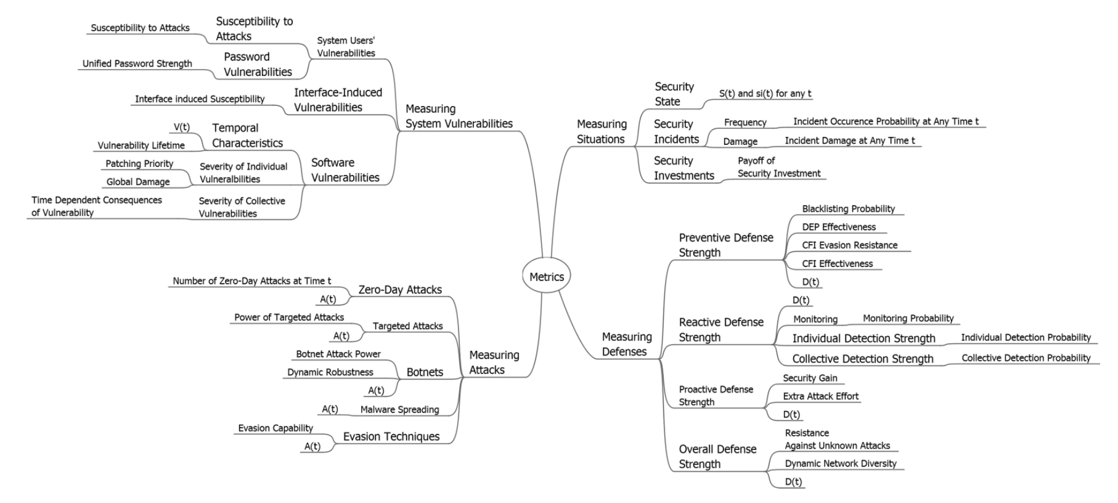
Security metrics and measurment
VULNERABILITY METRICS
Attacks, and Situations
DEFENSE METRICS

Slide 10
VULNERABILITY METRICS
Past and future Metrics
Metrics for Measuring Severity of Individual Software Vulnerabilities.
Categories of metrics:
Base metrics (including exploitability and impact),
Attack vector (vulnerability can be exploited remotely, locally, with/out or physical access to the computer), required conditions to a successful attack,…
Temporal metrics,
Exploit code maturity, Remediation level, …
Historically exploited vulnerability metric,
Metrics for measuring vulnerability lifetime (Server, Cloud-end)
future Metrics
Environmental metrics.

Slide 11
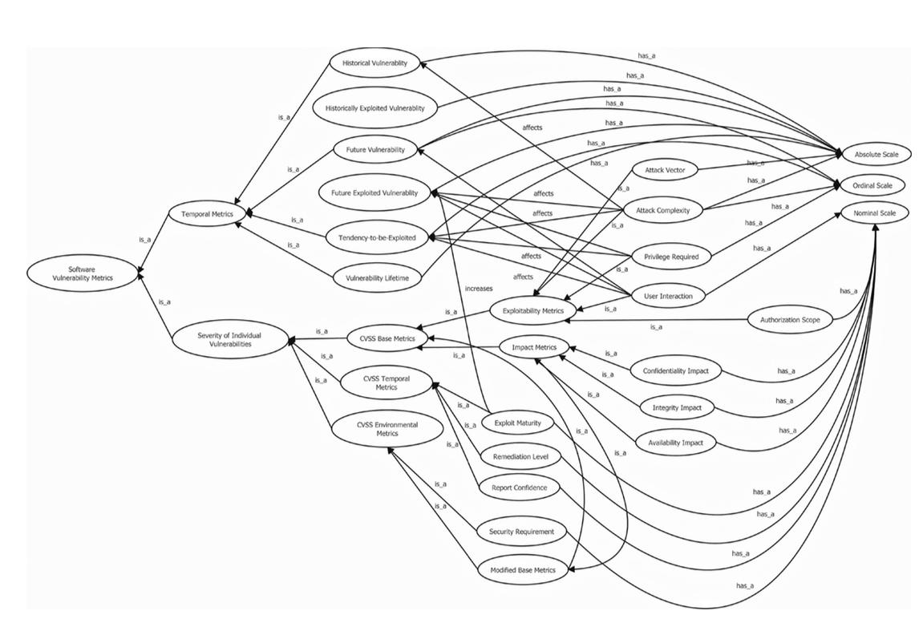
Sub-ontology metrics - temporal characteristics of vulnerabilities

Slide 12
A summary
The vast variety of approaches:
From graph-based
To game theory
Open challenges:
In theory
In practice
In approaches

Slide 13
Topics
Assessment of technology
Relation to SP1 (SCOTT SP1 Call)- SP2- SP3
Suggestion:
Each BB may have a progress report (might be missed)
Describing any individual progress – Per UC at least for the lead UC
Measurable security and labeling
Theoretical
Practical in UC
Suggestion: A light-wait risk assessment for lead UC
UiO PM (SCOTT No, SP3, Leading BBs, Partner BBs, 20 WPs,... )

Slide 14
Questions?
toktamr@ifi.uio.no
www.scottproject.eu

Slide 15
UiO PM
23.C: SCOTT-HW supported security mechanisms
23.N: SCOTT-SCOTT Security Library
SCOTT-SCOTT Security Core – Identification, authentication and secure communication
23.R: SCOTT-Trust Anchor and Trust Indicator for ES and smart sensors
SCOTT-Remote Configuration of Infrastructure
SCOTT-Mobile Edge Computing
1 UiO-WP1, 2 UiO-WP2, 3 UiO-WP3, 4 UiO-WP5, 5 UiO-WP6, 6 UiO-WP7, 7 UiO-WP8, 8 UiO-WP9, 9 UiO-WP13(2), 10 UiO-WP14(2), 11 UiO-WP15(3), 12 UiO-WP21, 13 UiO-WP22, 14 UiO-WP23, 15 UiO-WP24, 16 UiO-WP26, 17 UiO-WP29, 18 UiO-WP30(4)
46/36/

